Slide 1
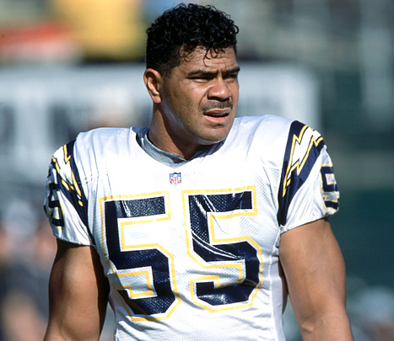
Are you satisfied?
Happiness Survey
U.S 34%
Afghanistan 35%
(Legget Marketing)
Notes:
NA living, comfort (cars, autostarters, automatic everything)

Slide 2
King Solomon (Ecc 2)
³ I searched in my heart how to gratify my flesh with
Wine
⁴ I built myself houses
and planted myself vineyards.
⁵ gardens and orchards, and I planted all kinds of fruit trees
⁶ water pools
⁷ male and female servants
herds and flocks
⁸ silver and gold
male and female singers
⁹ So I became great
¹⁰ Whatever my eyes desired I did not keep from them. I did not withhold my heart from any pleasure (wives & concubines included)

Slide 3
Round hole – Square peg?
“All things are full of labor; Man cannot express it. The eye is not satisfied with seeing, Nor the ear filled with hearing.” (Ecc 1:8)
“… He has put eternity in their hearts” (Ecc 3:11)
Notes:
Stupid

Slide 4
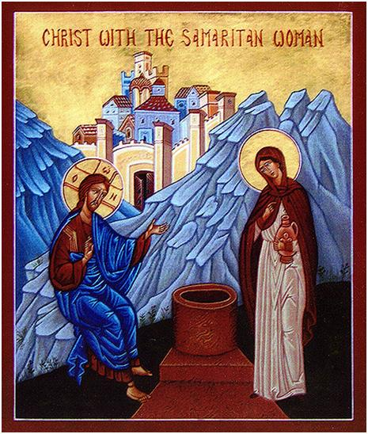
Samaritan Woman Jn. 4:1-42
Notes:
Great readings during Holy 50.
Why are you joyful because of food? Weather? Or resurrection.

Slide 5
1) Woman 2) Samaritan 3) Adulterer
Notes:
adultererrrrr

Slide 6
Living Water
…and He would have given you living water.” (Jn. 4:10)
“Whoever drinks of this water will thirst again, ¹⁴ but whoever drinks of the water that I shall give him will never thirst. But the water that I shall give him will become in him a fountain of water springing up into everlasting life.” (Jn. 4:13-14)
Notes:
Sounds great

Slide 7
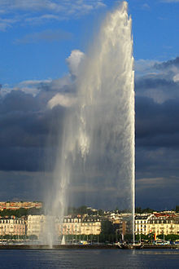
“Surely I am more stupid than any man” (Prov 30:2)
“For My people have committed two evils: They have forsaken Me, the fountain of living waters, And hewn themselves cisterns—broken cisterns that can hold no water.” (Jer 2:13)
2 Mistakes
Forgot about God – Fountain
Replaced with
Bucket
Broken

Slide 8
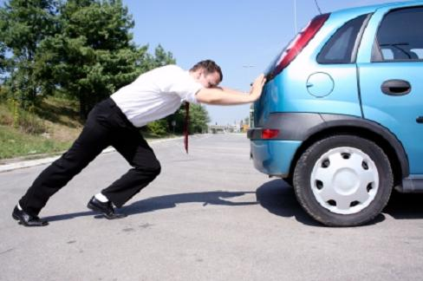
Are you running on empty?
“As the deer pants for the water brooks, So pants my soul for You, O God. My soul thirsts for God, for the living God.”(Ps 42:1-2)

Slide 9
Thirsty?
1) Come to Him
“Ho! Everyone who thirsts, Come to the waters; And you who have no money, Come, buy and eat. Yes, come, buy wine and milk Without money and without price.”
(Is 55:1)
“If anyone thirsts, let him come to
Me and drink.” (Jn 7:37)

Slide 10
1) Come to Him
“The LORD has been mindful of us; He will bless us; He will bless the house of Israel; He will bless the house of Aaron. He will bless those who fear the LORD, Both small and great.” (Ps 115:12-13)
“I have come that they may have life, and that they may have it more abundantly.” (Jn 10:10)
“These things I have spoken to you, that My joy may remain in you, and that your joy may be full” (Jn 15:11)
“In Your presence is fullness of joy; At Your right hand are pleasures forevermore.” (Ps 16:11)
“And God is able to make all grace abound toward you, that you, always having all sufficiency in all things, may have an abundance for every good work.” (2 Cor 9:8)

Slide 11
1) Come to Him
Relationship with Jesus Christ –
The Son of the Living God
Bible
Prayer
Sacraments
Obeying & Trusting (Is 55:8,9)
With GREAT Expectations
Satisfy
Solve your problems
Source of joy

Slide 12
2) Confront Sin
“…“Go, call your husband, and come here.” (Jn 4:16)
“5 Therefore put to death your members which are on the earth: fornication, uncleanness, passion, evil desire, and covetousness, which is idolatry.
⁸ But now you yourselves are to put off all these: anger, wrath, malice, blasphemy, filthy language out of your mouth. ¹² Therefore, as the elect of God, holy and beloved, put on tender mercies, kindness, humility, meekness, longsuffering; ¹³ bearing with one another, and forgiving one another,
(Col 3:5,8, 12-13)
Notes:
Bozo. Busted

Slide 13
2) Confront Sin
Way to Jesus is holiness
OR
Way to holiness is Jesus

Slide 14
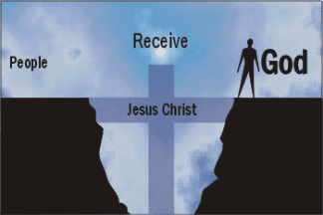
2) Confront Sin
Litany of the sick – church is not for the saints, but for the sick - Hospital

Slide 15
2) Confront Sin
Salvation requires a confrontation with sin
Salvation causes a transformation from within
God does not leave us the way He found us –
We can come as we are,
but
We will not leave as we were.
Notes:
Doctor, can’t come out same.

Slide 16
2) Confront Sin
In order to get the best,
you must give up the rest
“Therefore, if anyone is in Christ, he is a new creation; old things have passed away; behold, all things have become new.” (2 Cor 5:17)

Slide 17
3) Call Others
“The woman then left her waterpot, went her way into the city, and said to the men, ²⁹ “Come, see a Man who told me all things that I ever did. Could this be the Christ?” (Jn 4-28-29)
“My little children, let us not love in word or in tongue, but in deed and in truth” (1 Jn 3:18)
“And we are witnesses of all things which He did…
“And He commanded us to preach to the people, and to testify… (Acts 10:39,42)
Notes:
Call spouse, kids, friends. Who wouldn’t you tell?

Slide 18
1) Come to Him 2) Confront Sin 3) Call Others

