Slide 1
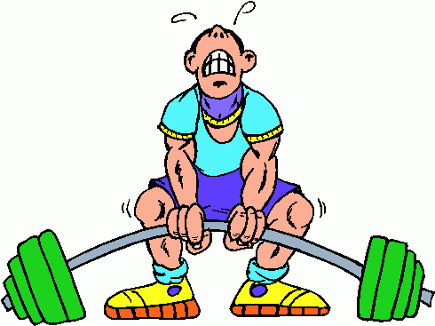
Wait Training

Slide 2
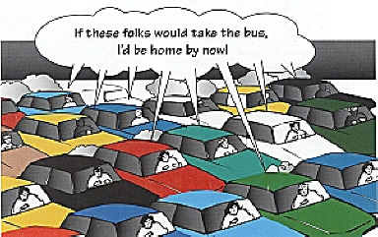
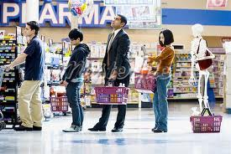
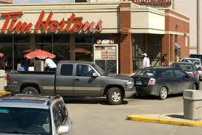
Wait! Wait! Wait!

Slide 3
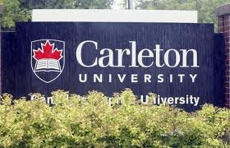
Wait! Wait! Wait!

Slide 4
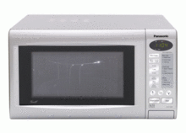
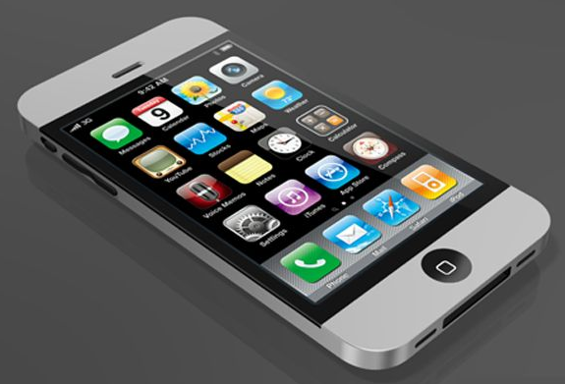
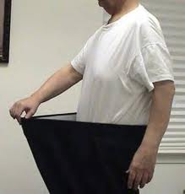
Instant Response
Instant response (e-mail, text, call …)

Slide 5
Problem is I’m in a hurry
God isn’t

Slide 6
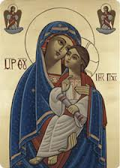
Mankind
The Father looked from Heaven
And found no one like you
He sent His Only Begotten
Who came and took flesh from you
(Wed Theotokia)
All Prophesied about a Saviour –
The Messiah
Silence – 400 years
Mother of God
Mother of us all
Above the Cherubim & Seraphim
Found in the:
Liturgy
Praises
Venerations
Hymns
Agpeya

Slide 7
Wait Training – Starts Now!
“Wait on the LORD; Be of good courage, And He shall strengthen your heart; Wait, I say, on the LORD!” (Ps 27:14)
“But those who wait on the Lord Shall renew their strength; They shall mount up with wings like eagles, They shall run and not be weary, They shall walk and not faint.” (Is 40:31)

Slide 8
Is waiting active or passive?

Slide 9
What is Waiting?
Waiting – not like waiting for a bus, or laziness
Waiting is seeking
Waiting is more work than working – requires strength, surrender
Situations to make it difficult to wait:
Fear
Enemies
Problems
Feel forsaken

Slide 10
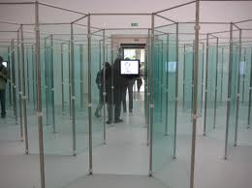
1) Wait Prayerfully
Waiting is seeking
House of mirrors
Obey new commands
“Show me Your ways, O Lord; Teach me Your paths.” (Ps 25:4)
“He commanded them not to depart from Jerusalem, but to wait for the Promise of the Father” (Acts 1:4)

Slide 11
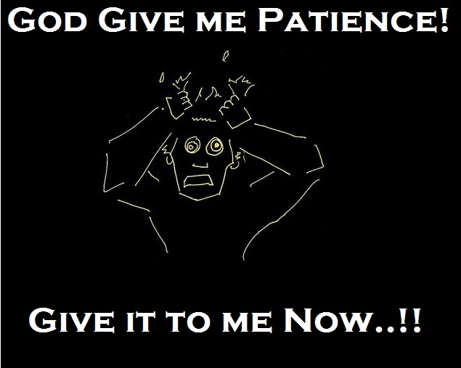
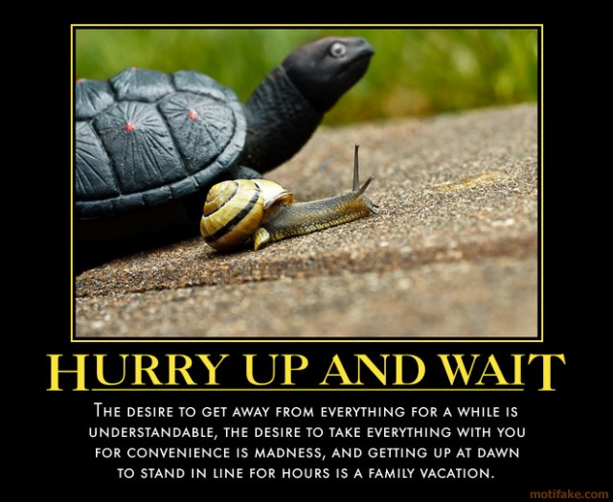
2) Wait Patiently
“Rest in the LORD, and wait patiently for Him” (Ps 37:7)
Give God time to work: in us, others, situation

Slide 12
3) Wait Expectantly
“My soul, wait silently for God alone, For my expectation is from Him.” (Ps 62:5)
“And let us not grow weary while doing good, for in due season we shall reap if we do not lose heart.” (Gal 6:9)
“He will ever be mindful of His covenant.” (Ps 111:5)
“The Lord is not slack concerning His promise.” (2Pet 3:9)

Slide 13
4) Wait Trustingly
“Is anything too hard for the Lord” (Gen 18:14)
“For My thoughts are not your thoughts, Nor are your ways My ways,” says the Lord.
“For as the heavens are higher than the earth, So are My ways higher than your ways, And My thoughts than your thoughts.” (Is 55:8-9)
“And you have praised the gods of silver and gold, bronze and iron, wood and stone, which do not see or hear or know; and the God who holds your breath in His hand and owns all your ways, you have not glorified.” (Dan 5:23)

Slide 14
Examples of those who wait
Characters
Abraham
Moses
David
Mankind – St. Mary
Simeon (200 years)
Apostles - Pentecost
St. Monica

Slide 15
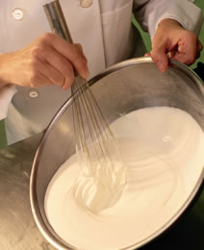
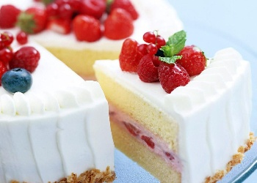
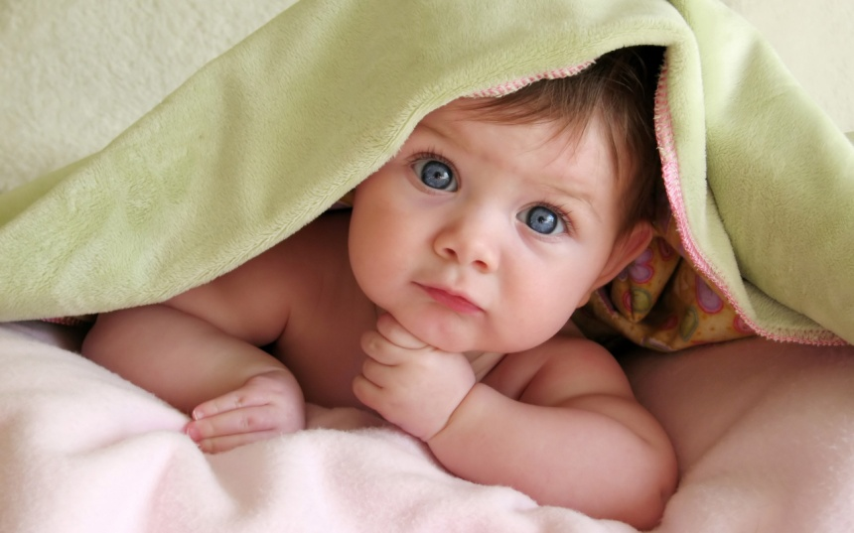
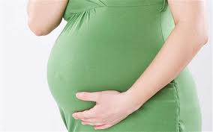
Rewards for those who wait

Slide 16
Summary
Wait Prayerfully
Wait Patiently
Wait Expectantly
Wait Trustingly

Slide 17
Wait Training

Slide 18
Wait Training – Results
“Wait on the LORD; Be of good courage, And He shall strengthen your heart; Wait, I say, on the LORD!” (Ps 27:14)
“But those who wait on the Lord Shall renew their strength; They shall mount up with wings like eagles, They shall run and not be weary, They shall walk and not faint.” (Is 40:31)

Slide 19
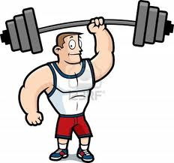
Reward - Strength

