Slide 1
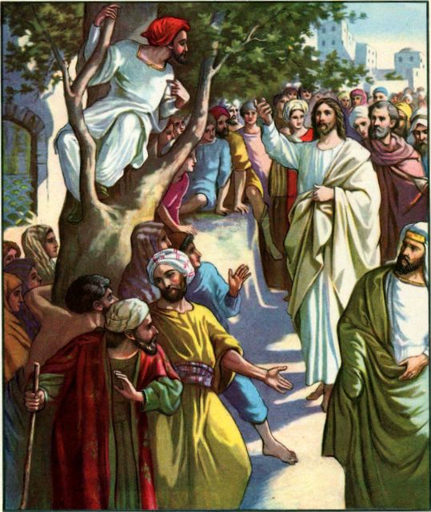
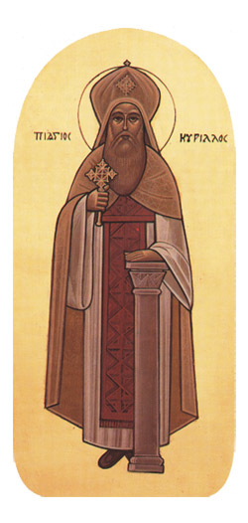
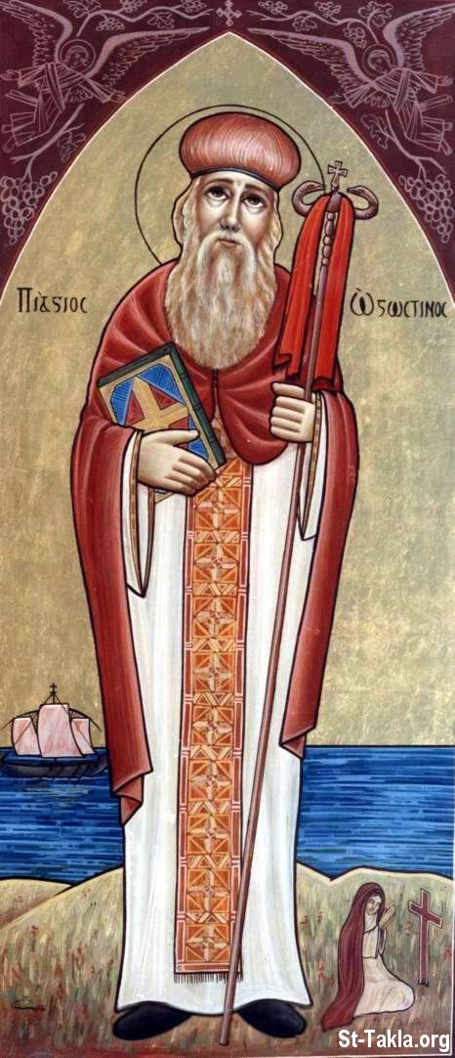
ZACCHAEUS
Saint Cyril
Saint Augustine

Slide 2
Luke 19
¹ Then Jesus entered and passed through Jericho. ² Now behold, there was a man named Zacchaeus, which was a chief tax collector, and he was rich. ³ And he sought to see who Jesus was, but could not because of the crowd, because he was of short stature. ⁴ So he ran ahead, and climbed into a sycamore tree to see him, for he was going to pass that way.
⁵ And when Jesus came to the place, He looked up and saw him, and said unto him, Zacchaeus, make haste and come down, for today I must stay at your house. ⁶ So he made haste and came down, and received him joyfully. ⁷ But when they saw it, they all complained, saying, He has gone to be a guest with a man who is a sinner. ⁸ Then Zacchaeus stood and said to the Lord, Look, Lord, I give half of my goods to the poor; and if I have taken any thing from anyone by false accusation, I restore fourfold.
⁹ And Jesus said unto him, Today salvation has come to this house, because he also is a son of Abraham. ¹⁰ For the Son of man is come to seek and to save that which was lost.

Slide 3
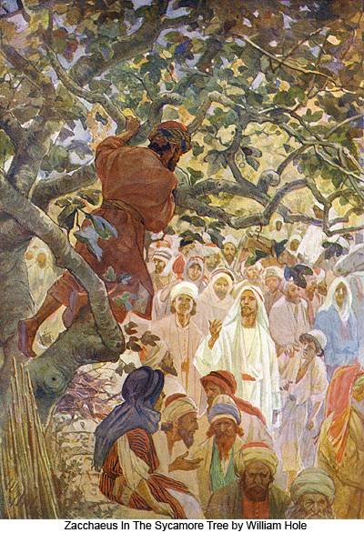
To See the Lord …
Zacchaeus wanted to see Jesus
He climbed into a sycamore tree
A seed of salvation sprouted within him
Christ saw this with his Divine eyes
Jesus looked up, and wanted to save him
Jesus encourages, “Come down quickly.”
Zacchaeus searched to see Christ
but the multitude prevented him …
not just the multitude of people, but the multitude of his sins!
In order to see the Lord, he had to climb the tree
By climbing up, Zacchaeus says NO to his OLD sinful way of earthly life
Zacchaeus gives up his OLD way, in order to GROW spiritually
Saint Cyril of Alexandria

Slide 4
Sinful Zacchaeus Seeks Jesus
Zacchaeus BEFORE
A rich leader of tax collectors
Life full of greed, cheating, selfish
But he repented
Zacchaeus AFTER
Zacchaeus received mercy from Jesus, and changed his life
HOPE for ME
Jesus calls those who are far away
Jesus gives light to those who are in darkness

Slide 5
Unashamed to Climb
Unable to see through the crowd
He was not ashamed to climb
Do you think the crowd laughed at him?
Do not be ashamed of the Cross
Don’t focus on the crowd, But focus on the Cross
Climb up, to see the Lord
Do not be ashamed of the Lord

Slide 6
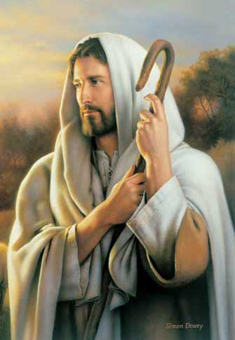
The Lord welcomes him
The Lord welcomed Zacchaeus in His heart
Zacchaeus welcomed the Lord into his home
Zacchaeus Repents
Gives half his goods to the poor
Pays back those he had cheated before
Repentance is Joy
BEFORE: Zacchaeus was filthy rich, but MISERABLE!
AFTER: Zacchaeus was Heavenly Rich, and full of Joy!
Trade in earthly riches, receive Heavenly Riches
Saint Augustine

Slide 7
What did Zacchaeus do?
Zacchaeus simply took a step toward the Lord.
The Lord did all the rest!
What should we do?
Like Zacchaeus, take a step toward the Lord.
The Lord will do all the rest!

Slide 8
Follow Zacchaeus take a step towards the Lord
Zacchaeus – climbed a tree to see the Lord
The Right Hand Thief – believed in the Lord
The Canaanite Woman – pleaded with the Lord
The Bleeding Woman – touched the Lord’s garment
Matthew the Tax Collector – left all and followed the Lord
“Come to Me, all you who labor and are heavy laden, and I will give you rest.” (Matthew 11:28)

Slide 9
What did the crowd do?
The crowd judged and made fun of Zacchaeus
The crowd made fun of Jesus for saving Zacchaeus
What should we do!
Forgive others
Encourage others
Don’t judge others, don’t be jealous of others

Slide 10
Must Forgive
Even if old Zacchaeus had hurt us, robbed or cheated us …
Do NOT hold onto the hurt feelings or memories
Remember, that old Zacchaues was a slave to sin!
We also were once a slave a like the old Zacchaeus
Forgive Zacchaeus, give him a new chance
Accept Zacchaeus back
as the Lord accepted him
as the Lords accepts you!
Forgive & Love Zacchaeus

Slide 11
Must Encourage
When we see someone climbing up the tree …
Do NOT judge
Do NOT pull him down
Do NOT make fun of him
Climb up with Zacchaeus
Encourage Zacchaeus
Help Zacchaeus up!

Slide 12
Return to the Lord
Before seeking the LORD:
Enslaved in the world, in Greed & Dishonesty
MISERABLE, enslaved to sin, far from God
POOR & DYING Spiritually
By returning to the LORD:
Give up worldly riches in Repentance & Charity
Give up worldly Possessions, Pleasures, Pride
BLESSED, forgiven, freed, saved by the Lord
Full of JOY and RICH in the LOVING LORD
“For the Son of man is come to seek and save that which was lost.”

