Slide 1
Gospel Readings of Lent Sundays
2014-03-30

Slide 2
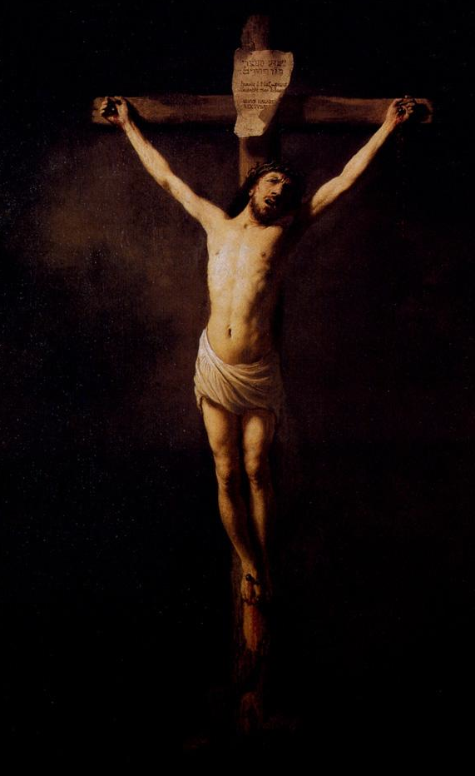

Slide 3
Great Lent Sundays
Pre-Lent Sunday Charity, Fasting, Prayer
1st Sunday Treasures
2nd Sunday Temptations
3rd Sunday Prodigal Son
4th Sunday Samaritan Woman
5th Sunday The Man at Pool of Bethesda
6th Sunday The Man Born Blind
7th Sunday Palm Sunday
+++++ Holy Week (The Lord’s Suffering) +++++
Easter … Christ is Risen … Indeed, He is Risen!!!

Slide 4
Great Lent Themes
FASTING + PRAYER
OFFERING (Give Alms, Charity, Time, Effort Good Deeds, Mercy, Love, Forgive)
CONFESSION + REPENTANCE

Slide 5
Pre-Lent Sunday Matthew 6:1-18
FASTING helps me fight against Lust of Flesh (Lust)
PRAYER helps me fight against Pride of Life (Ego)
CHARITY helps me fight against Lust of Eyes (Greed)
Give Time, Energy, Effort, Ears, Alms/Tithes, Pure Love, Forgiveness
“Take heed that you do not do your charitable deeds before men, to be seen by them. Otherwise you have no reward from your Father in heaven.”
Keep the Charity/Fasting/Prayer PRIVATE (between you & God). These acts to be performed in a spirit of HUMILITY.

Slide 6
Sunday of the Treasures Matthew 6:19-33
Focus on the HEAVENLY, not on the earthly.
Do not worry … trust Him, for He cares for you!
“Do not lay up for yourselves treasures in earth, where moth or rust destroy and where thieves break in and steal. But lay up for yourselves treasures in heaven, where neither moth nor rust destroys and where thieves do not break in and steal. For where your treasure is, there your heart will be also.”

Slide 7
Sunday of the Temptations Matthew 4:1-11
Important Messages
Fasting & Prayer defeats the devil.
Fasting is needed to overcome temptation.
The Holy Spirit is active in our life when we fast.
The devil is full of trickery and deceit, and can twist words and meanings, even from the Bible!
Rejoice – Christ has given us Victory over Satan!

Slide 8
Fight against the Lust of the Flesh
The devil attacks the body and physical needs.
The devil tempts the Lord to turn stone into bread.
“Man shall not live by bread alone, but by every word that proceeds out of the mouth of God.”
Fight against the Pride of Life
The devil attacks the soul, the self, the ego.
The devil tempts the Lord to jump down (show off how great you are).
“You shall not tempt the Lord your God.”
Fight against Lust of the Eyes
The devil is a liar, claiming that he can give the whole world!
Never believe the lies of the devil.
Also remember that the devil never gives for free.
Never submit to the devil; never negotiate with him!
The devil dares to ask Christ to worship him.
“Away with you, Satan! For it is written, ‘You shall worship the Lord your God, and Him only you shall serve.’ ”

Slide 9
The Prodigal Son Luke 15:11-32
REPENTANCE and CONFESSION
The Loving Father is always waiting for my return.
The Loving Father accepts his son unconditionally.
The elder son criticizes his brother, out of jealousy.
The elder son was serving outwardly, not out of love. This is not service of children, but of slaves.
“It was right that we should make merry and be glad, for your brother was dead and is alive again, and was lost and is found.”

Slide 10
The Samaritan Woman John 4:1-42
REPENTANCE
There is hope for all of us.
The Samaritan woman was a liar, adulterer, and had lived an immoral live with 5 husbands, but …
The love of Jesus leads her to repent.
She repents, and becomes a saintly preacher!
Do not judge a sinner; the Lord can make him into a Saint.
Jesus reveals Himself to all who are ready to accept Him.
“Now we believe, not because of what you said, for we ourselves have heard Him and we know that this is indeed the Christ, the Savior of the world.”

Slide 11
The Man at the Pool of Bethesda John 5:1-18
REPENTANCE
We see humanity’s emptiness, helplessness, and loneliness without God.
Jesus always respects our free will, asking, “do you want to be made well?”
When Christ forgives me, I need to make an effort to “sin no more.”
“See, you have been made well. Sin no more, lest a worse thing come upon you.”

Slide 12
The Man Born Blind John 9:1-38
CHRIST is the LIGHT of the WORLD
Blindness is a symbol of humanity who are in need of illumination of Christ.
Many deep meanings in this Gospel reading!
Baptism is essential (buried & risen with Christ).
“Go, wash in the pool of Siloam (which is translated, Sent). So he went and washed, and came back seeing.”

Slide 13
Palm Sunday Matthew 21:1-38, Mark 11:1-11, Luke 19:29-48, John 12:12-19
The beginning of the most Holy Week of the year
The highest honor and respect are paid to Jesus on this day.
“Hosanna!
‘Blessed is He who comes in the name of the Lord!’
Blessed is the kingdom of our father David
That comes in the name of the Lord!
Hosanna in the highest!”

Slide 14
Great Lent – Sunday Liturgy Gospels
Pre-Lent Matthew 6:1-18 Charity, Fasting, Prayer
1st Sunday Matthew 6:19-33 Treasures
2nd Sunday Matthew 4:1-11 Temptations
3rd Sunday Luke 15:11-32 Prodigal Son
4th Sunday John 4:1-42 Samaritan Woman
5th Sunday John 5:1-18 The Man at Pool of Bethesda
6th Sunday John 9:1-38 The Man Born Blind
7th Sunday Matthew 21:1-17, Palm Sunday Mark 11:1-11, Luke 19:29-48, John 12:12-19
+++++ Holy Week (the Lord’s Suffering) +++++
Easter … Christ is Risen … Indeed, He is Risen!!!

Slide 15
What does the Cross represent?
The power of God
The throne of the Lord (Our King reigns on the wood of the Cross)
The salvation of all of us
The price paid to forgive my sins
The reconciliation of Earth & Heaven
The open arms of the Lord to accept me
The infinite unconditional love of Our God
No resurrection without the Cross, no glory without suffering.
“For our light affliction, which is but for a moment, is working for us a far more exceeding and eternal weight of glory.” (2Corinthians 4:17)

Slide 16
O You who was Crucified on the Wood of the Cross for my sake ...
Please have mercy on me a sinner.
Heal my spiritual blindness that I may return to You.
Heal my disease of sin and accept me back.
Accept me into Your open arms,
as You accepted the Prodigal Son;
as You accepted the Samaritan Woman;
as You accepted the thief on the Cross.
Accept our confession & repentance.
Accept our fasting & prayer & offerings.

