Slide 1
as I was with Moses, so I will be with you. I will not leave you nor forsake you. Be strong and of good courage, for to this people you shall divide as an inheritance the land which I swore to their fathers to give them. Only be strong and very courageous, that you may observe to do according to all the law which Moses My servant commanded you; do not turn from it to the right hand or to the left, that you may prosper wherever you go. This Book of the Law shall not depart from your mouth, but you shall meditate in it day and night, that you may observe to do according to all that is written in it. For then you will make your way prosperous, and then you will have good success. Have I not commanded you? Be strong and of good courage; do not be afraid, nor be dismayed, for the Lord your God is with you wherever you go." (Joshua 1:5 ..)
كَمَا كُنْتُ مَعَ مُوسَى أَكُونُ مَعَكَ. لاَ أُهْمِلُكَ وَلاَ أَتْرُكُكَ. تَشَدَّدْ وَتَشَجَّعْ, لأَنَّكَ أَنْتَ تَقْسِمُ لِهَذَا الشَّعْبِ الأَرْضَ الَّتِي حَلَفْتُ لِآبَائِهِمْ أَنْ أُعْطِيَهُمْ. إِنَّمَا كُنْ مُتَشَدِّداً, وَتَشَجَّعْ جِدّاً لِتَتَحَفَّظَ لِلْعَمَلِ حَسَبَ كُلِّ الشَّرِيعَةِ الَّتِي أَمَرَكَ بِهَا مُوسَى عَبْدِي. لاَ تَمِلْ عَنْهَا يَمِيناً وَلاَ شِمَالاً لِتُفْلِحَ حَيْثُمَا تَذْهَبُ. لاَ يَبْرَحْ سِفْرُ هَذِهِ الشَّرِيعَةِ مِنْ فَمِكَ, بَلْ تَلْهَجُ فِيهِ نَهَاراً وَلَيْلاً, لِتَتَحَفَّظَ لِلْعَمَلِ حَسَبَ كُلِّ مَا هُوَ مَكْتُوبٌ فِيهِ. لأَنَّكَ حِينَئِذٍ تُصْلِحُ طَرِيقَكَ وَحِينَئِذٍ تُفْلِحُ. أَمَا أَمَرْتُكَ؟ تَشَدَّدْ وَتَشَجَّعْ! لاَ تَرْهَبْ وَلاَ تَرْتَعِبْ لأَنَّ الرَّبَّ إِلَهَكَ مَعَكَ حَيْثُمَا تَذْهَبُ

Slide 2
JOSHUA

Slide 3
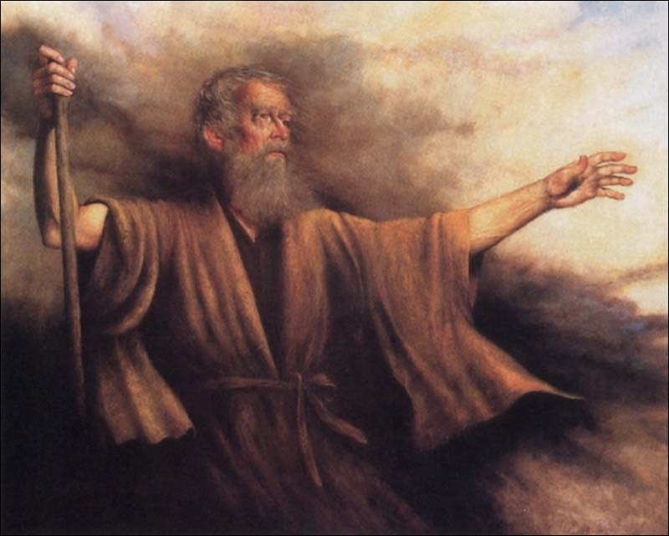
Moses the servant of the LORD

Slide 4
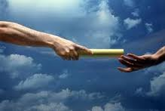
Moses had fully instructed them in the laws and the sacrifices before he died, and Joshua had assumed the task of leading the people into the land.

Slide 5
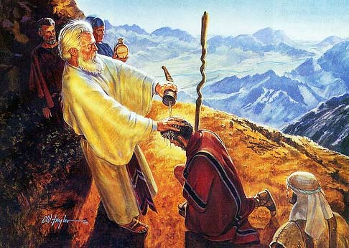
Joshua is actually called
by the name Jesus

Slide 6
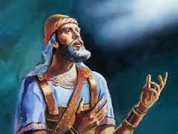
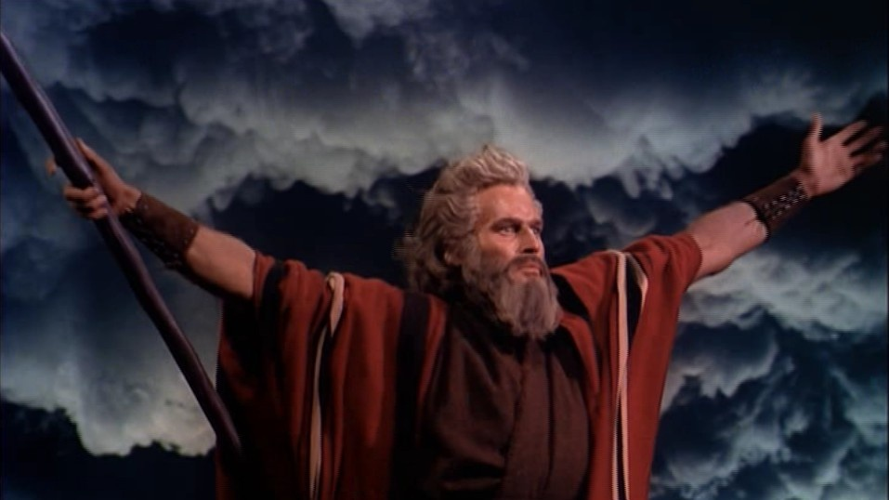
Joshua is the disciple of Moses

Slide 7
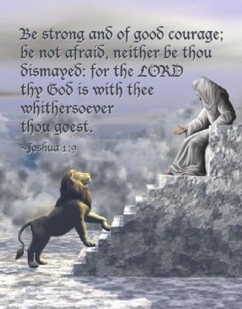

Slide 8
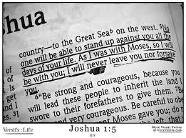

Slide 9
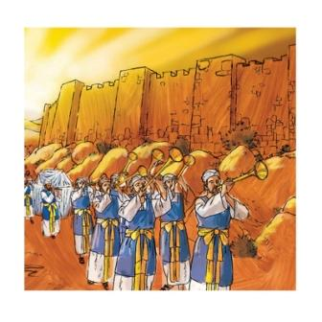
Jericho = the worries, affairs of this world & people:

Slide 10
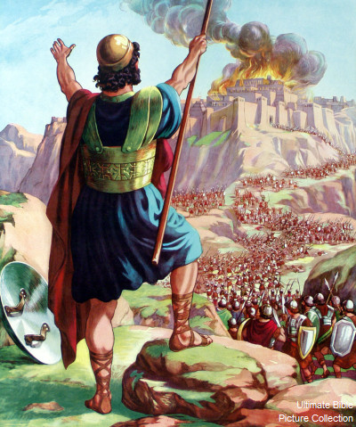
Ai = Pleasures and Lusts :

Slide 11
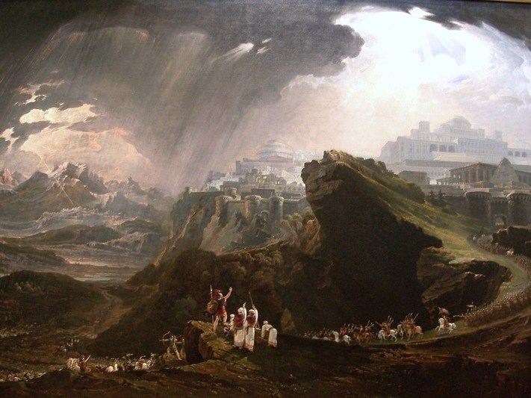
Gibeon = separation from God’s People
& Problems in life

Slide 12
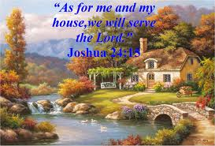

Slide 13
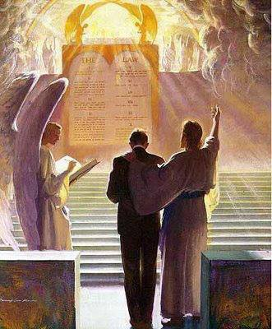
لأَنَّهُ هَكَذَا قَالَ السَّيِّدُ الرَّبُّ: هَئَنَذَا أَسْأَلُ عَنْ غَنَمِي وَأَفْتَقِدُهَا
'For thus says the Lord God: "Indeed I Myself will search
for My sheep and seek them out Ezekiel 34:11

Slide 14
