Slide 1
Romans 15:4-7
For everything that was written in the past was written to teach us, so that through endurance and the encouragement of the Scriptures we might have hope.
May the God who gives endurance and encouragement give you a spirit of unity among yourselves as you follow Christ Jesus, so that with one heart and mouth you may glorify the God and Father of our Lord Jesus Christ.
Accept one another, then, just as Christ accepted you, in order to bring praise to God.

Slide 2
Unity in the Body of Christ Unity Unity & Individuality Problem-Solving Decision-Making
2014-01-12

Slide 3
John 17
Jesus Prays for Himself
17 Jesus spoke these words, lifted up His eyes to heaven, and said: “Father, the hour has come. Glorify Your Son, that Your Son also may glorify You, ² as You have given Him authority over all flesh, that He should give eternal life to as many as You have given Him. ³ And this is eternal life, that they may know You, the only true God, and Jesus Christ whom You have sent. ⁴ I have glorified You on the earth. I have finished the work which You have given Me to do. ⁵ And now, O Father, glorify Me together with Yourself, with the glory which I had with You before the world was.
Jesus Prays for His Disciples
⁶ “I have manifested Your name to the men whom You have given Me out of the world. They were Yours, You gave them to Me, and they have kept Your word.⁷ Now they have known that all things which You have given Me are from You.⁸ For I have given to them the words which You have given Me; and they have received them, and have known surely that I came forth from You; and they have believed that You sent Me.

Slide 4
⁹ “I pray for them. I do not pray for the world but for those whom You have given Me, for they are Yours. ¹⁰ And all Mine are Yours, and Yours are Mine, and I am glorified in them. ¹¹ Now I am no longer in the world, but these are in the world, and I come to You. Holy Father, keep through Your name those whom You have given Me, that they may be one as We are. ¹² While I was with them in the world, I kept them in Your name. Those whom You gave Me I have kept; and none of them is lost except the son of perdition, that the Scripture might be fulfilled. ¹³ But now I come to You, and these things I speak in the world, that they may have My joy fulfilled in themselves. ¹⁴ I have given them Your word; and the world has hated them because they are not of the world, just as I am not of the world. ¹⁵ I do not pray that You should take them out of the world, but that You should keep them from the evil one. ¹⁶ They are not of the world, just as I am not of the world. ¹⁷ Sanctify them by Your truth. Your word is truth.¹⁸ As You sent Me into the world, I also have sent them into the world. ¹⁹ And for their sakes I sanctify Myself, that they also may be sanctified by the truth.

Slide 5
Jesus Prays for All Believers
²⁰ “I do not pray for these alone, but also for those who will believe in Me through their word; ²¹ that they all may be one, as You, Father, are in Me, and I in You; that they also may be one in Us, that the world may believe that You sent Me. ²² And the glory which You gave Me I have given them, that they may be one just as We are one: ²³ I in them, and You in Me; that they may be made perfect in one, and that the world may know that You have sent Me, and have loved them as You have loved Me.
²⁴ “Father, I desire that they also whom You gave Me may be with Me where I am, that they may behold My glory which You have given Me; for You loved Me before the foundation of the world. ²⁵ O righteous Father! The world has not known You, but I have known You; and these have known that You sent Me.²⁶ And I have declared to them Your name, and will declare it, that the love with which You loved Me may be in them, and I in them.”

Slide 6
UNITY is IMPORTANT to the LORD
In the Lord’s final (good-bye) prayer on earth
What did the Lord mention 5 times?
John 17:11 … that they may be ONE
John 17:21 … that they ALL may be ONE
John 17:21 … that they ALSO may be ONE
John 17:22 … that they may be ONE
John 17:23 … that they be made PERFECT in ONE
UNITY (being ONE) must be important!

Slide 7
WHY is UNITY so IMPORTANT?
Unity → the Holy Spirit will work
Apostles united together in prayer on Pentecost → the Holy Spirit established the Church (Acts 2:1) “they were all with one accord in one place”
Apostles united together in Council of Jerusalem → against the Heresy of Judaizers (Acts 15:28) “it seemed good to the Holy Spirit, and to us …”
NO Unity → NO work of the Holy Spirit!
NO Unity → NO Growth, NO Church!

Slide 8
Unity
Unity within Self
Integrity
no Hypocrisy
Unity within the Family (home)
Unity within the Body of Christ (church)
Unity within the Service of Christ (service)

Slide 9
What about Individuality?
Unity does not contradict Individuality.
The Holy Trinity is the Perfect example!
The Father, the Son, and the Holy Spirit
Are ONE (United)
The Father, the Son, and the Holy Spirit
Each hypostasis has a specific Role (Individually)

Slide 10
Unity & Individuality
In Service, we need Both!
Unity in Service to God and His children
Use each Individual’s own talents to serve
Each of us, individually has:
Unique calling (God’s plan for me)
Unique skills & talents (to discover & use to serve)
Unique family situation, other considerations
Respect each others individuality & decisions

Slide 11
Problem-Solving (WWJD)

Slide 12
Problem Solved – What Would Jesus Do? Love & Forgive
Then Peter came to Him and said, “Lord, how often shall my brother sin against me, and I forgive him? Up to seven times?” Jesus said to him, “I do not say to you, up to seven times, but up to seventy times seven.” (Matthew 18:21-22)
PROBLEM: When we are wronged or hurt … even repeatedly
SOLUTION: Love & Forgive

Slide 13
Problem Solved – What Would Jesus Do? Patience & Longsuffering
“Who, when He was reviled, did not revile in return; when He suffered, He did not threaten, but committed Himself to Him who judges righteously” (1Peter 2:23)
PROBLEM: When we are innocently accused, hated, persecuted, for Christ’s sake.
SOLUTION: Patience & Longsuffering

Slide 14
Problem Solved – What Would Jesus Do? Absolute Obedience to God
“And being found in appearance as a man, He humbled Himself and became obedient to the point of death, even the death of the cross.” (Philippians 2:8)
PROBLEM: When it seems difficult or impossible, to obey God.
SOLUTION: Absolute Obedience to God

Slide 15
Problem Solved – What Would Jesus Do? No Compromise with Evil (company or deeds)
But He turned and said to Peter, “Get behind Me, Satan! You are an offense to Me, for you are not mindful of the things of God, but the things of men.” (Matthew 16:23)
PROBLEM: When our friends or family give ungodly advice.
SOLUTION: No Compromise with Evil

Slide 16
Problem Solved – What Would Jesus Do? Constant Prayer
“Now it came to pass in those days that He went out to the mountain to pray, and continued all night in prayer to God.” (Luke 6:12)
PROBLEM: When we are faced with so many problems.
SOLUTION: Constant Prayer

Slide 17
Problem-Solving & Decision-Making using Agpeya Prayer
A Prayer For God’s Guidance Before Making A Decision
Lord, You know that I do not know what is good for me, and now that I am about to start . . . . ., how can I know [what is right or] if it is right unless You guide me with your grace.
O Lord, I beseech Your guidance in this matter [and in every matter], do not let me follow my tendencies, lest I will be confused and fall, keep me from slipping, help me, let it be according to Your will. If You see it fit, grant me Your blessing to complete it, if not, remove this desire from my heart.
You know all things, nothing is concealed from You.
Lord, I am Your servant, deal with me as You see fit as I realize that I will have neither success nor peace unless I submit myself to the grace of Your will, teach me to say in every occasion, “Father, not what I want, but what You will.”
For Yours is the Kingdom, the Power and Glory forevermore. Amen.

Slide 18
Decision-Making

Slide 19
Unity in Decision Making
The Lord likes things Organized (not Chaotic)
Church Councils convened to make decisions
Modern day Holy Orders (e.g. Holy Synod)
Local Church Structure (e.g. Church Board)
Sunday School Organization
Decisions can be small or big, all need UNITY!

Slide 20
A Model for Decision-Making
Five D’s
1. DISCUSS (communicate)
2. DEBATE (engaging openly)
3. DECIDE (be decisive without rushing)
4. DO (take action, in obedience/submission)
5. DONE (if you disagree, let it go and move on)

Slide 21
Decision-Making (Importance of Discussion + Debate)
Discussion & Debate
Discussion needs some structure
Words spoken in wisdom, to edify
Ideas need to be well thought-out
Of course, some topics are NOT for debate (e.g. our Trinitarian Faith as stated in the Creed)
Without Discussion or Debate
Utilitarian style with no flexibility
Can lead to frustration
Can stifle creativity

Slide 22
Decision-Making (Importance of Decision + Action + Closure)
Decision + Do + Done
Leaders must make decisions
Decisions should not be rushed
Take the time to consider viewpoints
Seek Lord’s advice (Decision-Making prayer in Agpeya)
Once decision made, communicate & follow-through
Without Decision or Action
Can lead to frustration, confusion, chaos
Without Closure
Can lead to endless, often fruitless, debate
Can lead to distraction, fracture & division

Slide 23
“Again I say to you that if two of you agree on earth concerning anything that they ask, it will be done for them by My Father in heaven. For where two or three are gathered together in My name, I am there in the midst of them.” (Matthew 18:19-20)
UNITY
No Unity → No Work of the Holy Spirit, No Church
UNITY & INDIVIDUALITY
Individual Talents united in Service to the Lord
PROBLEM-SOLVING
What Would the Lord Do?
Follow His Footsteps
Constant Prayer is Critical in Service
DECISION-MAKING
Discuss, Debate, Decide, Do, Done
Decision-Making Prayer is Critical in Service

Slide 24
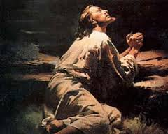
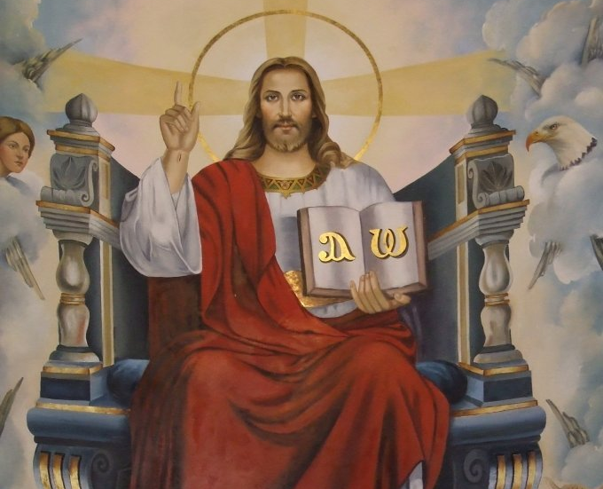
Lord, You know that I do not know what is good for me, and now that I am about to start . . . . ., how can I know [what is right or] if it is right unless You guide me with your grace.
O Lord, I beseech Your guidance in this matter [and in every matter], do not let me follow my tendencies, lest I will be confused and fall, keep me from slipping, help me, let it be according to Your will. If You see it fit, grant me Your blessing to complete it, if not, remove this desire from my heart.
You know all things, nothing is concealed from You.
Lord, I am Your servant, deal with me as You see fit as I realize that I will have neither success nor peace unless I submit myself to the grace of Your will, teach me to say in every occasion, “Father, not what I want, but what You will.”
For Yours is the Kingdom, the Power and Glory forevermore.
Amen.

