Slide 1
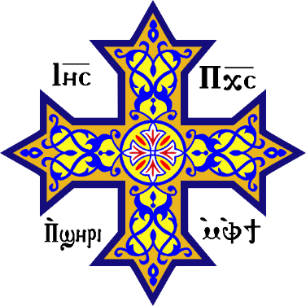
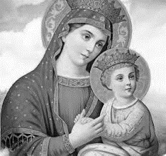
Obedience in Service
Saint Mary’s, Ottawa, February 2024
https://audio.stmary-ottawa.org/sermons/2024/SMO-2024-02-02-Obedience.pdf
Notes:
Image sources:
http://virginmarymtl.org/title-of-holy-theotokos-saint-mary/
https://en.wikipedia.org/wiki/Coptic_cross

Slide 2
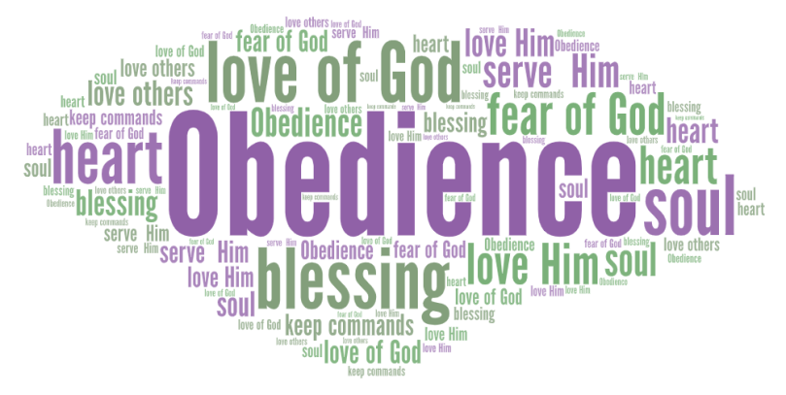
Obedience
Can you name Bible personalities that are role models of Obedience?
Notes:
Image source:
https://daybydayfearlessliving.com/2023/01/25/partial-obedience-is-not-obedience/

Slide 3
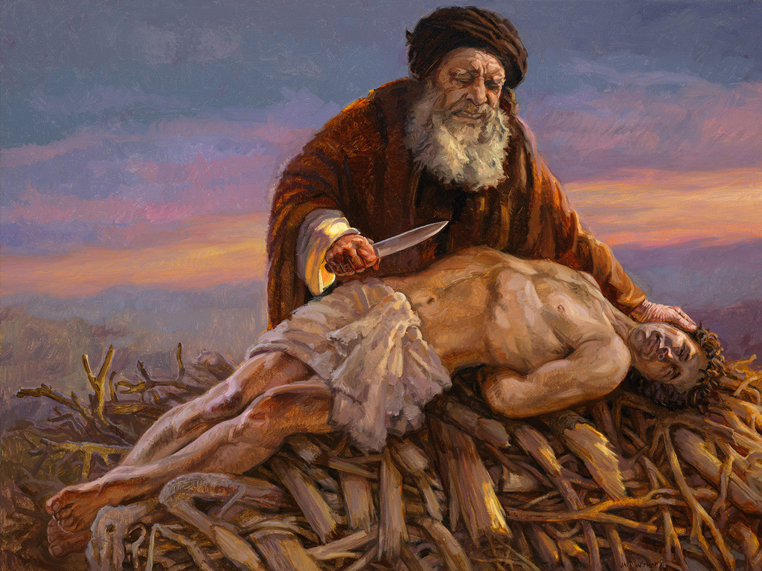
Refer to: Genesis 12
Genesis 22
Notes:
Image source:
https://www.freebibleimages.org/illustrations/jvh-abraham/

Slide 4
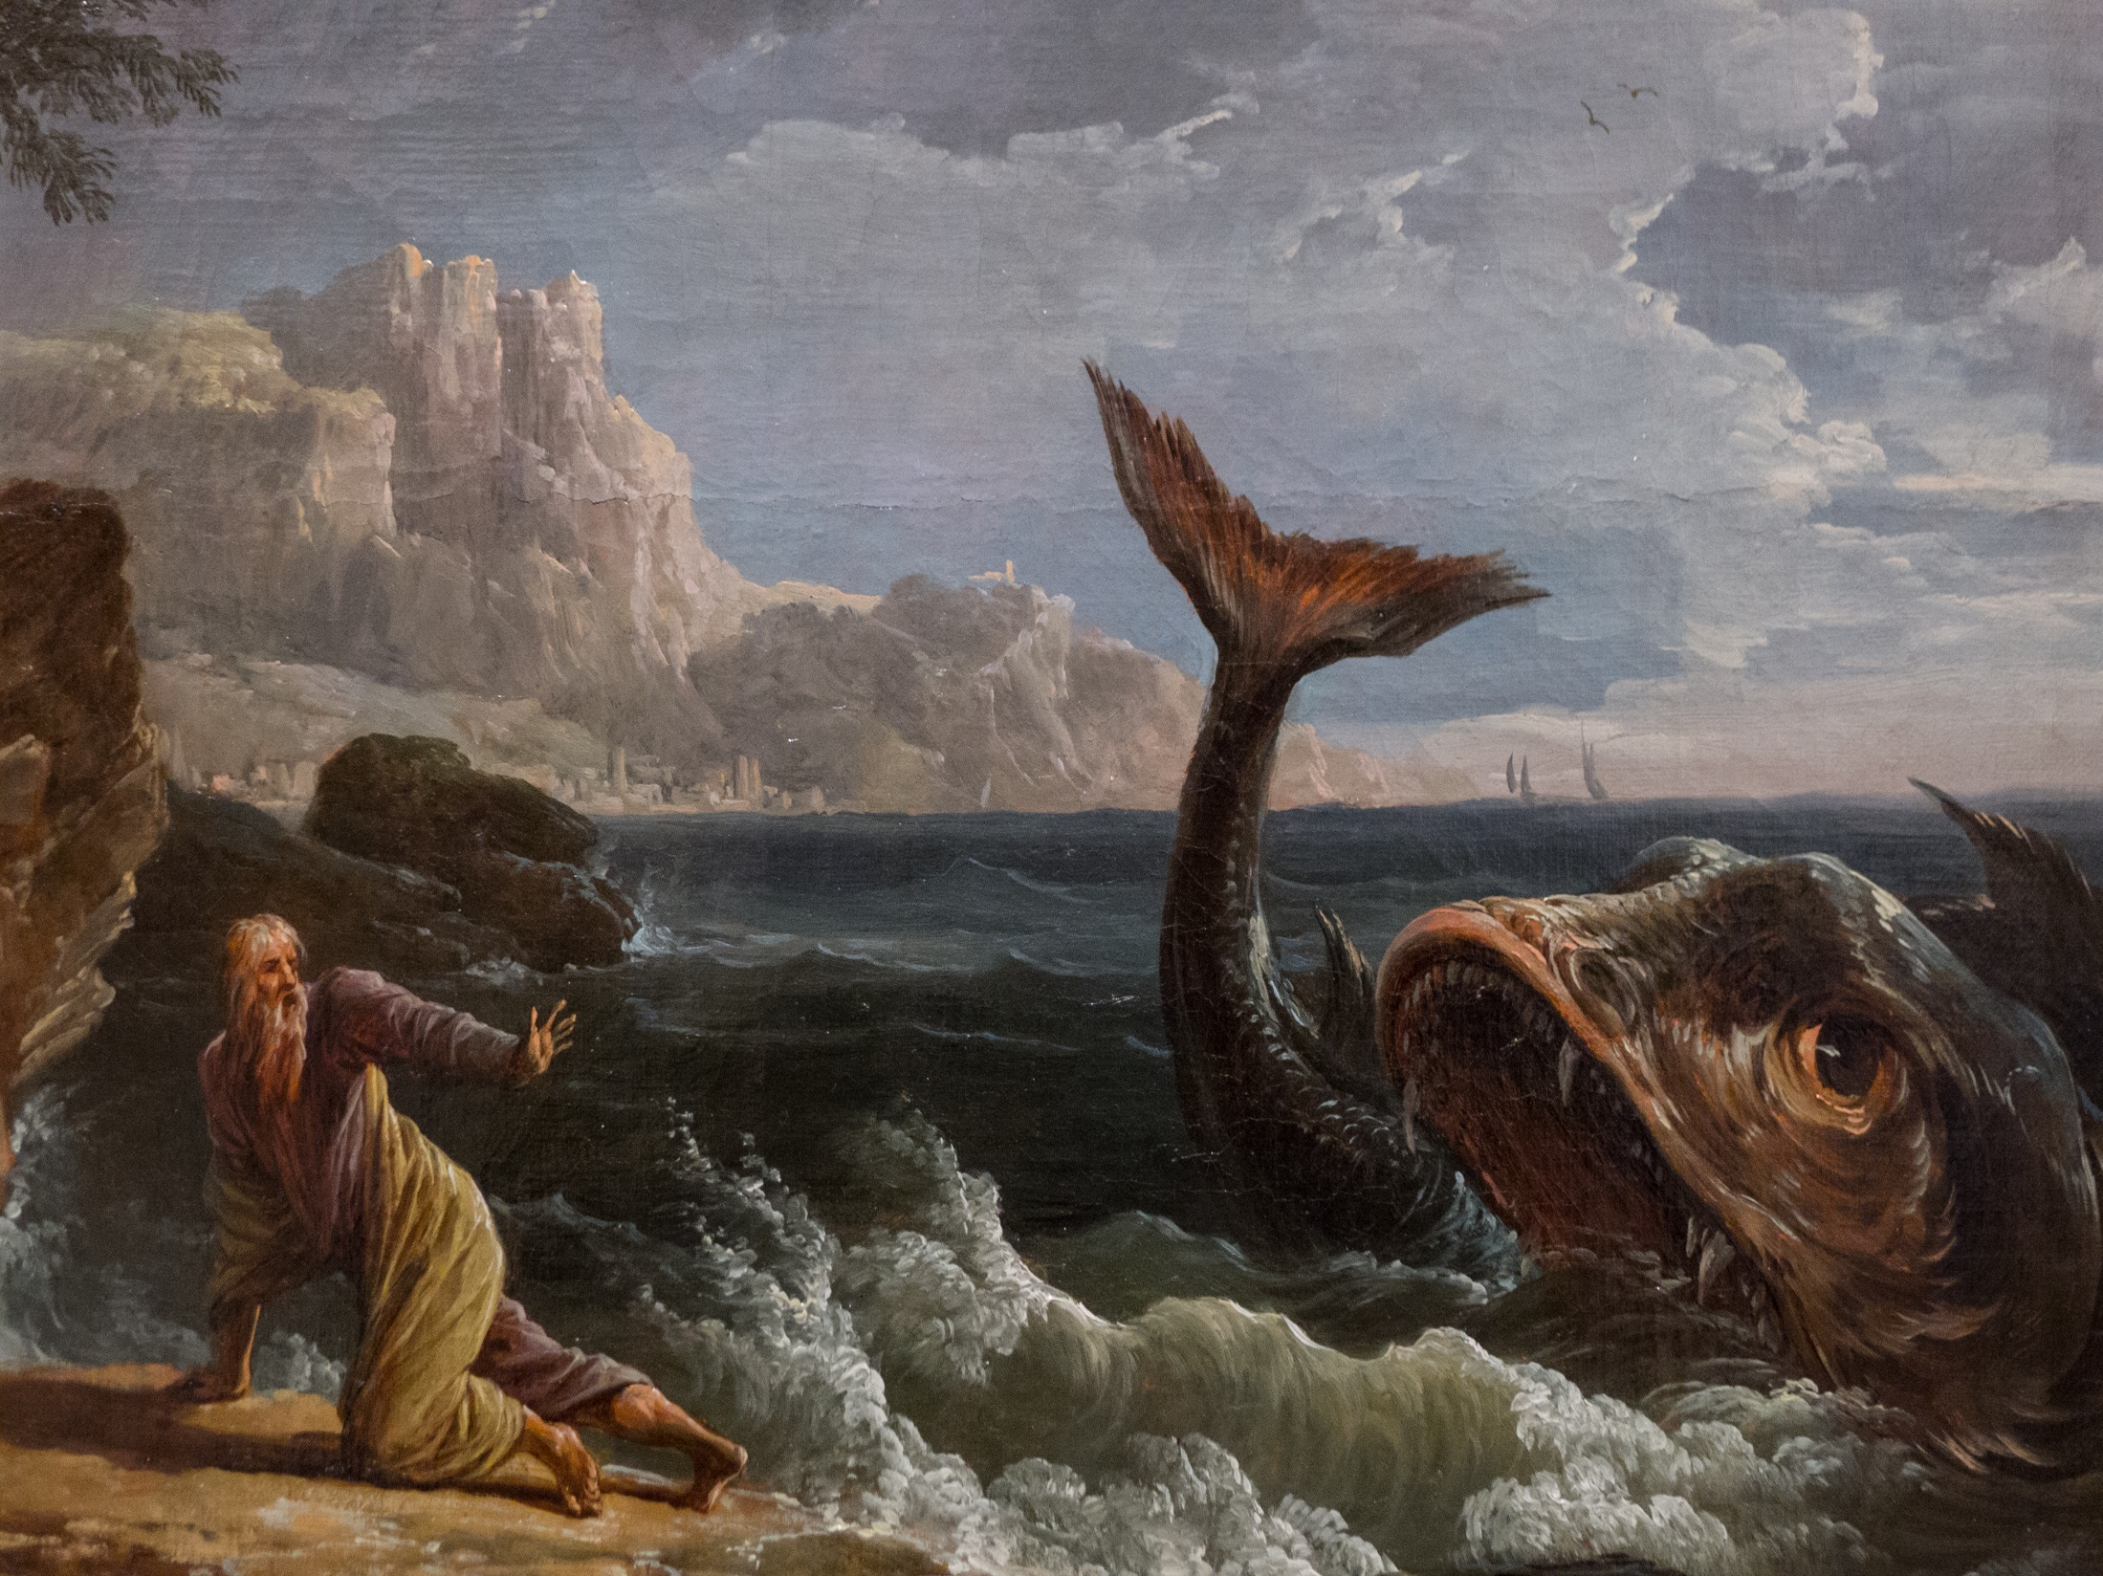
Refer to the Book of Jonah
Notes:
Image source:
https://www.flickr.com/photos/89235234@N00/8167639064

Slide 5
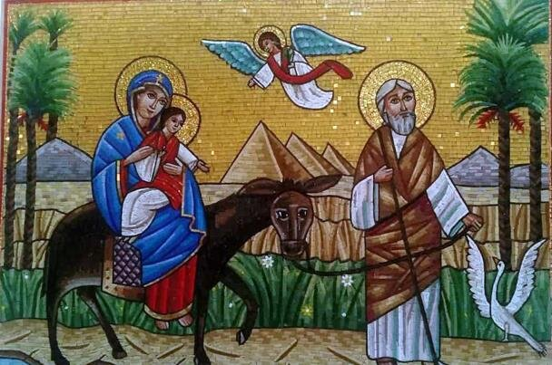
Luke 1:26-45
Matthew 1:18-2:23
Notes:
Image source:
https://www.mecc.org/mecc/2021/6/1/commemoration-of-the-entry-of-the-holy-family-into-Egypt

Slide 6
Saint Mary our Role Model
OBEDIENCE
In faith, trusting & submitting to God
Behold the maidservant of the Lord! Let it be to me according to your word. -Luke 1:38
SERVICE
In love, serving & caring for others
Now Mary arose in those days and went into the hill country with haste … -Luke 1:39
Notes:
Image source:
https://www.etsy.com/ca/listing/1587553024/our-lady-immaculate-conception-of-mary

Slide 7
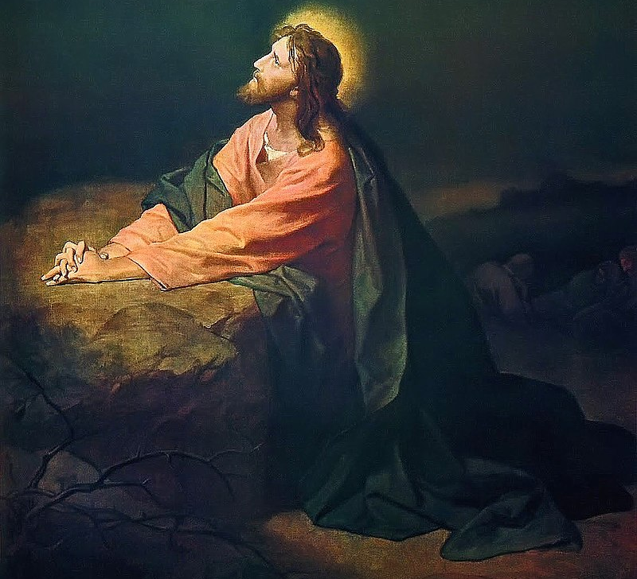
“O My Father, if it is possible, let this cup pass from Me; nevertheless, not as I will, but as You will.”
…
“O My Father, if this cup cannot pass away from Me unless I drink it, Your will be done.”
Notes:
Image source:
https://en.wikipedia.org/wiki/Agony_in_the_Garden

Slide 8
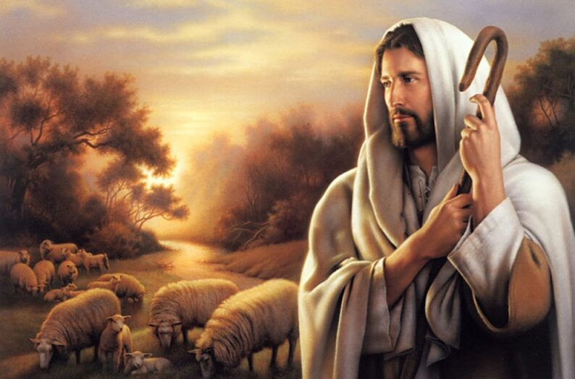
Obedience
To obey God, we need to discern His voice.
His sheep hear & know His voice.
Listen to His voice often, to get to know Him.
God’s children follow His footsteps & follow His faithful saints.
We do NOT follow strangers.
“ the sheep follow him, for they know his voice ”
-- John 10:4
Notes:
Image source:
https://www.holyfamilywhitby.ca/sermons/the-voice-of-the-good-shepherd/

Slide 9
“ My sheep hear My voice, and I know them, and they follow Me. ”
-- John 10:27
Notes:
Image source:
https://www.holyfamilywhitby.ca/sermons/the-voice-of-the-good-shepherd/

Slide 10
John chapter 10: “Most assuredly, I say to you, he who does not enter the sheepfold by the door, but climbs up some other way, the same is a thief and a robber.
² But he who enters by the door is the shepherd of the sheep.
³ To him the doorkeeper opens, and the sheep hear his voice; and he calls his own sheep by name and leads them out.
⁴ And when he brings out his own sheep, he goes before them; and the sheep follow him, for they know his voice.
⁵ Yet they will by no means follow a stranger, but will flee from him, for they do not know the voice of strangers.”
⁶ Jesus used this illustration, but they did not understand the things which He spoke to them.
⁷ Then Jesus said to them again, “Most assuredly, I say to you, I am the door of the sheep.
⁸ All who ever came before Me are thieves and robbers, but the sheep did not hear them.
⁹ I am the door. If anyone enters by Me, he will be saved, and will go in and out and find pasture.
Notes:
NKJV scripture

Slide 11
¹⁰ The thief does not come except to steal, and to kill, and to destroy.
I have come that they may have life, and that they may have it more abundantly.
¹¹ “I am the good shepherd. The good shepherd gives His life for the sheep.
¹² But a hireling, he who is not the shepherd, one who does not own the sheep, sees the wolf coming and leaves the sheep and flees; and the wolf catches the sheep and scatters them.
¹³ The hireling flees because he is a hireling and does not care about the sheep.
¹⁴ I am the good shepherd; and I know My sheep, and am known by My own.
¹⁵ As the Father knows Me, even so I know the Father; and I lay down My life for the sheep.
¹⁶ And other sheep I have which are not of this fold; them also I must bring, and they will hear My voice; and there will be one flock and one shepherd.
Notes:
NKJV scripture

Slide 12
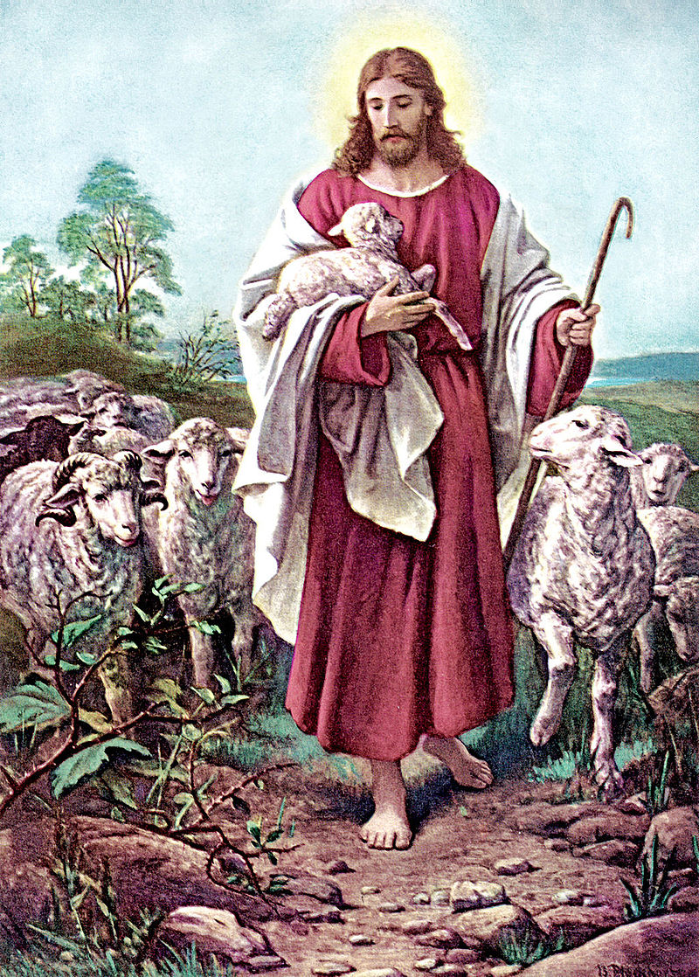
Who to obey & who to run from? Who to follow & who to flee from?
The Good Shepherd (gives His life for the sheep)
The Sheep (hear His loving voice & follow Him)
Thief & Robber (steal, kill, destroy)
Hireling (hired hand, does not care)
Stranger (is not familiar, does not care)
Wolf (catch, kill, scatter)
Notes:
Image source:
https://en.wikipedia.org/wiki/Good_Shepherd

Slide 13
Obey the One who cares for you …
To obey God, we need to get to know His voice.
Listen to His voice often, to get to know Him.
God’s children follow His footsteps & follow His faithful saints.
We do NOT follow strangers.
The Good Shepherd knows us, knows what is best for us, and protects us from all harm.
“ the sheep follow him, for they know his voice ”
-- John 10:4
Notes:
Image source:
https://www.holyfamilywhitby.ca/sermons/the-voice-of-the-good-shepherd/

Slide 14
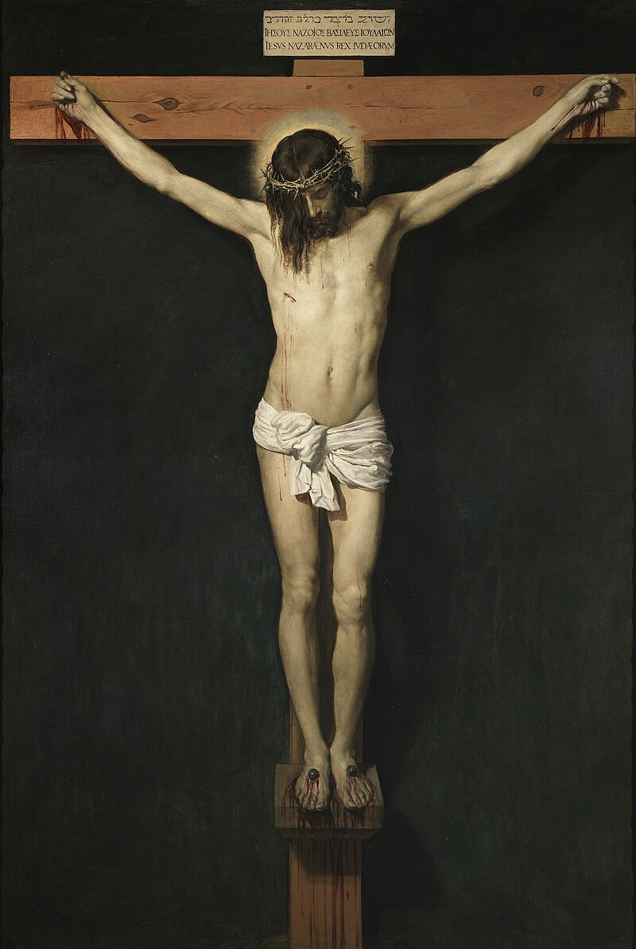
“… though He was a Son, yet He learned obedience by the things which He suffered. And having been perfected, He became the author of eternal salvation to all who obey Him”
(Hebrews 5:8-9)
Notes:
Image source:
https://en.wikipedia.org/wiki/Crucifixion_of_Jesus

Slide 15
Obey (keep) God’s Commandments
If you love Me, keep My commandments (John 14:15)
If anyone loves Me, he will keep My word (John 14:23)
If you keep My commandments, you will abide in My love, just as I have kept My Father’s commandments and abide in His love. (John 15:10)
To obey is better than sacrifice (1 Samuel 15:22)
Blessed are those who hear the word of God and keep it! (Luke 11:28)
Now he who keeps His commandments abides in Him, and He in him. (1 John 3:24)
For this is the love of God, that we keep His commandments. (1 John 5:3)
Notes:
NKJV scripture

Slide 16
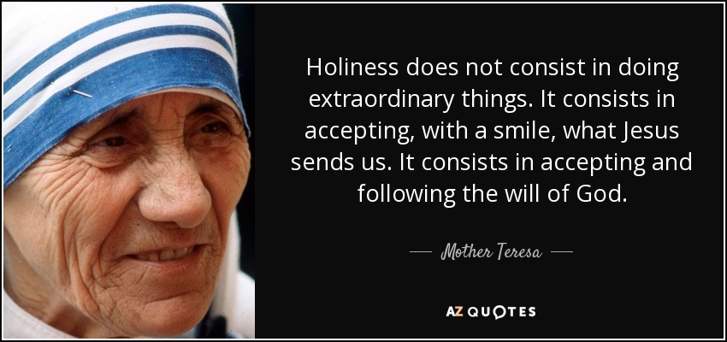
Notes:
Image source:
https://www.azquotes.com/quote/395447

Slide 17
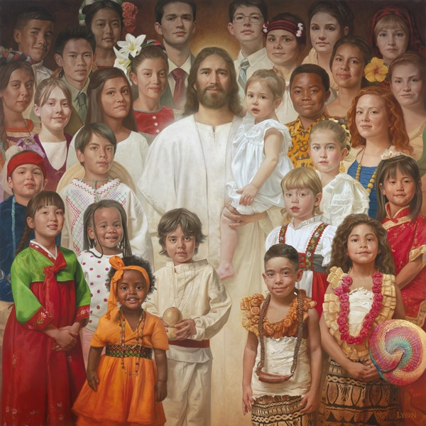
What kind of Obedience?
Children of God … obey out of love
Slaves … obey out of fear
Children … willingly choose to obey
Robots … forced to mechanically obey
We are not slaves nor robots
You are children of God with a free will …
Accept with a smile what the Lord sends your way :-)
www.howardlyon.com/fineart-store/i-am-a-child-of-god
Notes:
Image source:
https://www.howardlyon.com/fineart-store/i-am-a-child-of-god

Slide 18
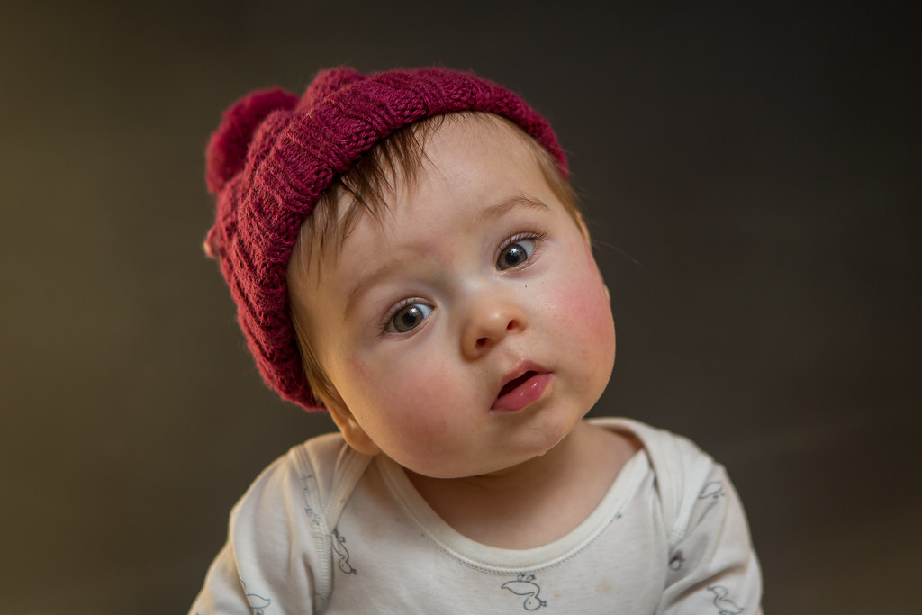
But if I am free … why do I have to obey anyone!?
Notes:
Image source:
https://www.flickr.com/photos/fsmvpggru/32403704306

Slide 19
Romans 6:16
“Do you not know that to whom you present yourselves slaves to obey, you are that one’s slaves whom you obey, …
whether of sin leading to death,
or of obedience leading to righteousness?”
RIGHETEOUSNESS IN THE LORD NOW & FORECER (love, comfort, peace, joy, glory)
DEATH ETERNAL (weeping & gnashing of teeth)
SLAVERY TO SIN
OBEDIENCE TO GOD
CHOOSE WISELY
Notes:
Image source:
https://www.flickr.com/photos/fsmvpggru/32403704306

Slide 20
Okay, so I only have to obey God, right?
Notes:
Image source:
https://www.flickr.com/photos/fsmvpggru/32403704306

Slide 21
Titus 3:1-2
“Remind them to be subject to rulers and authorities, to obey, to be ready for every good work, to speak evil of no one, to be peaceable, gentle, showing all humility to all men.”
Obey God first & foremost.
Honour & obey your parents, in the Lord.
Obey God’s Word & His faithful Saints.
Obey rulers & authorities, in the Lord.
Notes:
NKVJ scripture

Slide 22
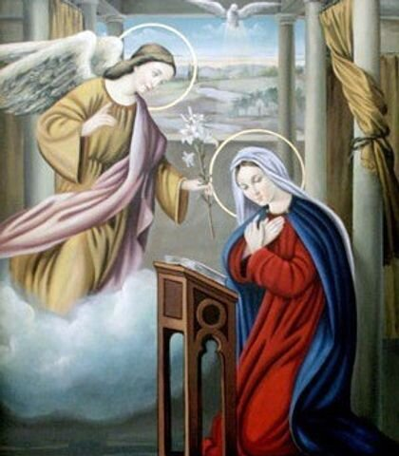
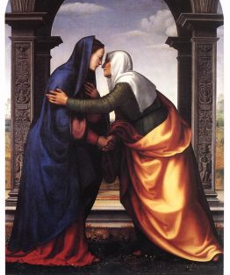
How to Obey God & Serve
OBEY … little by little
Come to church early
Come to church often
Read the Bible regularly
Pray the Agpeya & Psalms
Behold the maidservant of the Lord! Let it be to me according to your word. -Luke 1:38
SERVICE … start at home :-)
Help siblings with homework
Help with chores regularly (dishes, laundry, snow, grass, vacuum, clean)
Now Mary arose in those days and went into the hill country with haste … -Luke 1:39
Notes:
Image source:
https://www.stvnashville.org/feast-of-the-annunciation
https://catholicsaintmedals.com/saints/st-elizabeth-of-the-visitation/
NKJV scripture

Slide 23
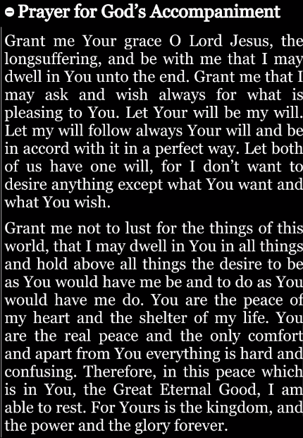
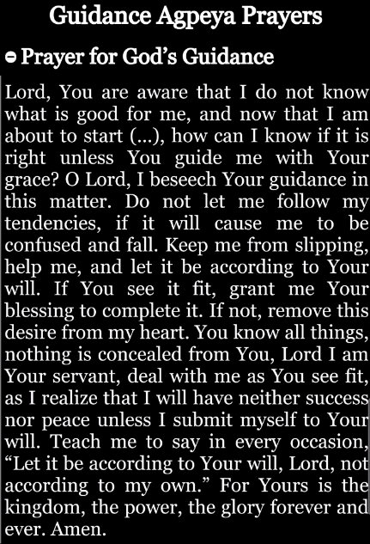
Coptic Reader – Agpeya Prayers
Notes:
Image source:
https://suscopts.org/coptic-reader/
Prayers taken from Coptic Reader App on Feb 1, 2024

Slide 24
Our Father who art in heaven, Hallowed be Your name.
Your kingdom come.
Your will be done On earth as it is in heaven.
Give us this day our daily bread.
And forgive us our trespasses, As we forgive those who trespass against us.
And lead not us into temptation, But deliver us from the evil one.
In Christ, Jesus, Our Lord.
For Yours is the kingdom and the power and the glory forever. Amen.

Slide 25
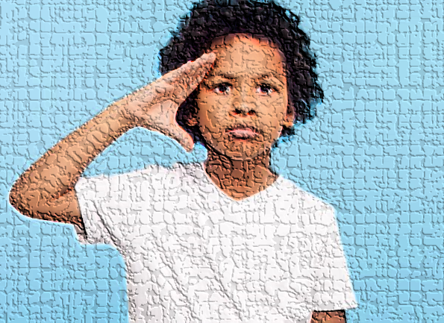
Disobedience ☹
Obedience ☺
Disobedience goes hand-in-hand with pride
“I know better than God, I don’t need to obey!”
Obedience is built on faith in God
“God knows what’s best for me & I lovingly obey.”
Notes:
Image sources:
https://familyfelicity.com/causes-of-child-disobedience/
https://funkeawojide.com/obedience-one-day-at-a-time/

Slide 26
Obedience
Who to Obey?
Why Obey?
How to Obey?
Notes:
Image source:
https://www.holyfamilywhitby.ca/sermons/the-voice-of-the-good-shepherd/

Slide 27
Additional Material

Slide 28
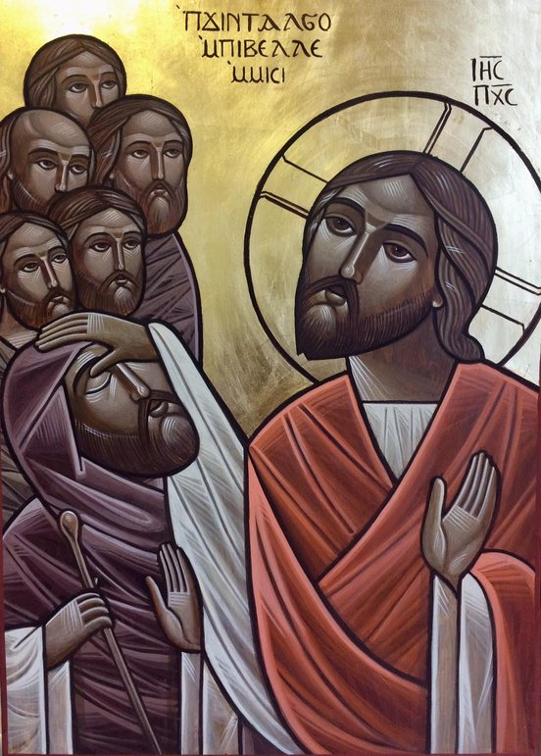
John chapter 9 – The Man Born Blind
Now as Jesus passed by, He saw a man who was blind from birth.
² And His disciples asked Him, saying, “Rabbi, who sinned, this man or his parents, that he was born blind?”
³ Jesus answered, “Neither this man nor his parents sinned, but that the works of God should be revealed in him.
⁴ I must work the works of Him who sent Me while it is day; the night is coming when no one can work.
⁵ As long as I am in the world, I am the light of the world.”
⁶ When He had said these things, He spat on the ground and made clay with the saliva; and He anointed the eyes of the blind man with the clay.
⁷ And He said to him, “Go, wash in the pool of Siloam” (which is translated, Sent). So he went and washed, and came back seeing.
Notes:
Image source:
https://www.anthonyekpunobi.org/fourth-sunday-of-lent-year-a-3/

Slide 29
2 Kings chapter 5 – Naaman the Syrian
5 Now Naaman, commander of the army of the king of Syria, was a great and honorable man in the eyes of his master, because by him the Lord had given victory to Syria. He was also a mighty man of valor, but a leper. ² And the Syrians had gone out on raids, and had brought back captive a young girl from the land of Israel. She waited on Naaman’s wife. ³ Then she said to her mistress, “If only my master were with the prophet who is in Samaria! For he would heal him of his leprosy.”
⁴ And Naaman went in and told his master, saying, “Thus and thus said the girl who is from the land of Israel.”
⁵ Then the king of Syria said, “Go now, and I will send a letter to the king of Israel.” So he departed and took with him ten talents of silver, six thousand shekels of gold, and ten changes of clothing.
⁶ Then he brought the letter to the king of Israel, which said, Now be advised, when this letter comes to you, that I have sent Naaman my servant to you, that you may heal him of his leprosy.
⁷ And it happened, when the king of Israel read the letter, that he tore his clothes and said, “Am I God, to kill and make alive, that this man sends a man to me to heal him of his leprosy? Therefore please consider, and see how he seeks a quarrel with me.”
⁸ So it was, when Elisha the man of God heard that the king of Israel had torn his clothes, that he sent to the king, saying, “Why have you torn your clothes? Please let him come to me, and he shall know that there is a prophet in Israel.”
Notes:
NKJV scripture

Slide 30
2 Kings chapter 5 (cont’d)
⁹ Then Naaman went with his horses and chariot, and he stood at the door of Elisha’s house.
¹⁰ And Elisha sent a messenger to him, saying, “Go and wash in the Jordan seven times, and your flesh shall be restored to you, and you shall be clean.”
¹¹ But Naaman became furious, and went away and said, “Indeed, I said to myself, ‘He will surely come out to me, and stand and call on the name of the Lord his God, and wave his hand over the place, and heal the leprosy.’
¹² Are not the Abanah and the Pharpar, the rivers of Damascus, better than all the waters of Israel? Could I not wash in them and be clean?” So he turned and went away in a rage.
¹³ And his servants came near and spoke to him, and said, “My father, if the prophet had told you to do something great, would you not have done it? How much more then, when he says to you, ‘Wash, and be clean’?”
¹⁴ So he went down and dipped seven times in the Jordan, according to the saying of the man of God; and his flesh was restored like the flesh of a little child, and he was clean.
¹⁵ And he returned to the man of God, he and all his aides, and came and stood before him; and he said, “Indeed, now I know that there is no God in all the earth, except in Israel; now therefore, please take a gift from your servant.”
Notes:
NKJV scripture

Slide 31
Discussion
It is ok to ask questions.
What is blind obedience?
It is ok to try and understand.
It is ok to struggle. (yes, we all struggle, but it's not ok to be rebellious)
It is ok to fall once in a while? (but you must try to get up quickly)
Who benefits from the obedience?
What if the blind man did not obey the Lord?
Could the Lord not just have opened the eyes of the blind man without sending him to wash?
Could Elisha not have just waved his hand and asked God to heal Naaman the Syrian?

