Slide 1
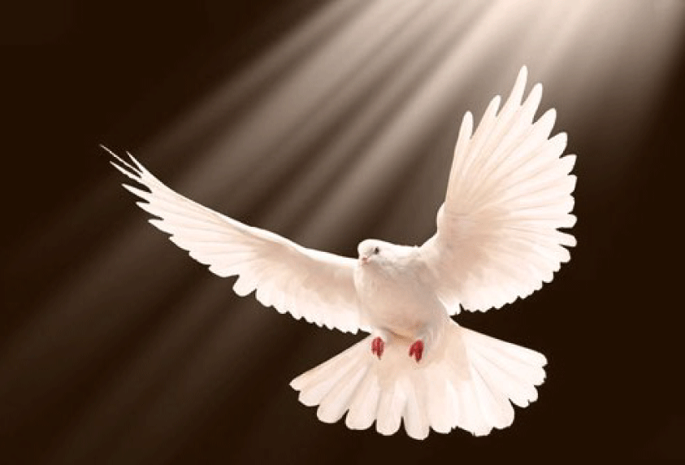
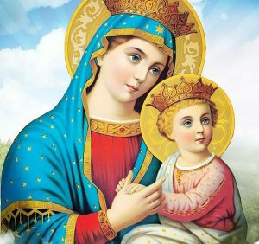
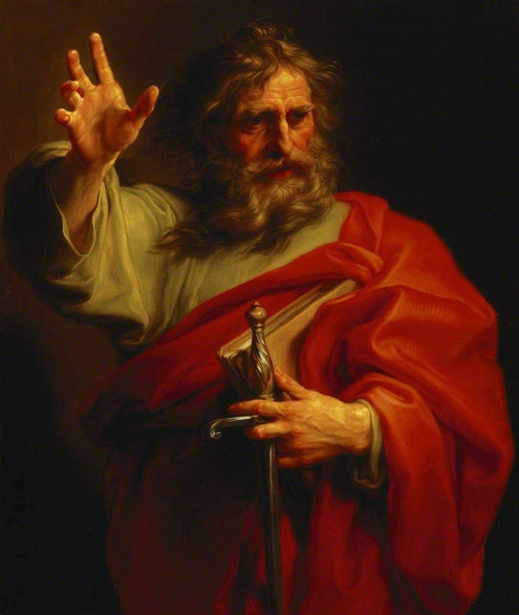
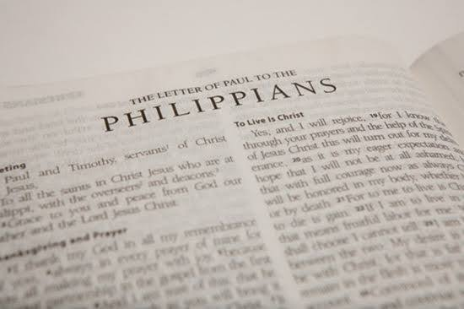

Philippians Bible Study
2025-10-17
https://audio.stmary-ottawa.org/sermons/2025/SMO-2025-10-17-Philippians.pdf
Notes:
Image source:
https://virginmarymtl.org/title-of-holy-theotokos-saint-mary/
https://www.etsy.com/ca/listing/1337299905/rejoice-in-the-lord-always-philippians
https://medium.com/artisanal-article-machine/st-paul-the-giant-who-called-himself-the-least-of-the-apostles-2805e185bd71
https://www.9marks.org/article/5-reasons-you-should-preach-through-philippians/
https://awf.world/theology-and-history/person-and-work-of-the-holy-spirit/

Slide 2
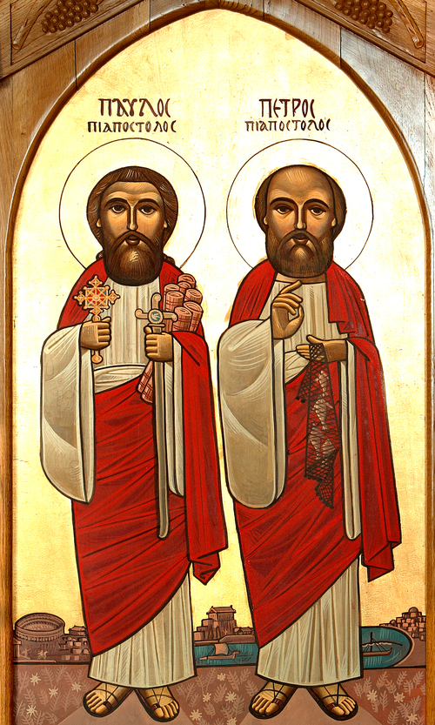
The Apostles Peter & Paul
Role Models of Faith
Exemplify faith, love, determination & passion.
Overcoming Challenges
Inspire us to remain steadfast in Christ amidst difficulties.
Our Mission
Be faithful witnesses, and bring others to Christ, continuing the work to make disciples of all nations.
Notes:
Image source:
https://www.peterpaulcoc.org/icons

Slide 3
Saint Paul
from Persecutor to Preacher The Transformed Evangelist
Perseverance and Evangelism Enduring to the End
Crown of Righteousness A Life Well-Lived
Notes:
Image source:
https://www.peterpaulcoc.org/icons

Slide 4
Saint Paul’s Transformation from Persecutor to Preacher
Began as a zealous Pharisee and persecutor of Christians.
The Damascus Road Conversion
“Then he fell to the ground and heard a voice saying to him, 'Saul, Saul, why are you persecuting Me?’”
Acts 9:4
A new calling (Saul becomes Paul): becomes a passionate defender & preacher of the faith,
taking extensive missionary journeys
and authoring numerous epistles, rich with theological wisdom.
Notes:
Image source:
https://www.peterpaulcoc.org/icons

Slide 5
Saint Paul’s 14 Epistles & Three Missionary Journeys
Year | Major Events | Acts | Period | 14 Epistles
34 AD | Conversion, Damascus, Arabia | 9 | 3 years in Arabia
37 | Jerusalem, Tarsus, Syria, Cilicia
46-47 | Antioch, Jerusalem | 11 | 1 year in Antioch
48-49 | First Missionary Trip and Antioch | 13-14 |  | Galatians
50 | Jerusalem Council and Antioch | 15
51-53 | Second Missionary Trip | 16-18 | 18 months in Corinth | 1 & 2 Thessalonians
53-54 | Antioch
54-57 | Third Missionary Trip | 19-21 | 3 years in Ephesus | 1 & 2 Corinthians Romans
57 | Jerusalem Arrest | 22-23
57-59 | Caesarea Prisoner | 24-26 | 2 years
59-60 | Journey to Rome | 27-28
60-67 | Rome House Arrest and subsequent Martyrdom | 28 | 5-8 years | Ephesians Philippians Colossians Philemon Hebrews Titus 1 & 2 Timothy
Notes:
Reference:
https://www.conformingtojesus.com/charts-maps/en/paul%27s_letters-journeys_chart.htm

Slide 6
Learning from Saint Paul’s Joy and Perseverance
Joy in Adversity Even in prison, Saint Paul wrote of joy, keeping his focus on Christ.
Pressing Onward and Upward “But one thing I do, forgetting those things which are behind and reaching forward to those things which are ahead, I press toward the goal for the prize of the upward call of God in Christ Jesus.” Philippians 3:13-14
Notes:
Image source:
https://www.peterpaulcoc.org/icons

Slide 7
Learning from Saint Paul’s Vigilance and Evangelism
Vigilance
Saint Paul calls us to “Redeem the time” Ephesians 5:16
Do the Work of an Evangelist
“But you be watchful in all things, endure afflictions, do the work of an evangelist, fulfill your ministry.” 2 Timothy 4:5
Notes:
Image source:
https://www.peterpaulcoc.org/icons

Slide 8
Learning from Saint Paul’s Crown of Righteousness
Ready for Departure "For I am already being poured out as a drink offering, and the time of my departure is at hand.“ 2 Timothy 4:6
The Ultimate Reward “Finally, there is laid up for me the crown of righteousness, which the Lord, the righteous Judge, will give to me on that Day, and not to me only but also to all who have loved His appearing.“ 2 Timothy 4:8
Notes:
Image source:
https://www.peterpaulcoc.org/icons

Slide 9
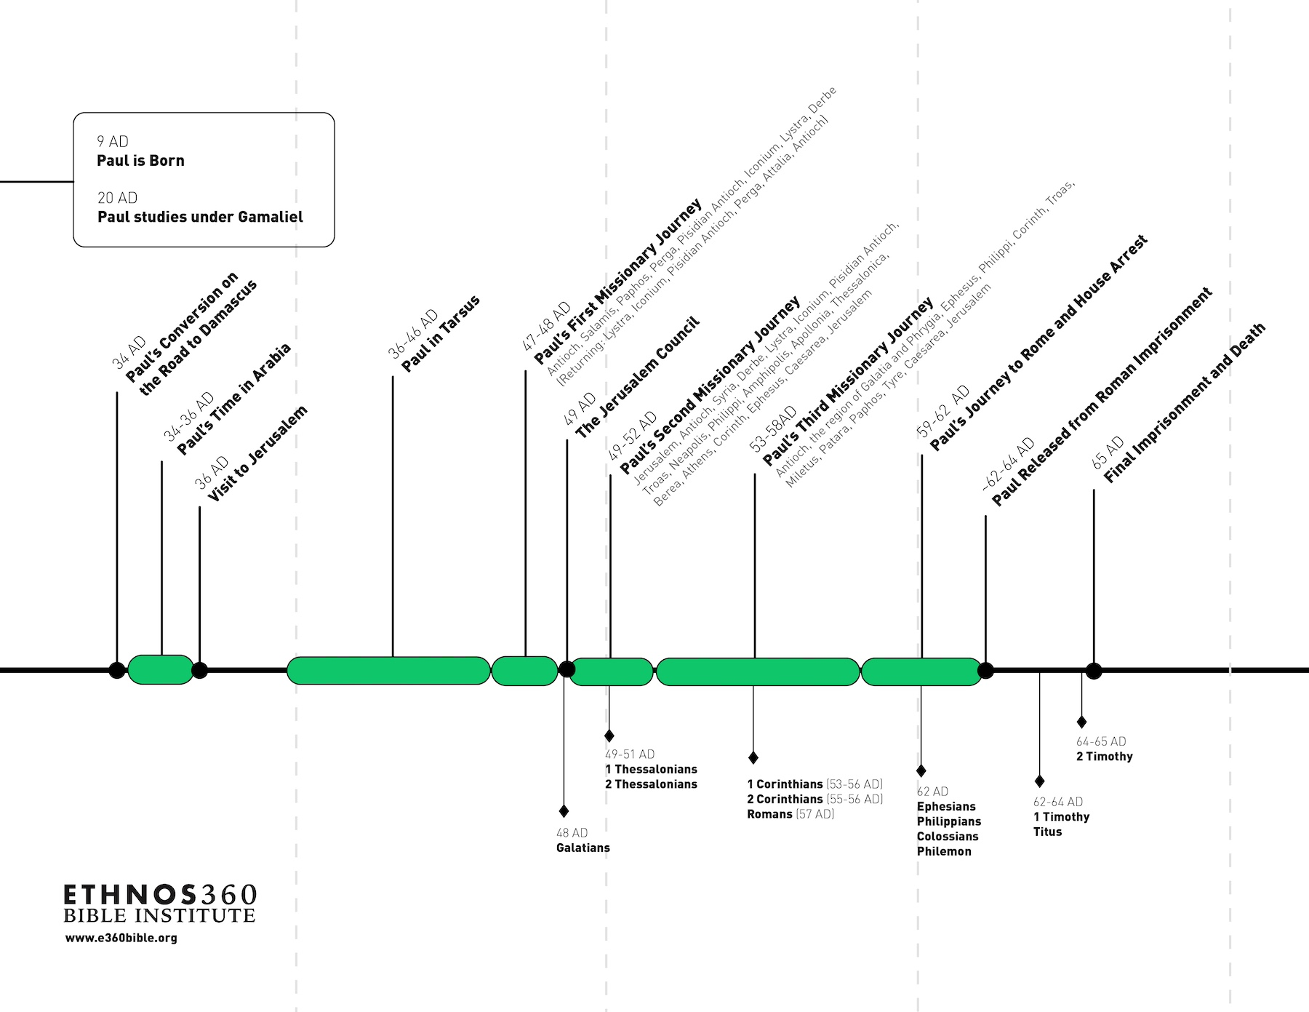
The Prison Epistles
Notes:
Image source:
https://e360bible.org/blog/timeline-of-pauls-life-and-missionary-journeys/

Slide 10
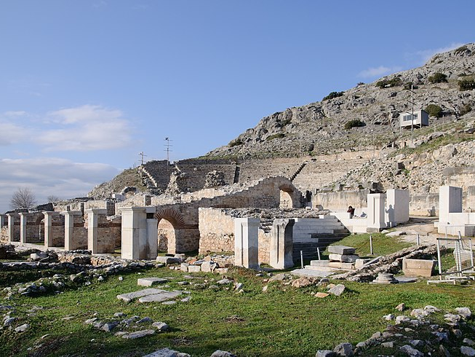
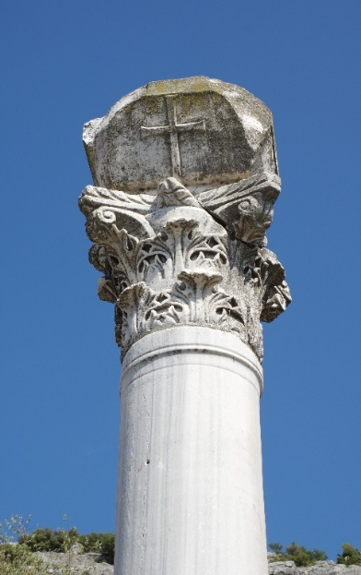
Philippian Church
AD 50-51
Saint Paul founded the church in Philippi during his 2nd missionary journey (Acts 16:11-40)
This was the first church established in Europe
AD 57-58
Saint Paul made two brief visits to Philippi during his 3rd missionary journey (Acts 20:1,6)
AD 61-63
Saint Paul wrote Philippians from Rome while he was under house arrest (Acts 28:16-31)
He was free to receive visitors & write letters at that time
Notes:
Image source:
https://commons.wikimedia.org/wiki/File:Philippi_-_2.jpg
https://upload.wikimedia.org/wikipedia/commons/4/45/Archaeological_site_of_Philippi_BW_2017-10-05_13-20-29.jpg
Reference: OSB

Slide 11
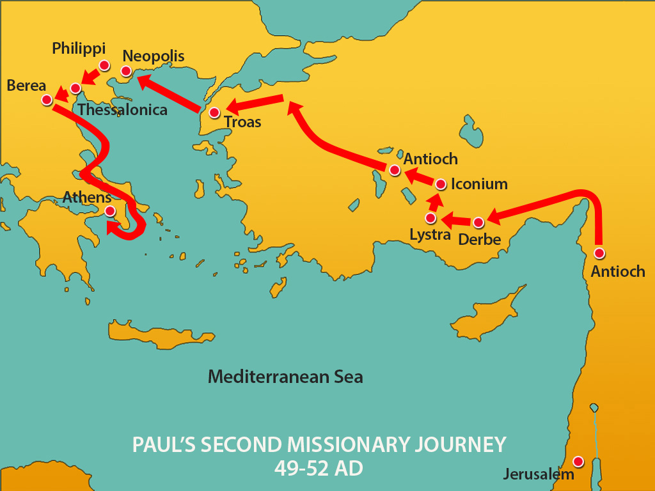
Notes:
Image source:
https://upwards.blog/wp-content/uploads/2015/11/1b-2nd-missionary-journey.jpg

Slide 12
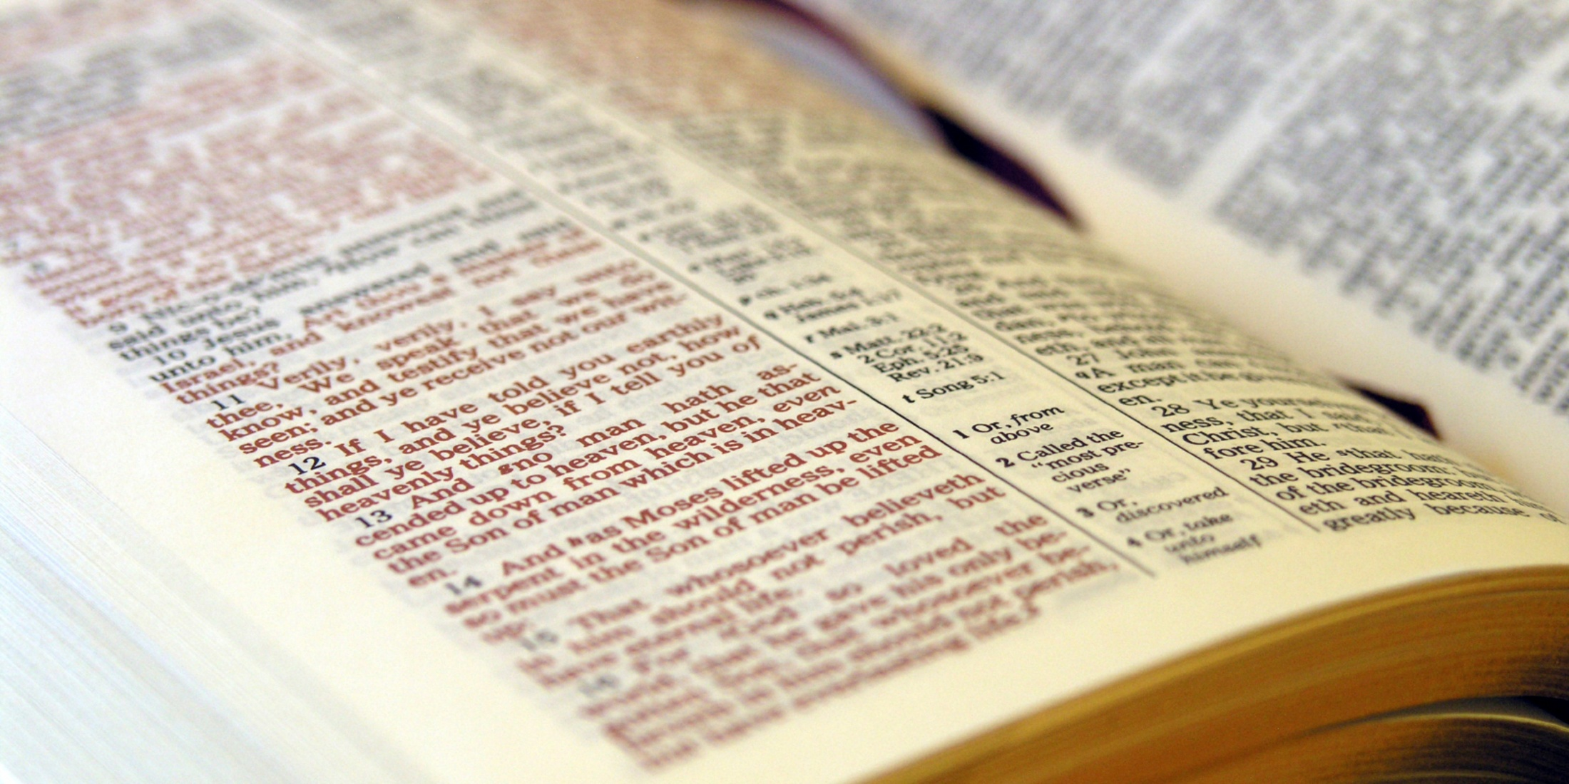
Let’s read Acts 16:11-40
Notes:
Image source:
https://www.pinecove.com/blog/the-bible-tells-me-so/

Slide 13
Philippi
AD 50-51
Saint Paul founded the church in Philippi during his 2nd missionary journey (Acts 16:11-40)
This was the first church established in Europe
AD 57-58
Saint Paul made two brief visits to Philippi during his 3rd missionary journey (Acts 20:1,6)
AD 61-63
Saint Paul wrote Philippians from Rome while he was under house arrest (Acts 28:16-31)
He was free to receive visitors & write letters at that time
Notes:
Image source:
https://commons.wikimedia.org/wiki/File:Philippi_-_2.jpg
https://upload.wikimedia.org/wikipedia/commons/4/45/Archaeological_site_of_Philippi_BW_2017-10-05_13-20-29.jpg
Reference: OSB

Slide 14
Background
Philippi was noted for its generosity in support of the apostolic ministry (1:5, 4:15, 16; Acts 16:15, 40)
It had sent Epaphroditus to visit Saint Paul in prison with a financial gift and instructions to stay with Paul
Epaphroditus was so devoted to his work that he neglected his own physical health (2:30) and was sick
The Philippian church was worried about Epaphroditus
In the meantime, Paul’s trial had started (1:7) and he was hoping for an early release (1:25; 2:24) from prison
Saint Paul wrote this letter of thanks to Philippi with comforting words, and sending Epaphroditus home (2:25-30) and also sending Timothy to Philippi (2:19)
Notes:
Image source:
https://commons.wikimedia.org/wiki/File:Philippi_-_2.jpg
Reference: OSB

Slide 15
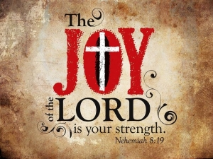

Major Themes
Christian Life
**Joy in Christ **
Unity
Humility
Selfless Generosity
“Christ’s Salvation and our Life in Christ is a dynamic, ongoing experience that is not merely personal, but shared among believers.” – OSB
Notes:
Image source:
https://commons.wikimedia.org/wiki/File:Philippi_-_2.jpg
https://images.squarespace-cdn.com/content/v1/55844033e4b0b4466f11c152/1513200807769-RB7KQBKZRGR9RDRJII7A/95d30d62e16362830b6947f9e1ba1425--unity-in-diversity-quotes-quotes-for-children.jpg?format=1500w
https://philanbobogospel.wordpress.com/2015/08/17/the-joy-of-the-lord-is-our-strenght/
Reference: OSB

Slide 16
1:21
“For to me, to live is Christ, and to die is gain.”
Notes:
Image source:
https://commons.wikimedia.org/wiki/File:Philippi_-_2.jpg

Slide 17
1:27
“let your conduct be worthy of the gospel of Christ”
Notes:
Image source:
https://commons.wikimedia.org/wiki/File:Philippi_-_2.jpg

Slide 18
2:5
“Let this mind be in you which was also in Christ Jesus”
Notes:
Image source:
https://commons.wikimedia.org/wiki/File:Philippi_-_2.jpg

Slide 19
2:12
“work out your own salvation with fear and trembling”
Notes:
Image source:
https://commons.wikimedia.org/wiki/File:Philippi_-_2.jpg

Slide 20
3:1
“Finally, my brethren, rejoice in the Lord.”
Notes:
Image source:
https://commons.wikimedia.org/wiki/File:Philippi_-_2.jpg

Slide 21
3:10
“that I may know Him and the power of His resurrection, and the fellowship of His sufferings, being conformed to His death”
Notes:
Image source:
https://commons.wikimedia.org/wiki/File:Philippi_-_2.jpg

Slide 22
3:14
“I press toward the goal for the prize of the upward call of God in Christ Jesus.”
Notes:
Image source:
https://commons.wikimedia.org/wiki/File:Philippi_-_2.jpg

Slide 23
3:20
“For our citizenship is in heaven, from which we also eagerly wait for the Savior, the Lord Jesus Christ.”
Notes:
Image source:
https://commons.wikimedia.org/wiki/File:Philippi_-_2.jpg

Slide 24
4:1
“Therefore, my beloved and longed-for brethren, my joy and crown, so stand fast in the Lord, beloved.”
Notes:
Image source:
https://commons.wikimedia.org/wiki/File:Philippi_-_2.jpg

Slide 25
4:4
“Rejoice in the Lord always. Again I will say, rejoice!”
Notes:
Image source:
https://commons.wikimedia.org/wiki/File:Philippi_-_2.jpg

Slide 26
4:7-8
“Be anxious for nothing, but in everything by prayer and supplication, with thanksgiving, let your requests be made known to God; and the peace of God, which surpasses all understanding, will guard your hearts and minds through Christ Jesus.”
Notes:
Image source:
https://commons.wikimedia.org/wiki/File:Philippi_-_2.jpg

Slide 27
Rejoice in the Lord!
Philippians is one of Paul’s four prison epistles (Ephesians, Philippians, Colossians, Philemon)
Despite Paul writing from prison, a central theme is to always “Rejoice in the Lord”
Saint Paul writes to thanks the Philippian church for their support, and to comfort them about his imprisonment.

Slide 28
Let’s read Philippians chapter 1
Notes:
Image source:
https://www.pinecove.com/blog/the-bible-tells-me-so/

Slide 29
Greetings & Thanksgiving Philippians 1:1-11
Saint Paul includes Timothy and addresses the letter to the bishops & deacons—this is the only letter where he specifically includes the clergy
Expresses deep joy for the Philippians because it is their fellowship (Greek koinonia κοινωνία) in worship & community of life that made their spiritual father joyful
Saint Paul prays that their love may abound in knowledge and discernment, that they approve the things that are excellent, be sincere and without offense till Christ returns, and be filled with the fruit of righteousness

Slide 30
Paul's Imprisonment Advances the Gospel Philippians 1:12-26
Paul’s imprisonment
Helped to further spread the gospel, with everyone in the palace knowing that his chains are because of the Gospel.
This made other believers more courageous to preach.
Different Motivations for Preaching
Some preached from goodwill, love, and sincerity;
Others preached out of evil motives (envy, strife, self-ambition, to add more afflictions to his chains).
Paul rejoiced regardless because Christ was proclaimed!
Paul’s Philosophy
“To live is Christ and to die is gain”— joyful in either case.

Slide 31
Steadfastness in Suffering Philippians 1:27-30
Paul calls believers to behave worthy of the gospel through unity (one mind and one spirit), striving for the faith, and not being terrified but confident.
The Gift of Suffering
The believer is granted both to believe and to suffer, as suffering is …
the way to glory,
increases our faith,
and is participation in God's grace.

Slide 32
Notes:
Image source:
https://www.etsy.com/ca/listing/1337299905/rejoice-in-the-lord-always-philippians

Slide 33
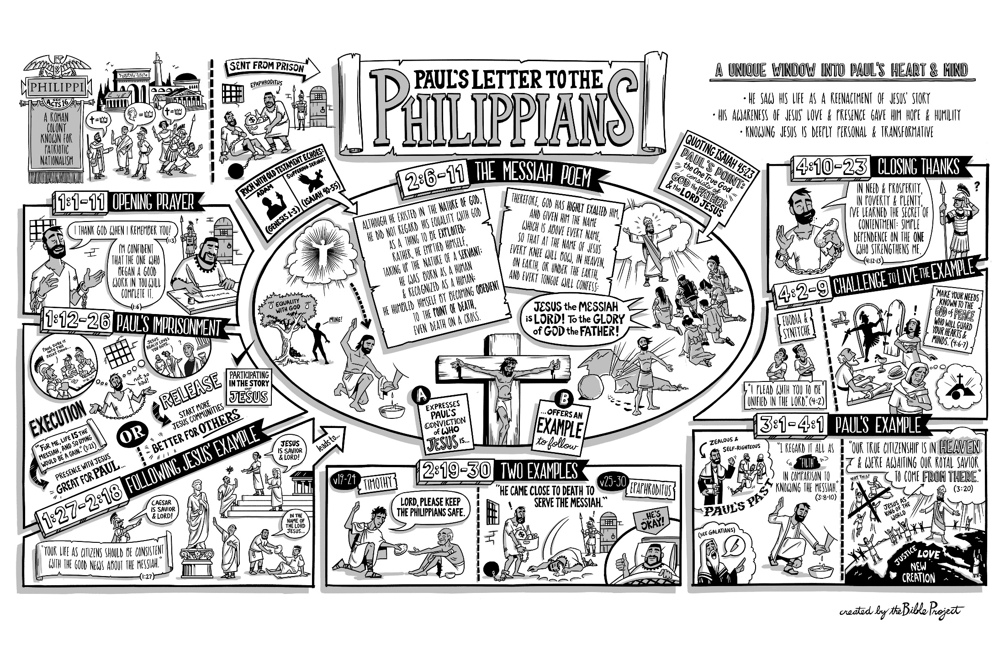
bibleproject.com/videos/philippians [9 mins]

