Slide 1
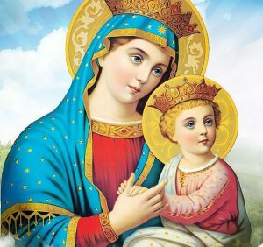
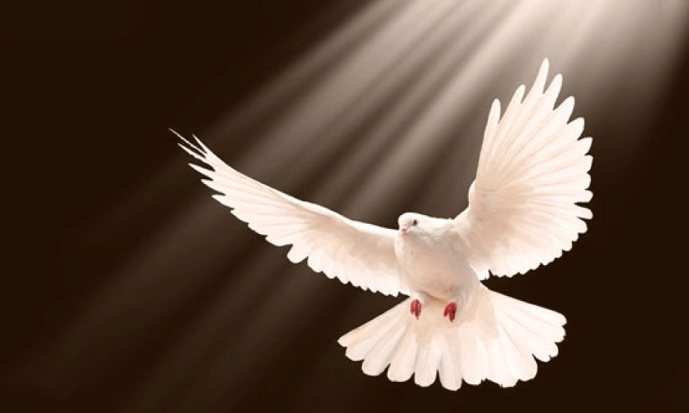
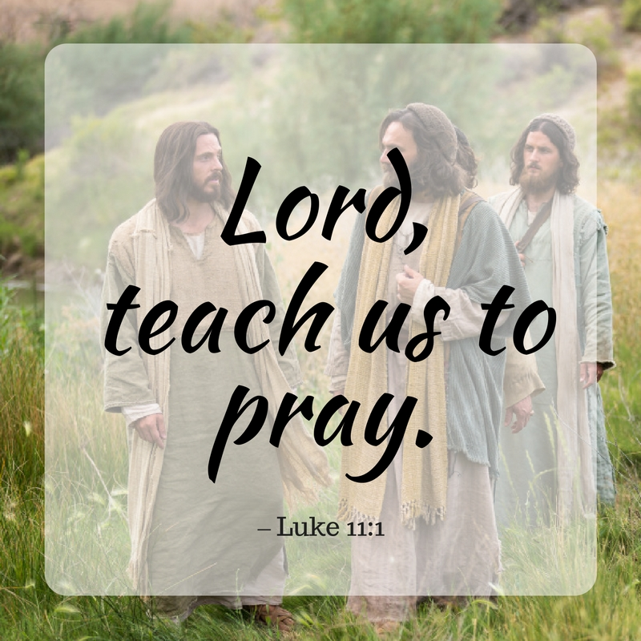
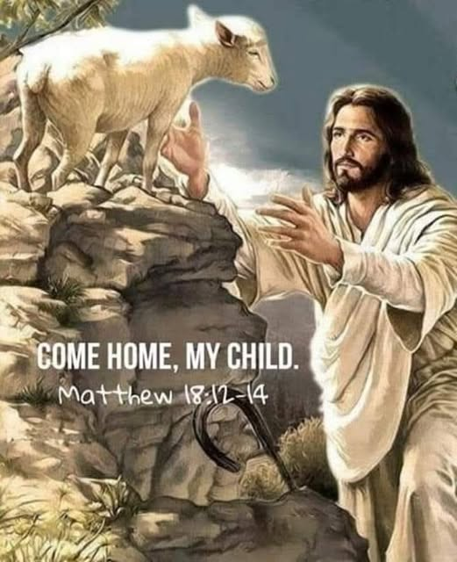
Discipleship
2025-10-26
https://audio.stmary-ottawa.org/sermons/2025/SMO-2025-10-26-Discipleship.pdf
Notes:
Image source:
https://virginmarymtl.org/title-of-holy-theotokos-saint-mary/
https://awf.world/theology-and-history/person-and-work-of-the-holy-spirit/
https://godinallthings.com/2016/09/22/teach-us-to-pray/
https://www.facebook.com/groups/1669298240229349/posts/2122553738237128/

Slide 2
Discipleship
The Lord sent His disciples and told them to make disciples …
“Go therefore and make disciples of all the nations, baptizing them in the name of the Father and of the Son and of the Holy Spirit”
MATTHEW 28:19
The life of a servant is a life of discipleship.

Slide 3
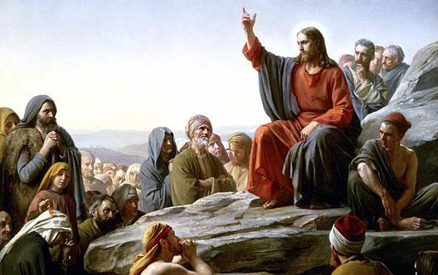
One Teacher
Christ is the One true teacher. We are all called to be His disciples.
Notes:
Image source:
https://sfcatholic.org/bishopsbulletin/are-the-teachings-of-the-church-jesus-teachings/

Slide 4
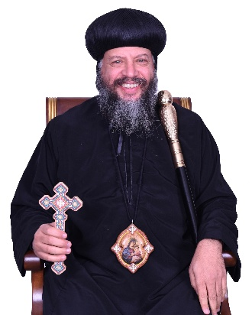
One Teacher
Christ is the One true teacher. We are all called to be His disciples.
What are the requirements to be His disciple?
Reference:
H.E. Metropolitan Youssef
November 2020 sermon available here:
youtube.com/watch?v=oojVtiOGZB0
Notes:
Image source:
https://copticorthodox.church/en/bishops/metropolitan-youssef/

Slide 5
(1) ABIDE IN THE WORD OF GOD
Then Jesus said to those Jews who believed Him, “If you abide in My word, you are My disciples indeed.”
JOHN 8:31
Just listening to the Word of God is not enough.
Transform the words into life.
Live the Word of God.

Slide 6
(1) ABIDE IN THE WORD OF GOD
READ the Word of God
UNDERSTAND the Word of God
Keep it in your HEART (meditate, reflect)
Apply it in your LIFE
Hold yourself ACCOUNTABLE

Slide 7
(2) LOVE
“By this all will know that you are My disciples, if you have love for one another.”
JOHN 13:35
If we do not love one another, we are not disciples.
A house divided against itself cannot stand.
If there is conflict among us, the servants, we are not disciples, and we cannot be successful.

Slide 8
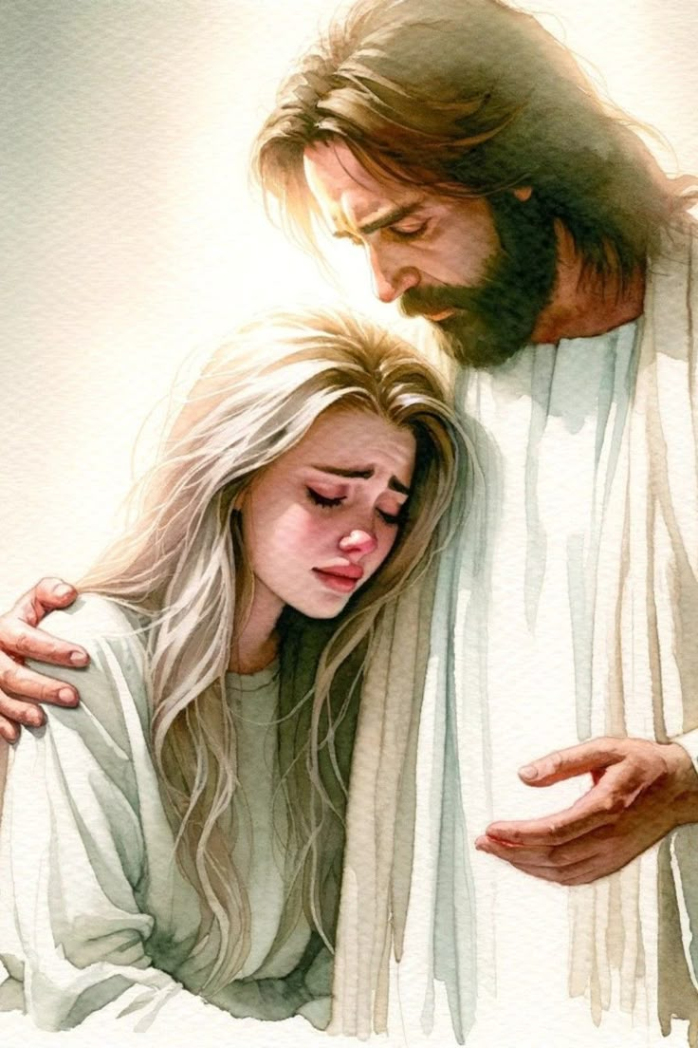
(2) LOVE
Aghapy Love
a WILLFUL love
a DECISION you make
a CHOICE (not an ability)
is UNCONDITIONAL
is SACRIFICIAL
is LIMITLESS
Notes:
Image source:
https://ca.pinterest.com/pin/89438742592999246/

Slide 9
(3) WALK IN HIS FOOTSTEPS
“He who says he abides in Him ought himself also to walk just as He walked.”
I JOHN 2:6
We need to walk according to the footsteps of Our Lord.
A disciple follows his Master.
“If you were Abraham’s children, you would do the works of Abraham.”
JOHN 8:39

Slide 10
(3) WALK IN HIS FOOTSTEPS
“He who says he abides in Him ought himself also to walk just as He walked.”
I JOHN 2:6
ASIDE: the Arabic word “telmeez” (تلميذ ) can be translated as:
PUPIL, STUDENT, DISCIPLE
A PUPIL (in primary school) learns by feeding.
A STUDENT learns by studying.
A DISCIPLE learns by discipline, from the LIFE of their teacher.
A DICIPLE walks in the footsteps of their teacher.

Slide 11
Requirements to be a disciple …
Abide in the Word of God
Love
Walk in His Footsteps
“Now great multitudes went with Him. And He turned and said to them …”
LUKE 14:25
Before you follow Me, did you calculate the cost to be My disciples?
Prioritize God First
Carry my Cross
Detach from the Earthly

Slide 12
(4) PRIORITIZE GOD FIRST
“If anyone comes to Me and does not hate his father and mother, wife and children, brothers and sisters, yes, and his own life also, he cannot be My disciple.”
LUKE 14:26
“Hate” here is not to be taken as the opposite of love.
The message is that God is the priority, He is first.
I am not attached to anyone outside of God; even family is to be loved through God.

Slide 13
(4) PRIORITIZE GOD FIRST
Do I put God first?
before my family
before my spouse
before my children
before my self
Direct all love …
my love to my family
my love to my spouse
my love to my children
to be included within …
my love toward God (not against it)

Slide 14
(5) CARRY MY CROSS
“whoever does not bear his cross and come after Me cannot be My disciple.”
LUKE 14:27
Many of us, when we see the cross, we refrain from being disciples.
Carrying the Cross is part of our calling as disciples.

Slide 15
(5) CARRY MY CROSS
“My child, when you come to serve the Lord,
prepare yourself for testing.”
SIRACH 2:1 NRSV
Carrying the Cross includes my choices …
Choosing to fast
Choosing to wake up early to pray
Choosing to do those things happily, though they may be inconvenient

Slide 16
(6) DETACH FROM EARTHLY
“whoever of you does not forsake all that he has cannot be My disciple.”
LUKE 14:33
We are like a bird that wants to fly … If the bird is tied with a rope to the ground, it cannot !
CUT THE CORD THAT BINDS YOU DOWN
LET YOUR SPIRIT SOAR TO HEAVEN

Slide 17
(6) DETACH FROM EARTHLY
“See, we have left all and followed You. Therefore what shall we have?”
A hundredfold, and inherit eternal life!
“Everyone who has left houses or brothers or sisters or father or mother or wife or children or lands, for My name’s sake, shall receive a hundredfold, and inherit eternal life.”
MATTHEW 19:27-30
The Lord’s Promise: you will gain everything!

Slide 18
(7) DO NOT LOOK BACKWARDS
“No one, having put his hand to the plow, and looking back, is fit for the kingdom of God.”
LUKE 9:62
Remember Lot’s wife!
YOU NEED ONLY LOOK FORWARD …
KEEP YOUR EYES ONLY ON JESUS CHRIST

Slide 19
(7) DO NOT LOOK BACKWARDS
Peter was walking on water with His eyes on the Lord.
When he took his eyes off the Lord, he looked at the waves, the storm, the sea, and began to sink!
Keep your eyes on the Lord
Peter, later, during the Lord’s trial, denied Him … then Peter (looking at the Lord) saw the Lord looking at him. And Peter went out and wept bitterly.
Peter’s repentance started from looking at the Lord!

Slide 20
(7) DO NOT LOOK BACKWARDS
So long as you are His disciples, keep your eyes fixed on the Lord.
Looking at the Lord leads to our repentance, our deliverance, and our salvation.

Slide 21
(8) COMMITMENT
A disciple should be committed to follow his Master.
Just like a student shadows the professor to learn,
we are called to “shadow” the Lord.
A shadow is inseparable from what it shadows.
This requires commitment.

Slide 22
(8) COMMITMENT
Commitment to the service.
Commitment to preparation of lessons.
Commitment to our service meeting.
Commitment to visitation.
Commitment to my spiritual canon.
If we lose our commitment, we are not shadowing the Lord.

Slide 23
(9) THE DESIRE TO LEARN
If a student were to shadow a professor but have no desire to learn, it is pointless!
A disciple must have a desire to learn, to retain the knowledge, to apply it, and to live by it.
Learn from God’s word; Learn from Early Church Fathers;
In humility, learn even from nature itself.

Slide 24
(10) HUMBLENESS
Without being humble, you can never learn!
Saint Paul said that he was disciplined at the feet of Gamaliel.
The sin of pride prevents any spiritual progress.
An arrogant or proud person can never learn.

Slide 25
(11) RETAIN WHAT WE LEARNED
“Your word I have hidden in my heart,
That I might not sin against You.”
PSALM 119:11
A disciple studies and is tested to retain what was learned.
Retain what was learned in our MIND & HEART.

Slide 26
(11) RETAIN WHAT WE LEARNED
“And these words which I command you today shall be in your heart.
You shall teach them diligently to your children, and shall talk of them when you sit in your house, when you walk by the way, when you lie down, and when you rise up.
You shall bind them as a sign on your hand, and they shall be as frontlets between your eyes.
You shall write them on the doorposts of your house and on your gates.”
DEUTERONOMY 6:6-9

Slide 27
(12) EXERCISE
Be patient & exercise!
Being a disciple is a journey, a life to be lived.
It does not happen overnight.
It does not happen instantly.
Apply what we learned through spiritual exercise.

Slide 28
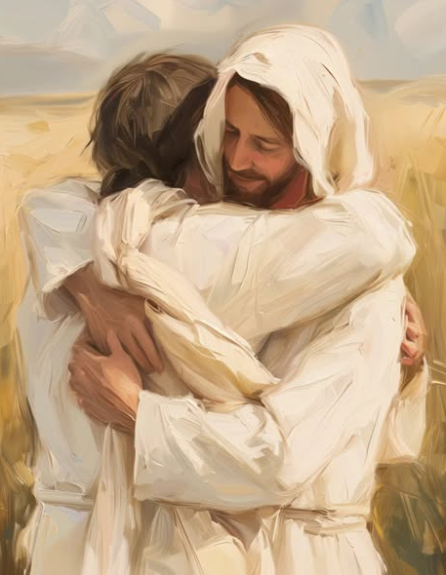
To be His disciple …
Abide in the Word of God
Love
Walk in His Footsteps
Prioritize God First
Carry my Cross
Detach from the Earthly
Do Not look Backwards
Be Committed
Have a desire to Learn
Be Humble
Retain what we Learned
Exercise and be patient!
Notes:
Image source:
https://www.facebook.com/christfirstnc/posts/jesus-christ-desires-to-have-you-home-he-will-always-be-standing-with-open-arms-/917802560551830/

