Slide 1
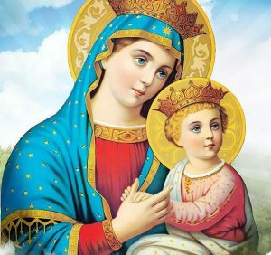

Church History Three Councils Guardians of the Faith
2025-11-01
audio.stmary-ottawa.org/sermons/2025/SMO-2025-11-01-Church-History.pdf
Notes:
Image source:
https://virginmarymtl.org/title-of-holy-theotokos-saint-mary/
https://awf.world/theology-and-history/person-and-work-of-the-holy-spirit/

Slide 2

Church History and our faith
Why does Church History matter ?
So that we understand the foundation of our faith and how the Church protected Orthodox teaching
The Church faced challenges from the outside (persecution) and from the inside (heresies)
Heroes of faith kept the apostolic teachings pure from heresies
Councils were gatherings of bishops to address threats, to correct doctrine and preserve apostolic teaching
Notes:
Image source:
https://parentinghub.co.za/wp-content/uploads/2018/07/Questioning-Questions.jpg

Slide 3
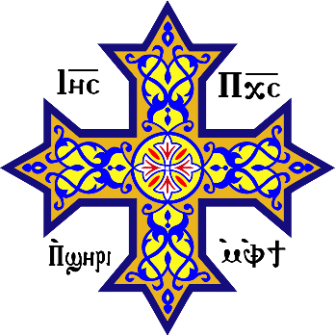
1st Century
Early Church (4th - 5th Centuries)
heroes of the faith
Athanasius the Apostolic
Basil the Great
Gregory the Theologian
Cyril the Pillar of Faith
John the Beloved
Clement of Rome
Ignatius of Antioch
Polycarp of Smyrna
Early Councils
Nicaea (325 AD)
Constantinople (381 AD)
Ephesus (431 AD)
Notes:
Image Source:
https://en.wikipedia.org/wiki/Coptic_cross
Reference:
newadvent.org/fathers
Saint John the Beloved, one of Jesus's twelve apostles, had several notable disciples and followers in the early Church. Here are the key figures associated with him:
Polycarp of Smyrna (c. 69-155 AD) is considered the most prominent disciple of John. He served as Bishop of Smyrna and was a direct link between the apostolic age and the next generation of Church fathers. Polycarp was martyred at age 86 and is revered as a saint in both Eastern and Western Christianity.
Ignatius of Antioch (c. 35-108 AD) was another important figure who likely knew John personally. As Bishop of Antioch, he wrote seven influential letters while being transported to Rome for martyrdom, which provide valuable insights into early Christian theology and church structure.
Papias of Hierapolis (c. 60-130 AD) was a bishop and early Christian writer who claimed to have heard John preach. He's known for collecting oral traditions about Jesus and the apostles, though most of his writings survive only in fragments quoted by later authors.
Irenaeus of Lyons (c. 130-202 AD), while not a direct disciple, was taught by Polycarp and thus represents the third generation from John. He became a crucial figure in early Christian theology and often cited what Polycarp had told him about John's teachings.
According to tradition, John spent his later years in Ephesus, where he trained these and other leaders who would shape the early Church's development in Asia Minor and beyond.

Slide 4
Church History The robe of Christ is not to be torn!
TODAY’S FOCUS
The first 450 years of Christianity, the Church was united
There were heresies that tried to divide & disrupt the church
Church fathers fought against the heresies, defending the faith
In 451, the Western (Roman Catholic) & Eastern Orthodox Churches incorrectly accused the Oriental Orthodox Church of being Monophysite (believing in only one nature of Christ)
The Oriental Churches are Miaphysite (united nature of Christ)
Eastern & Oriental Orthodox Churches reconciled in modern time
In 1054, the Western (Roman Catholic) & Eastern Orthodox Churches were split, in what is known as “the Great Schism”
Rome had wanted to exercise authority over all other Churches
In 1500’s, Protestant & Anglican split off from Catholicism

Slide 5
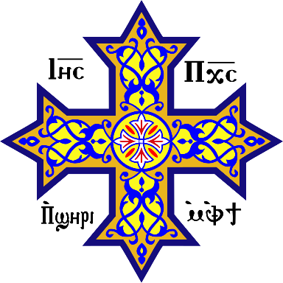
Oriental Orthodox (Coptic, Antioch, Armenian, Ethiopian, Indian)
Nicaea 325
Ephesus 431
Jerusalem 45
Pentecost 33
Chalcedon 451
Constantinople 381
Eastern Orthodox (Constantinople, Greece, Russia)
1054
Chalcedonic
Catholic (Rome)
The Great Schism filoque addition
1521
1538
Anglican (Church of England, United, Episcopal)
Reformation
Protestant (Lutheran, Baptist)
Cults (Heretical) (Jehovah’s Witness, Adventists, Mormons)
Timeline of Christian Denominations
Notes:
Image Source:
https://en.wikipedia.org/wiki/Coptic_cross

Slide 6
Do you know your Agpeya?
Notes:
Image source:
https://parentinghub.co.za/wp-content/uploads/2018/07/Questioning-Questions.jpg

Slide 7
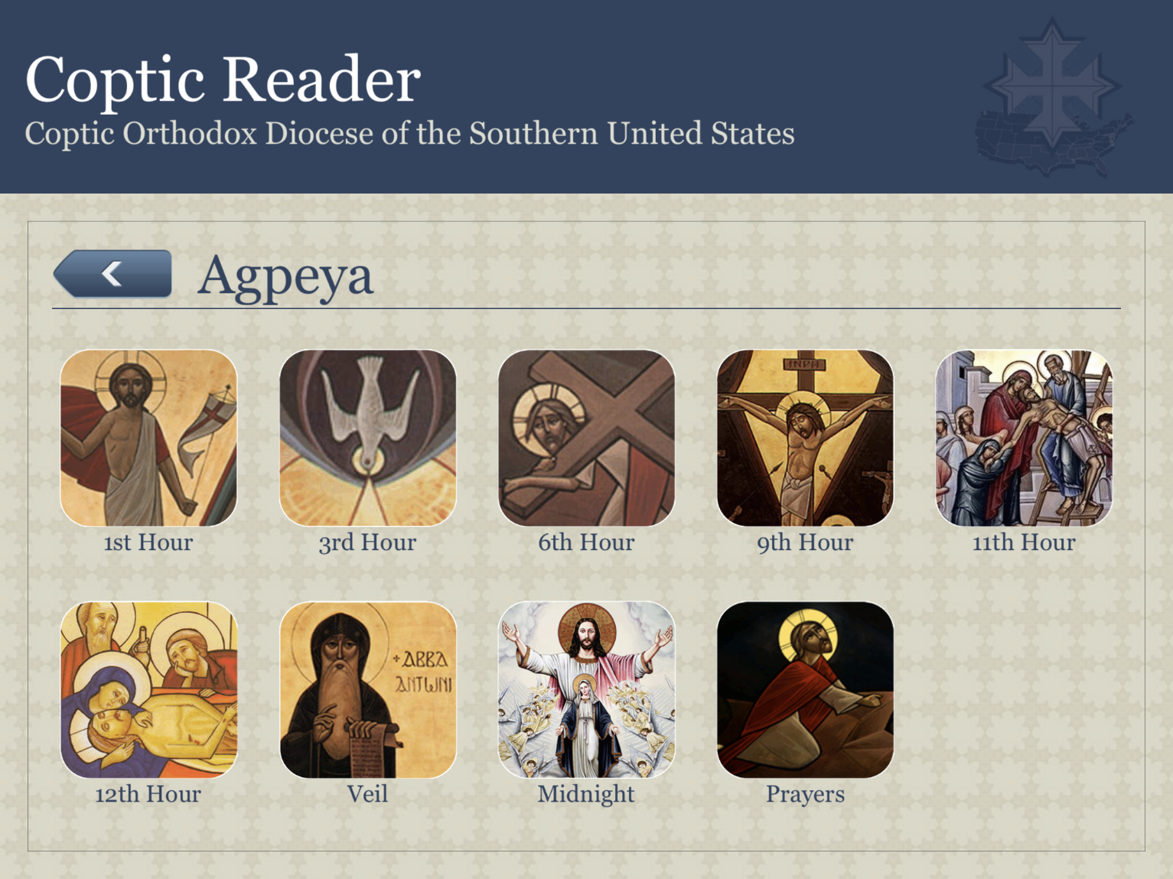
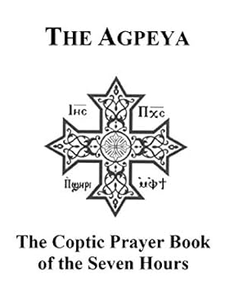
Do you know your Agpeya?
Notes:
Image source:
Coptic Reader
https://www.amazon.ca/Agpeya-Fr-Abraham-Azmy/dp/1712786253

Slide 8
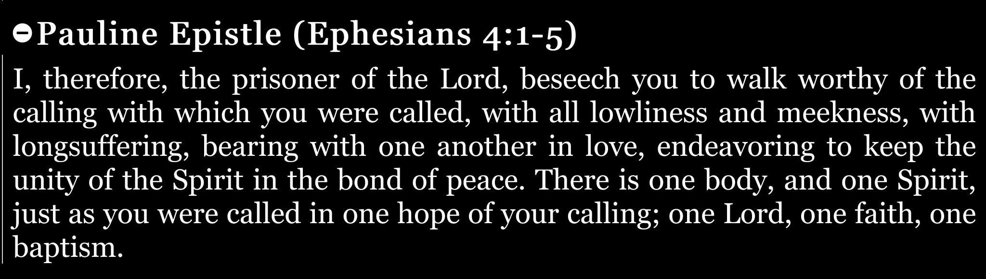
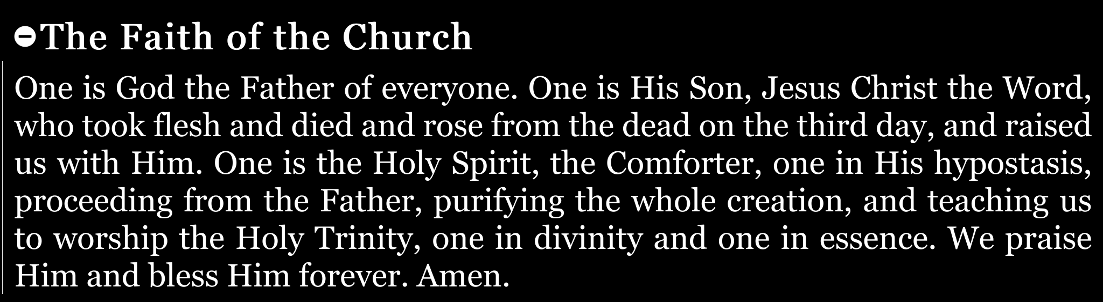


From our Agpeya prayers …

Slide 9
Do you know the Liturgy?
Notes:
Image source:
https://parentinghub.co.za/wp-content/uploads/2018/07/Questioning-Questions.jpg

Slide 10
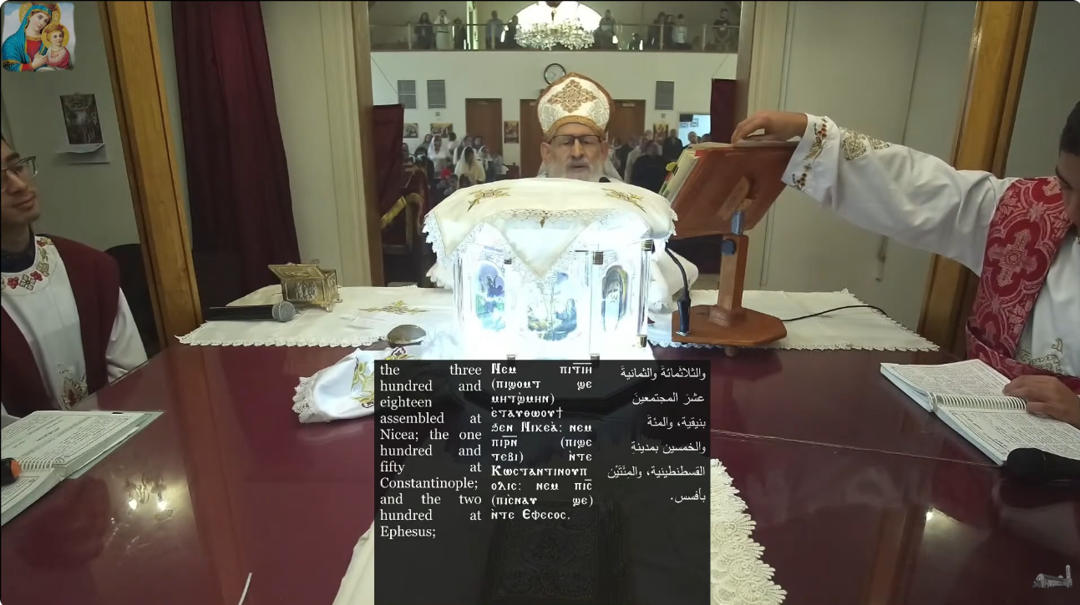
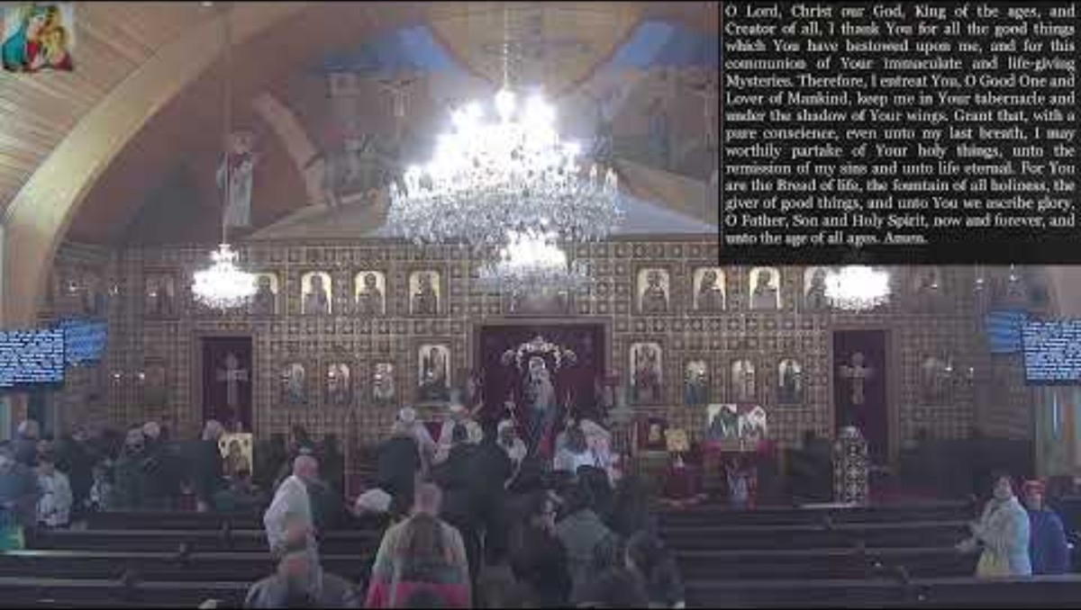

Which part of the Liturgy is this?
youtube.com/watch?v=ke_DeHVdT40&t=9731s

Slide 11
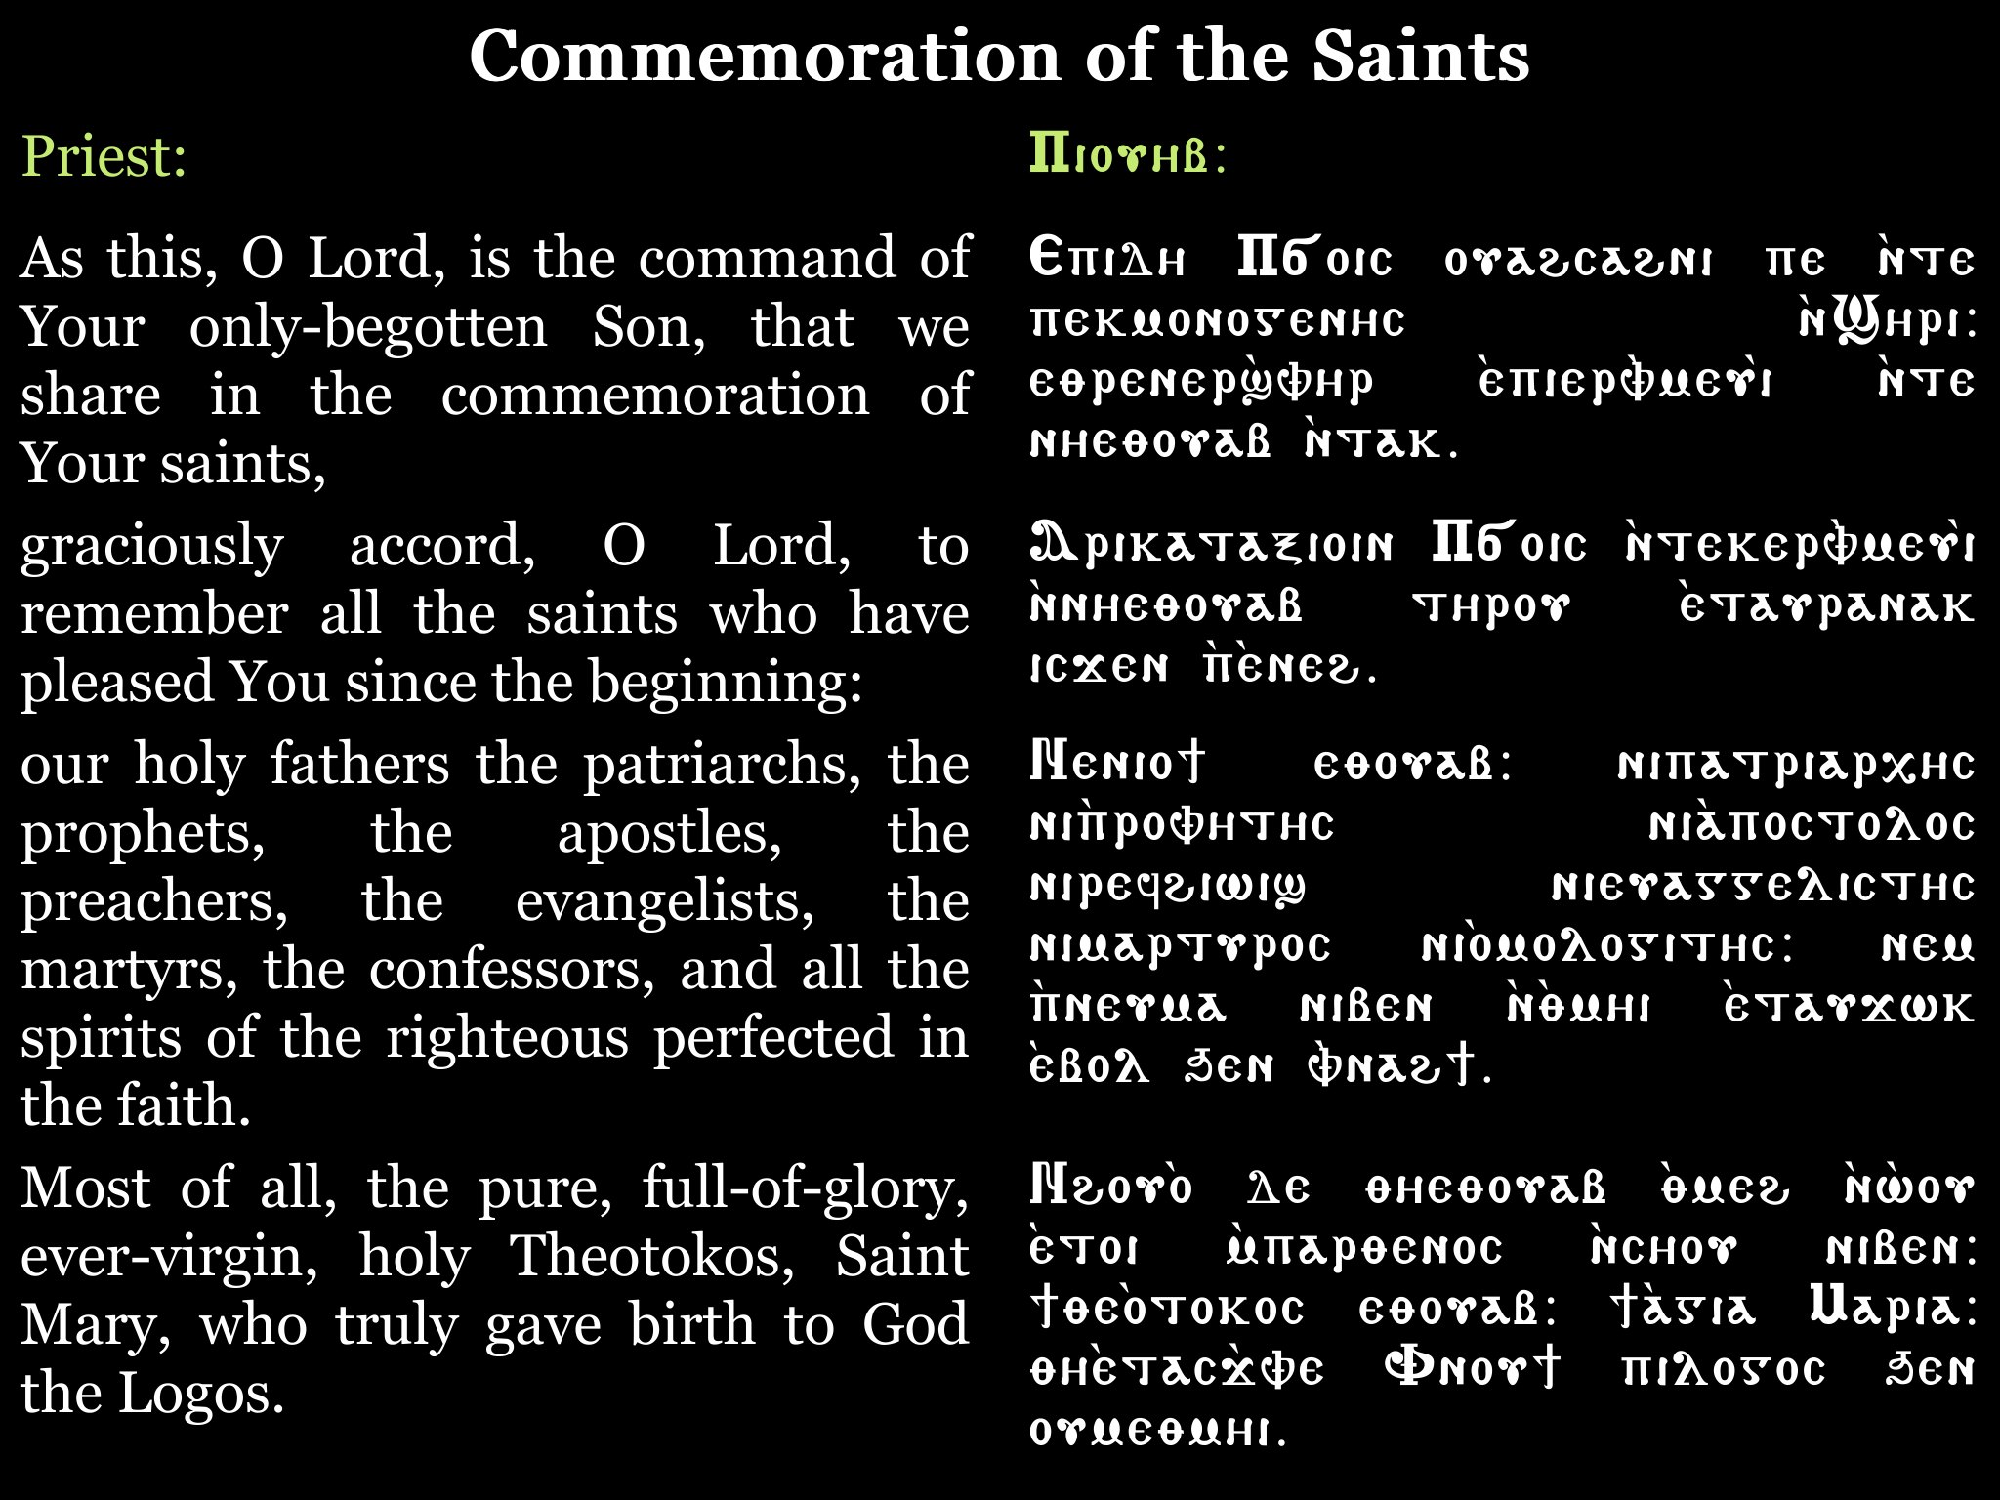
Commemoration of the Saints

Slide 12
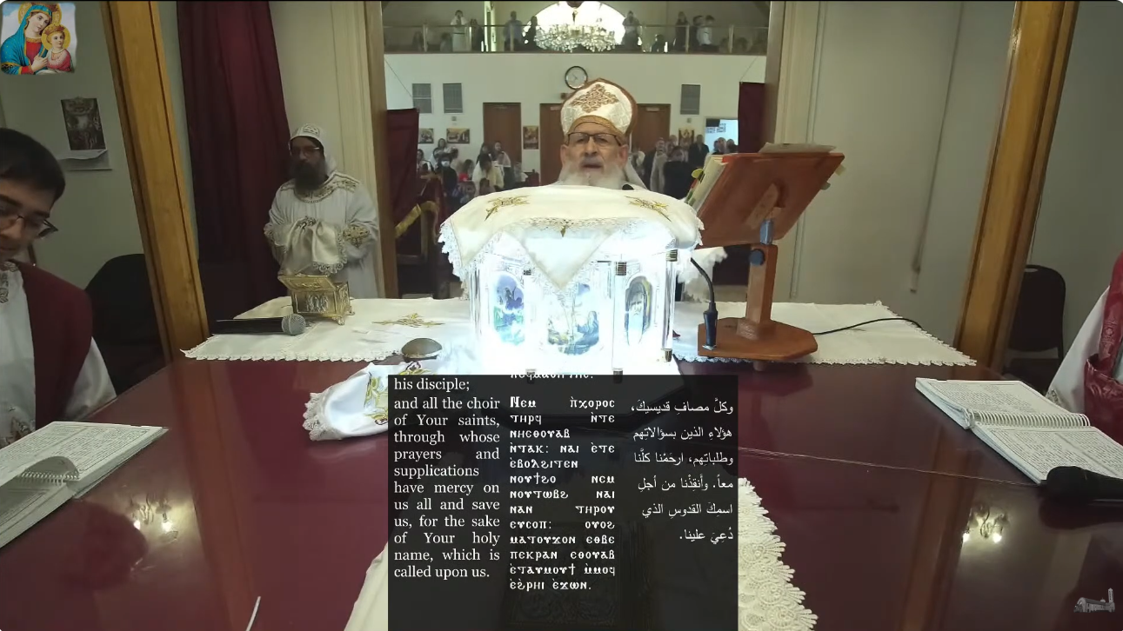
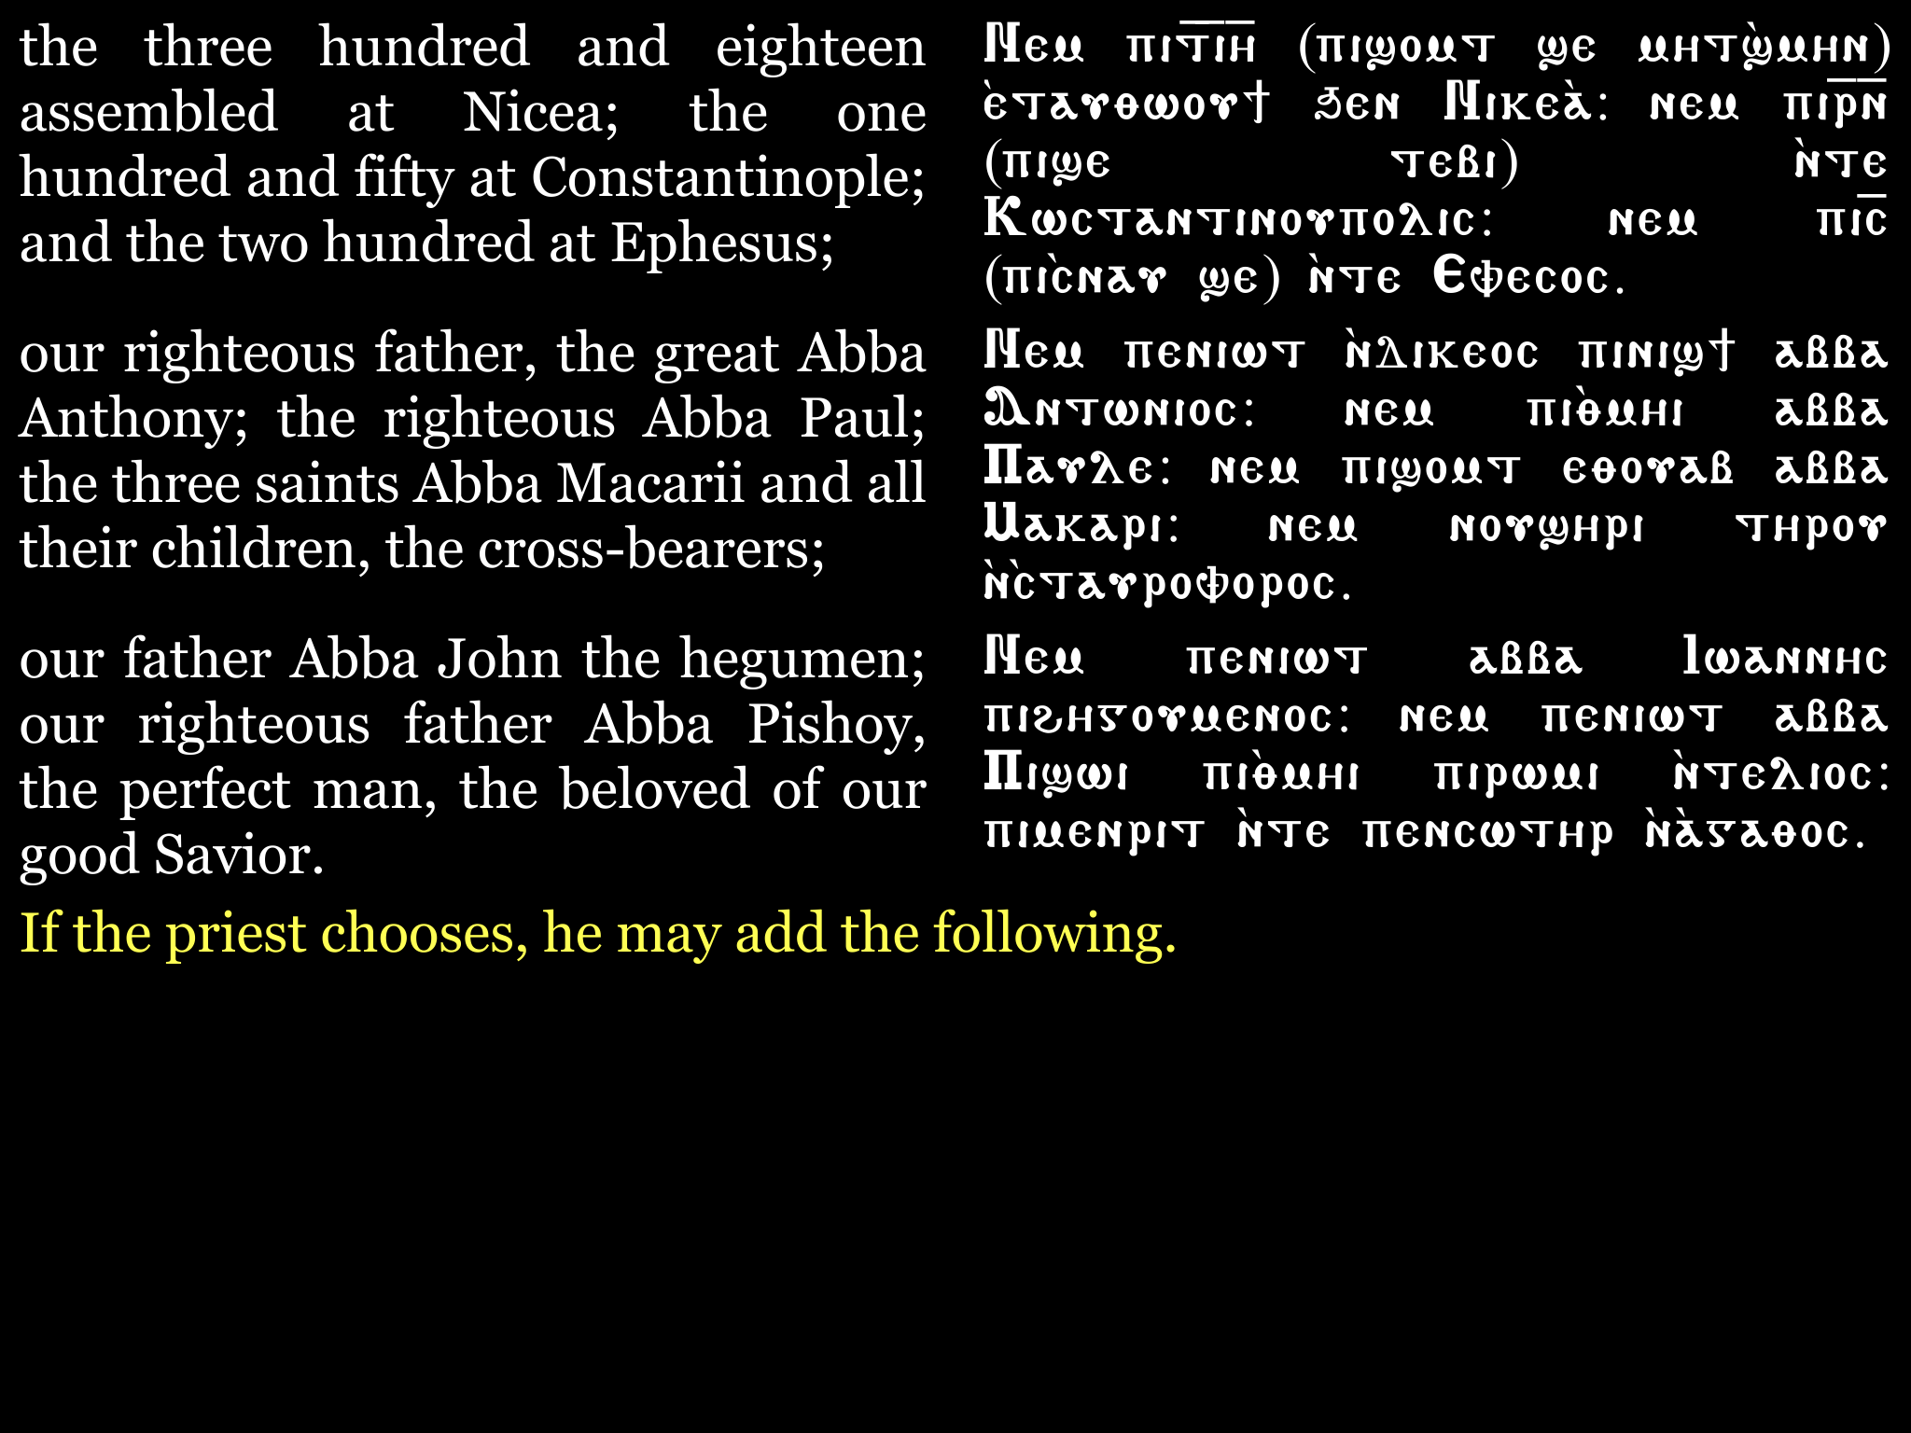
Who are the … 318 assembled at Nicaea, the 150 at Constantinople, and the 200 at Ephesus

Slide 13
Do you know the Synaxarion?
Notes:
Image source:
https://parentinghub.co.za/wp-content/uploads/2018/07/Questioning-Questions.jpg

Slide 14
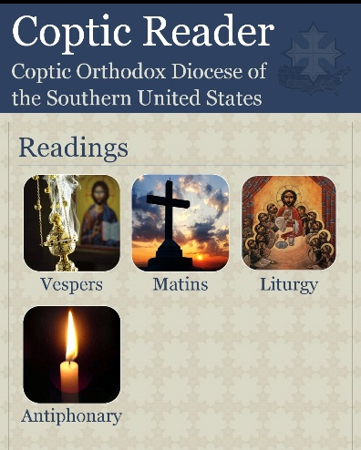
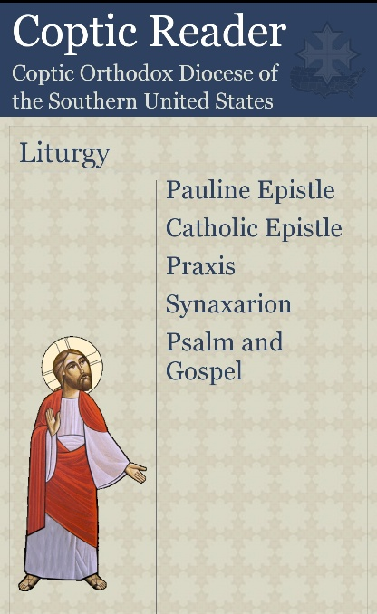
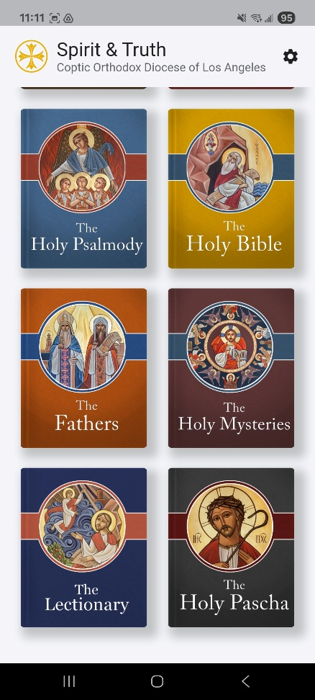
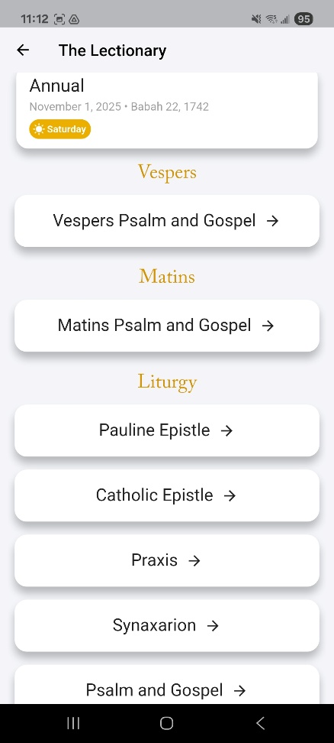

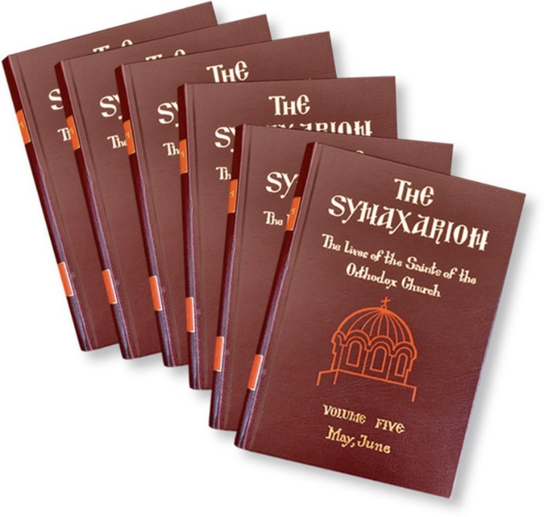






Church History Our Synaxarion continues the Book of Acts!
Coptic Reader
Spirit and Truth
Online Resources:
abanoub.org.au/Synaxarium.html
copticchurch.net/synaxarium/all/en
Notes:
Image source:
https://sebastianpress.org/synaxarion/
https://www.suscopts.org/diocese/apps
https://spiritandtruth.app/

Slide 15

Saint | Timeframe | Titles | Reference
The Virgin Mary | First Christian Century | Holy Theotokos | Tobe 21
John the Baptist | First Christian Century | Forerunner, Baptist, Martyr | Thoout 2
Saint Stephen | First Christian Century | Archdeacon & Protomartyr | Tobe 1
Saint Mark | 12 AD – 68 AD | 1st Patriarch of Alexandria, Holy Apostle & Martyr | Parmoute 30
Severus | Departed 538 AD | Patriarch of Antioch | Meshir 14
Dioscorus | Departed 451 AD | 25th Patriarch of Alexandria | Thoout 7
Athanasius | 296 AD – 373 AD | 20th Patriarch of Alexandria, The Apostolic | Pashons 7
Pope Peter | Departed 311 AD | 17th Patriarch of Alexandria, Holy Seal of the Martyrs | Hathor 29
John Chrysostom | 347 AD – 407 AD | Patriarch of Constantinople | Hathor 17
Theodosius | Departed 567 AD | 33rd Patriarch of Alexandria | Paone 28
Theophilus | Departed 404 AD | 23rd Patriarch of Alexandria | Paope 18
Demetrius | Departed 224 AD | 12th Patriarch of Alexandria | Paope 12
Cyril | 376 AD – 444 AD | 24th Patriarch of Alexandria, Theologian | Epip 3
Basil | 335 AD – 379 AD | The Great, Bishop of Caesarea, of the Cappadocian Fathers | Tobe 6
Gregory | 329 AD – 390 AD | Theologian, Gregory Nazianzen, of the Cappadocian Fathers | Online
Gregory | 330 AD – 396 AD | Bishop of Nyssa, brother of Basil, of the Cappadocians | Tobe 21
Gregory | Departed 270 AD | Wonderworker | Hathor 21
Gregory | 257 AD – 331 AD | Armenian Patriarch | Koiahk 15
318 Fathers | 325 AD | 1st Universal Council at Nicaea | Hathor 9
150 Fathers | 381 AD | 2nd Universal Council at Constantinople | Meshir 1
200 Fathers | 431 AD | 3rd Universal Council at Ephesus | Thoout 12
Notes:
https://www.abanoub.org.au/Synaxarium.html
https://www.copticchurch.net/synaxarium/all/en
https://www.orthodoxonline.org/theology/en/saints-and-fathers/ain-ghain/st-gregory-the-theologian-the-archbishop-of-constantinople/

Slide 16
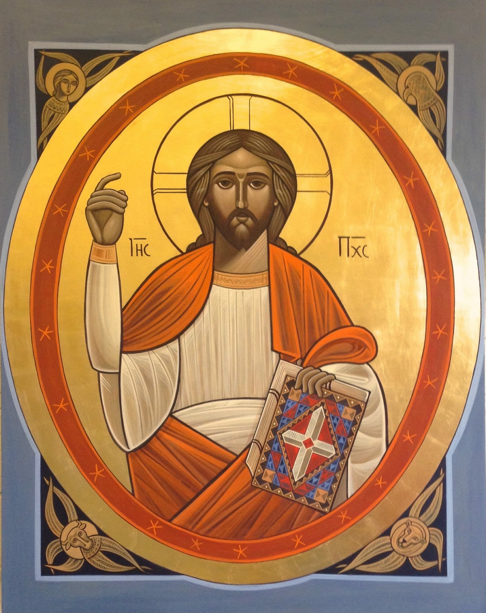
Nicaea
Notes:
Image source:
https://orthodoxartsjournal.org/interview-with-neo-coptic-iconographer-stephane-rene/

Slide 17

Council of Nicaea (325 AD)
Against Heresy of Arianism
Arias, a priest from Alexandria, taught that Christ was created and not eternal with the Father
Arias claimed “there was a time when the Son was not”
This heresy denied Christ's full divinity and our salvation (only God can save us; if Christ is not God, we cannot be saved!)
Heroes of Faith
Pope Alexander of Alexandria: First to confront Arius and defend the faith
Saint Athanasius the Apostolic (his deacon, later Pope): Chief defender of Orthodoxy, exiled five times for the faith
Saint Nicholas of Myra and other bishops who stood firm in the faith
Orthodox Teaching
Christ is “homoousios” (consubstantial, of one essence) with the Father
The Son is eternally begotten, not created
The Nicene Creed was formulated to express this truth
Notes:
Image source:
https://orthodoxartsjournal.org/interview-with-neo-coptic-iconographer-stephane-rene/

Slide 18
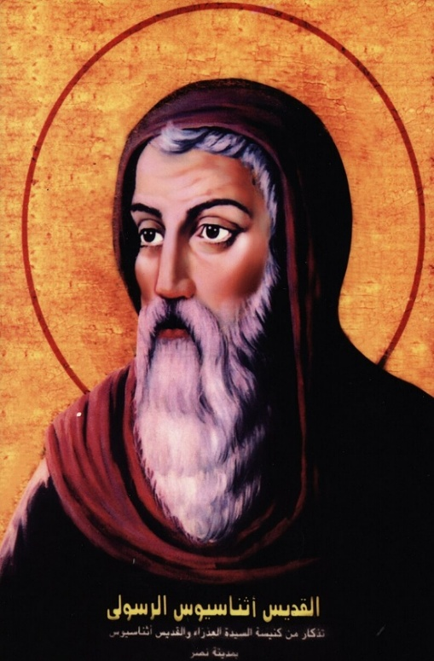
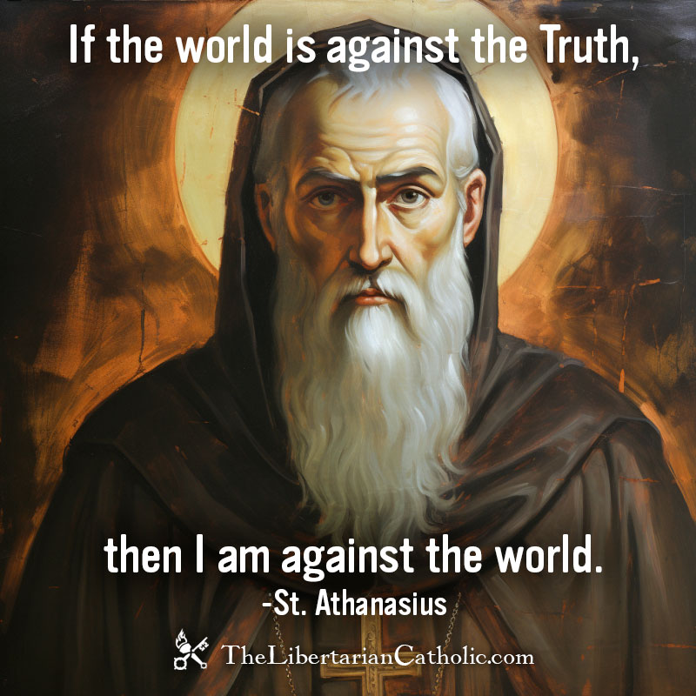
Saint Athanasius the Apostolic
297 Born
312 Reader
318 Deacon & Papal Secretary
325 Went with Pope Alexander to Nicaea
328 Becomes Pope after Pope Alexander
338 Visited by Saint Anthony
373 Reposed in the Lord
46 years as Patriarch
17 years in exile for defending the faith
Famous quote: Athanasius contra mundum
Wrote Biography of Saint Anthony
Champion of the faith at Council of Nicaea
Credited with the Nicene Creed
Notes:
Image source:
https://en.wikipedia.org/wiki/Athanasius_of_Alexandria
https://thelibertariancatholic.com/st-athanasius-if-the-world-is-against-the-truth-then-i-am-against-the-world/

Slide 19
Arius versus Athanasius
Arius
“The Lord possessed me at the beginning of His way” (Proverbs 8:22)
Saint Athanasius .
The Hebrew translation is “The Lord begot Me”
“I have been established from everlasting, from the beginning, before there was ever an earth” (Proverbs 8:23)

Slide 20
Arius versus Athanasius
Arius
“My Father is greater than I” (John 14:28)
Saint Athanasius .
The Son in the flesh is less than the Father as He is carrying the human nature in a mission to redeem the human being, but He is always in the bosom of the Father.
“I am in My Father and My Father is in Me” (John 14:10)

Slide 21
Arius versus Athanasius
Arius
“All authority has been given to Me in heaven and on earth” (Matthew 28:18)
Saint Athanasius .
The Son, as He is born from the Father before all ages, has gained all authority because He told His disciples, “Go and baptize in the name of the Father, and of the Son, and of the Holy Spirit” (Matthew 28:19)

Slide 22
Arius versus Athanasius
Arius
“But of that day and hour, no one knows, not even the angels of heaven, but My Father only” (Matthew 24:36)
Saint Athanasius .
Our Lord said this as He was in the flesh, the Son of Man. However, Saint Peter said to Him, “Lord, you know all things” (John 21:17)

Slide 23
Arius versus Athanasius
Arius
“I do not seek My own will but the will of the Father who sent Me” (John 5:30)
Saint Athanasius .
“He who has seen Me has seen My Father” (John 14:9)
“I am in My Father and My Father is in Me” (John 14:10)

Slide 24
Statement of Anathema
“As for them who say concerning the Son of God,
there was a time when He was not,
OR He was not before He was produced,
OR He was produced from things that are not,
OR He is of another substance or essence, or created, or subject to conversion or mutation,
the Universal Apostolic Church says let them be anathema”
Notes:
Reference:
https://www.papalencyclicals.net/councils

Slide 25
In Nicaea …
Truly we believe in one God, God the Father, the Pantocrator, Creator of heaven and earth, and all things seen and unseen.
We believe in one Lord, Jesus Christ, the only-begotten Son of God, begotten of the Father before all ages.
Light of Light, true God of true God; begotten, not created; of one essence with the Father; by whom all things were made.
Who for us men and for our salvation came down from heaven, was incarnate of the Holy Spirit and of the Virgin Mary, and became man.
And He was crucified for us under Pontius Pilate, suffered and was buried, and on the third day He rose from the dead according to the Scriptures.
Ascended into the heavens; He sits at the right hand of His Father,
and He is coming again in His glory to judge the living and the dead, whose kingdom shall have no end.

Slide 26
In Nicaea …
We believe in God, the Father.
Truly we believe in one God, God the Father, the Pantocrator, Creator of heaven and earth, and all things seen and unseen.
We believe in one Lord, Jesus Christ, the only-begotten Son of God, begotten of the Father before all ages.
Light of Light, true God of true God; begotten, not created; of one essence with the Father; by whom all things were made.
Who for us men and for our salvation came down from heaven, was incarnate of the Holy Spirit and of the Virgin Mary, and became man.
And He was crucified for us under Pontius Pilate, suffered and was buried, and on the third day He rose from the dead according to the Scriptures.
Ascended into the heavens; He sits at the right hand of His Father,
and He is coming again in His glory to judge the living and the dead, whose kingdom shall have no end.
We believe in Jesus Christ our God, the Son.
Christ’s work for our Salvation (His First Coming is to Save) Incarnation, Crucifixion, Resurrection, Ascension
Christ is coming again (His Second Coming is to Judge)

Slide 27
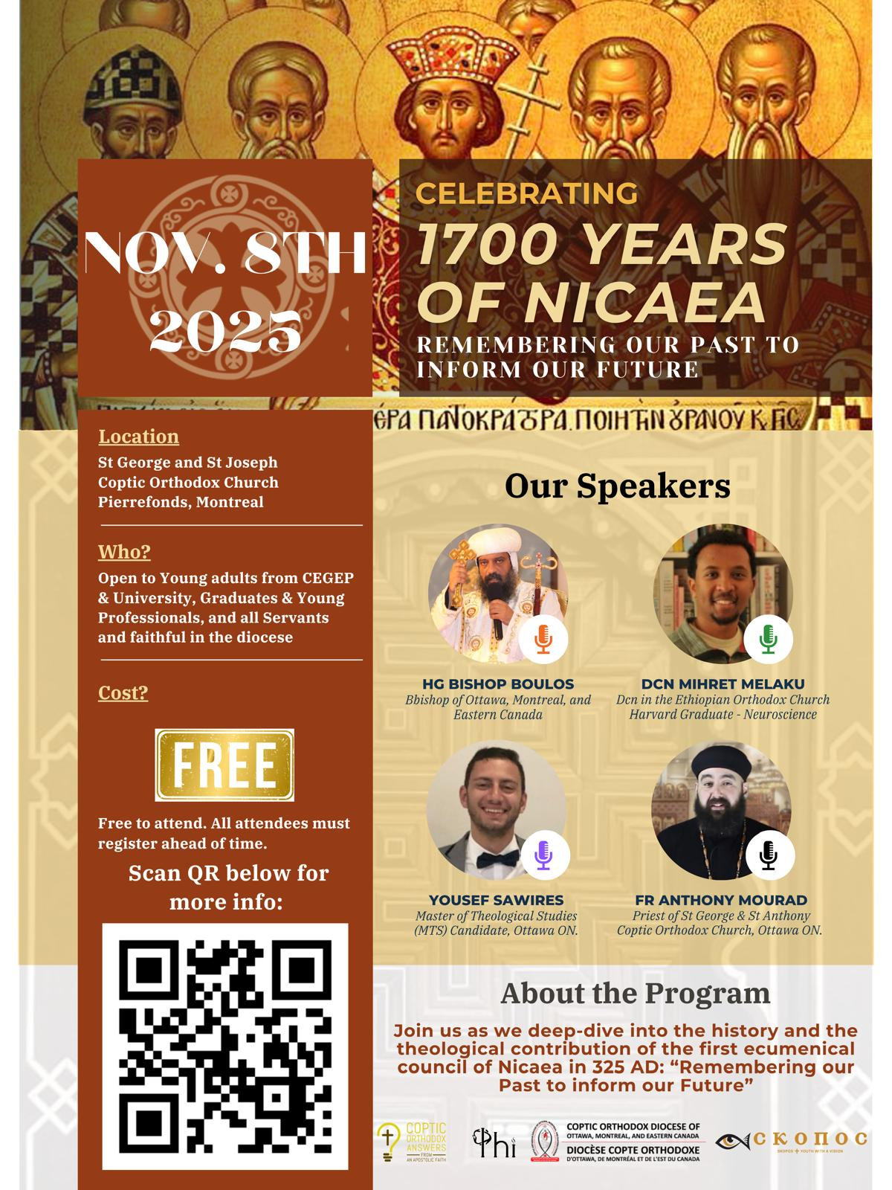
1700 Year Anniversary!
( from 325 to 2025 )
Truly we believe in one God, God the Father, the Pantocrator, Creator of heaven and earth, and all things seen and unseen.
We believe in one Lord, Jesus Christ, the only-begotten Son of God, begotten of the Father before all ages. Light of Light, true God of true God; begotten, not created; of one essence with the Father; by whom all things were made.
Who for us men and for our salvation came down from heaven, was incarnate of the Holy Spirit and of the Virgin Mary, and became man.
And He was crucified for us under Pontius Pilate, suffered and was buried, and on the third day He rose from the dead according to the Scriptures. Ascended into the heavens; He sits at the right hand of His Father, and He is coming again in His glory to judge the living and the dead, whose kingdom shall have no end.
stgeorgestjoseph.ca
St George & St Joseph, Montréal
unityapp.ca/e/27663 registration for Nov 8, 2025 celebration

Slide 28
Constantinople
Notes:
Image source:
https://awf.world/theology-and-history/person-and-work-of-the-holy-spirit/

Slide 29
Council of Constantinople (381 AD)
Heresy of Macedonius
Macedonius denied the divinity of the Holy Spirit
Heroes of Faith
Pope Timothy of Alexandria
Gregory the Theologian (Gregory Nazianzen)
Gregory of Nyssa (brother of Saint Basil the Great)
Orthodox Teaching
The Holy Spirit is “the Lord, the Giver of Life, who proceeds from the Father”
The Spirit is worshipped and glorified together with the Father and the Son.
Completion of the Nicene-Constantinopolitan Creed that we pray today.
Notes:
Image source:
https://awf.world/theology-and-history/person-and-work-of-the-holy-spirit/

Slide 30
Completion of the Creed in Constantinople …
Yes, we believe in the Holy Spirit, the Lord, the Giver of Life, Who proceeds from the Father, who with the Father and the Son, is worshipped and glorified, who spoke by the prophets.
And in one holy, catholic (universal), and apostolic Church.
We confess one baptism, for the remission of sins.
We look for the resurrection of the dead,
and the life of the age to come. Amen.

Slide 31
In Constantinople …
We believe in God, the Holy Spirit.
Yes, we believe in the Holy Spirit, the Lord, the Giver of Life, Who proceeds from the Father, who with the Father and the Son, is worshipped and glorified, who spoke by the prophets.
And in one holy, catholic (universal), and apostolic Church.
We confess one baptism, for the remission of sins.
We look for the resurrection of the dead,
and the life of the age to come. Amen.
We believe in the Holy Church.

Slide 32
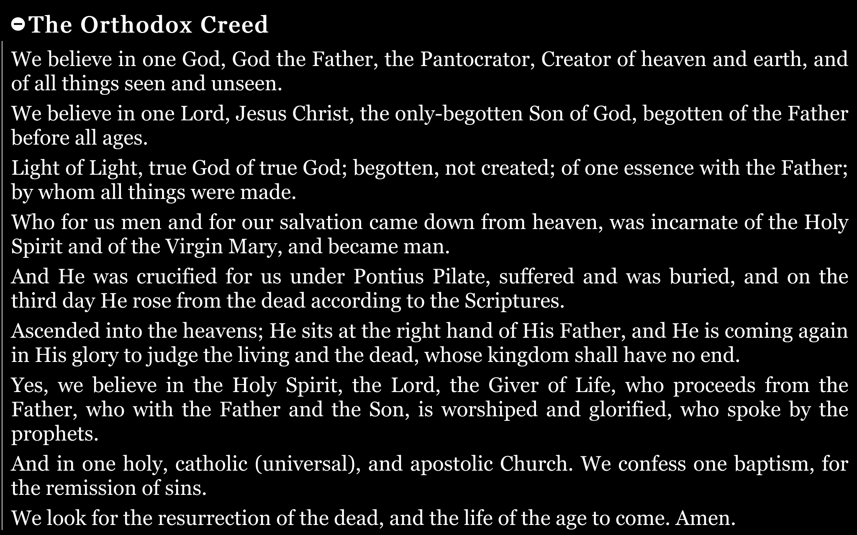

Slide 33
Ephesus
Theotokos Θεοτόκος
Notes:
Image source:
https://awf.world/theology-and-history/person-and-work-of-the-holy-spirit/

Slide 34
Council of Ephesus (431 AD)
Heresy of Nestorianism
Nestorius, Patriarch of Constantinople, refused to call Saint Mary “Theotokos” (Mother of God)
He preferred to only use the term, “Christotokos” (Mother of Christ)
Taught Christ was two separate persons (divine and human) loosely joined
This divided Christ's unity and threatened our salvation
Hero of Faith
Saint Cyril, Pope of Alexandria
The pillar of faith who defended Christology
Wrote letters and treatises explaining the Hypostatic Union
Led the council with wisdom and firmness
Orthodox Teaching
Christ is one Person with two complete natures (divine and human) united without confusion
The Virgin Saint Mary is truly the “Theotokos” because she gave birth to Christ who is God incarnate
The Hypostatic Union: one nature of God the Word Incarnate
Notes:
Image source:
https://awf.world/theology-and-history/person-and-work-of-the-holy-spirit/

Slide 35
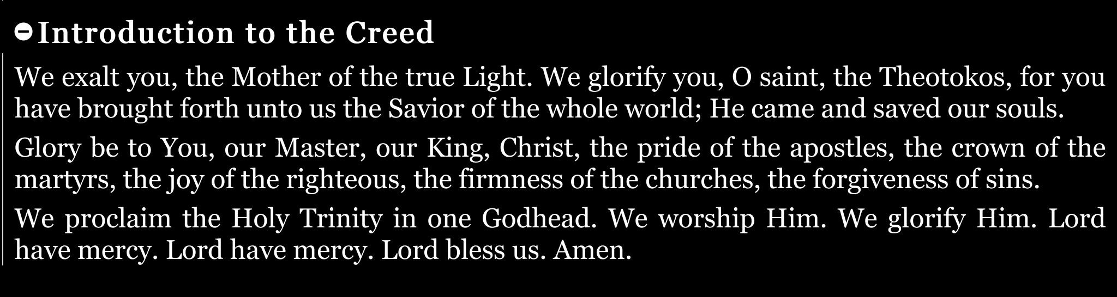

Slide 36
Church Councils

Slide 37
Council | Date | Why? To defend against a heresy? | Reference
Jerusalem | 49 AD | Against the Judaizers Heresy (see Acts chapter 15) | Acts 15:1-24
In Rome | Around 200 AD | Not because of heresies. To establish the Feast of Theophany and Lend | Hathor 10
In Alexandria | 243 AD | Against a Heresy that claimed that the human spirit dies with the body, and it (the spirit) rises again with the body. | Thoout 3
In Rome | 249 AD | Against Novatus who said that those who deny Christ cannot be forgiven even if they repent! | Koiahk 12
In Antioch | 280 AD | Against Paul of Samosata who claimed that Christ was an ordinary man | Paope 19
Nicaea (1st Ecumenical) | 325 AD | 318 assembled to protect against the Heresy of Arias who blasphemed against the Son of God. | Hathor 9
Constantinople (2nd Ecumenical) | 381 AD | 150 assembled to judge Macedonius (heresy against the Holy Spirt) and Apollinaris (heresy against the Holy Trinity). | Meshir 1
Ephesus (3rd Ecumenical) | 431 AD | 200 assembled to protect against the Heresy of Nestorius who refused to refer to Saint Mary as the Theotokos (Mother of God). | Thoout 12

Slide 38
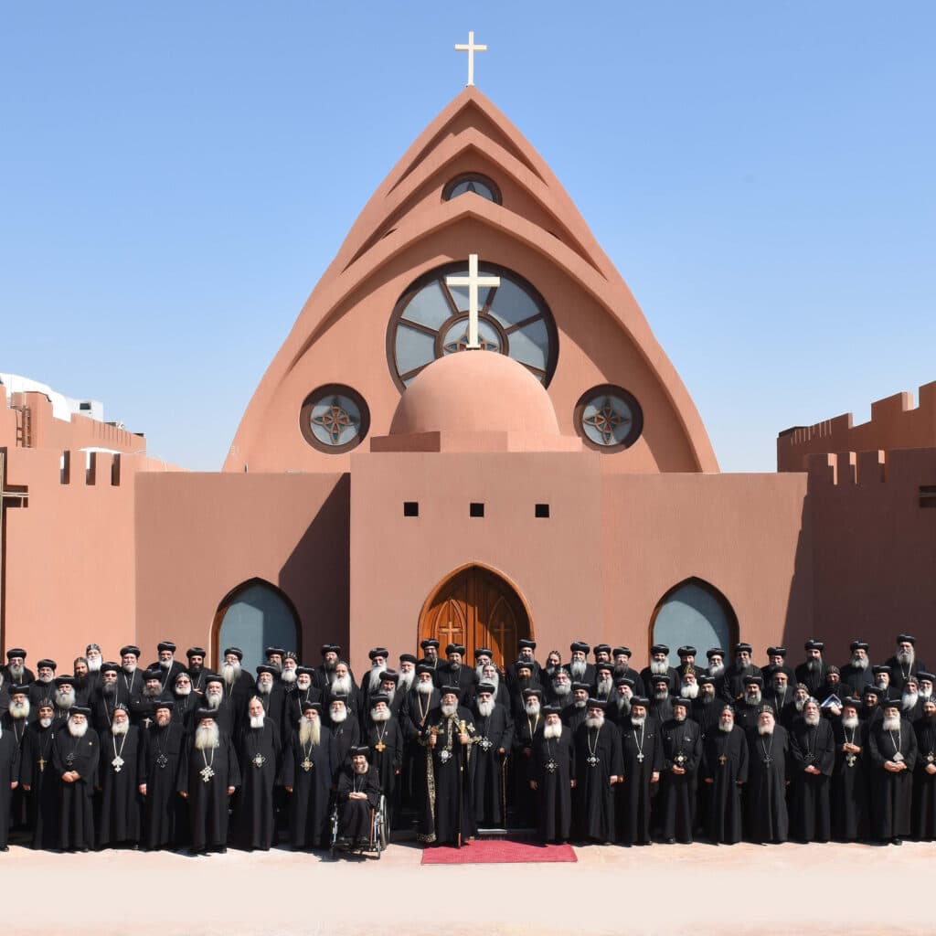
The Coptic Holy Synod

Slide 39
The Coptic Holy Synod
copticorthodox.church/en/holysynod
Notes:
Image source:
https://copticorthodox.church/wp-content/uploads/2020/11/Holy-Synod-1024x1024.jpg

Slide 40
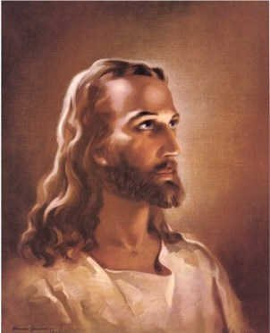
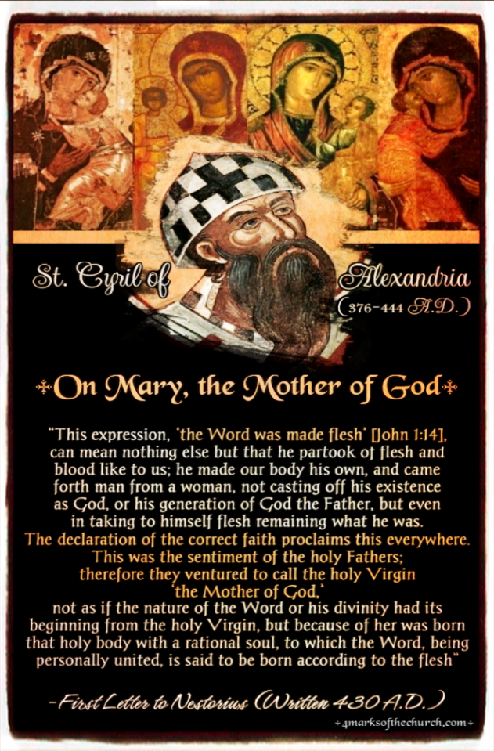
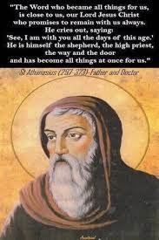
Concluding Thoughts
Notes:
Image source:
https://catholic.fandom.com/wiki/Jesus_Christ
https://4marksofthechurch.com/cyril-of-alexandria/
https://encrypted-tbn0.gstatic.com/images?q=tbn:ANd9GcR676epn3JvujL2Emrd9zDDlI3ZF_Eg1g7JEIFUIA3gw2zyslQUa7vU9kpJbMmPiRRBRPA&usqp=CAU

Slide 41
Concluding Thoughts Nicaea, Constantinople, Ephesus
The 3 councils show the Church as a guardian of faith
Through these critical moments of Christian History, the Coptic Church stood as a pillar of Orthodoxy
We have a role to continue to be guardians of faith
Our Church is rich in history & tradition
We are the Church, the Body of Christ
We must know our faith to defend it and teach it to the next generation
Our faith heroes suffered for truth; we value what they preserved for us
The same faith they defended is what we confess every Liturgy in the Creed
Notes:
Image source:
https://catholic.fandom.com/wiki/Jesus_Christ
Teaching Tips
Use the Creed as a connecting thread throughout the lesson
Emphasize that doctrine isn’t abstract but affects our salvation
Share stories of Saint Athanasius’s perseverance and Saint Cyril’s courage to inspire us
Consider bringing icons of these saints to make the saints more present
Remember that as future servants, they are inheritors and protectors of this apostolic faith

Slide 42
Thank you!
Questions or Comments?
Notes:
Image source:
https://parentinghub.co.za/wp-content/uploads/2018/07/Questioning-Questions.jpg

