Slide 1
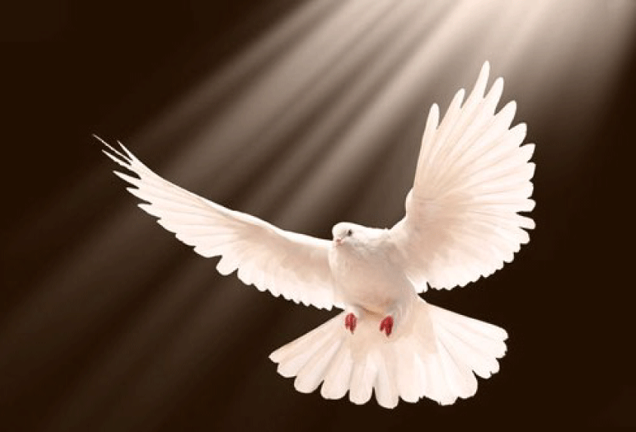
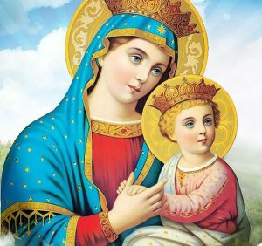
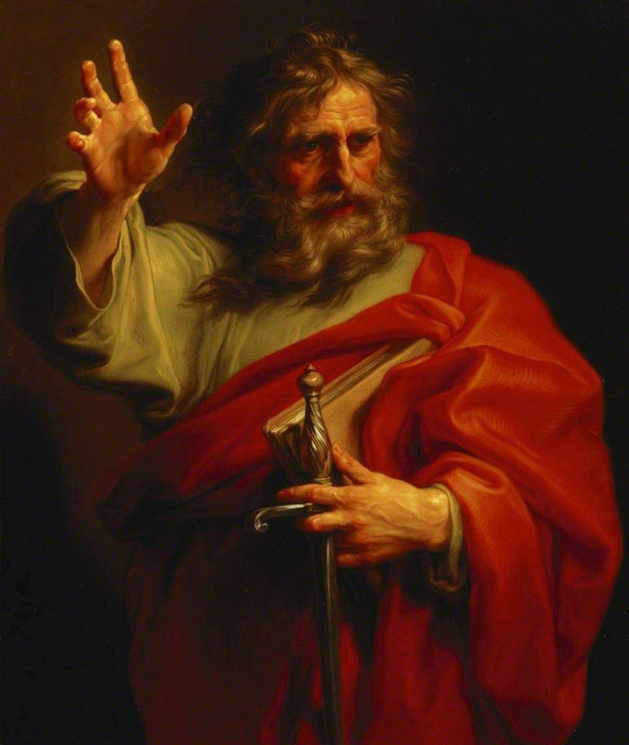
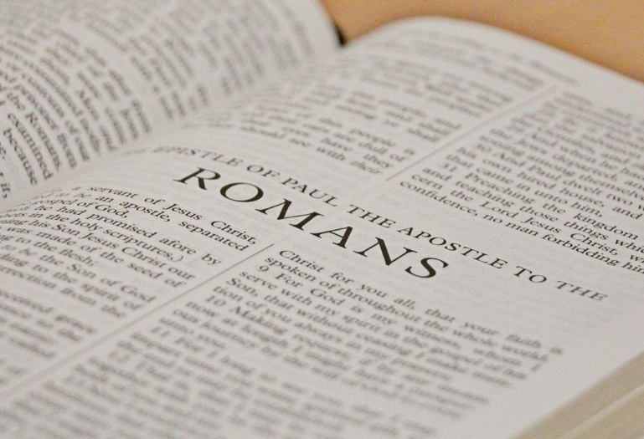
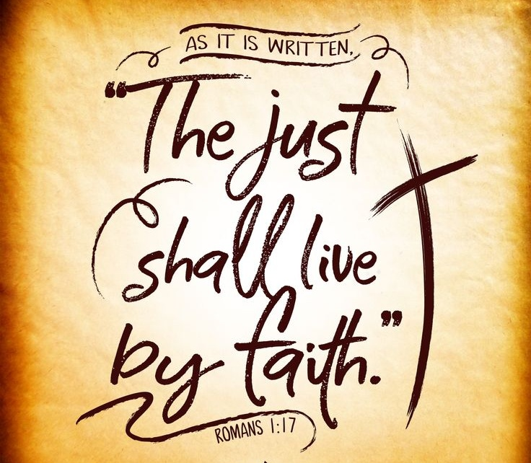
Romans Bible Study
2026-01-16
audio.stmary-ottawa.org/sermons/2026/SMO-2026-01-16-Romans.pdf
Notes:
Image source:
https://virginmarymtl.org/title-of-holy-theotokos-saint-mary/
https://imageproxy.youversionapi.com/https://s3.amazonaws.com/yvplans/25574/1280x720.jpg
https://medium.com/artisanal-article-machine/st-paul-the-giant-who-called-himself-the-least-of-the-apostles-2805e185bd71
https://ca.pinterest.com/pin/2744449760350028/
https://awf.world/theology-and-history/person-and-work-of-the-holy-spirit/

Slide 2
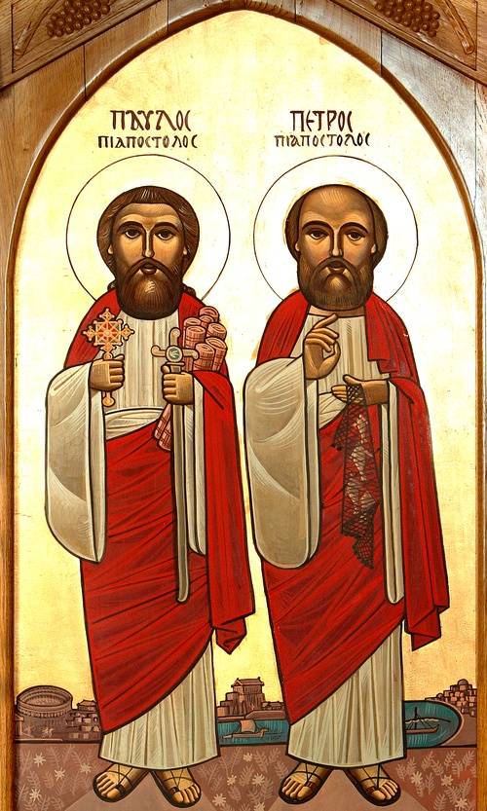
The Apostles Peter & Paul
Role Models of Faith
Exemplify faith, love, determination & passion.
Overcoming Challenges
Inspire us to remain steadfast in Christ amidst difficulties.
Our Mission
Be faithful witnesses, and bring others to Christ, continuing the work to make disciples of all nations.
Notes:
Image source:
https://www.peterpaulcoc.org/icons

Slide 3
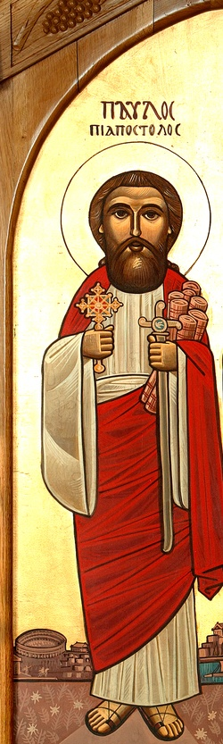
Saint Paul’s Transformation from Persecutor to Preacher
Began as a zealous Pharisee and persecutor of Christians.
The Damascus Road Conversion
“Then he fell to the ground and heard a voice saying to him, 'Saul, Saul, why are you persecuting Me?’”
Acts 9:4
A new calling (Saul becomes Paul): becomes a passionate defender & preacher of the faith,
taking extensive missionary journeys
and authoring numerous epistles, rich with theological wisdom.
Notes:
Image source:
https://www.peterpaulcoc.org/icons

Slide 4
Saint Paul’s 14 Epistles & Three Missionary Journeys
Year | Major Events | Acts | Period | 14 Epistles
34 AD | Conversion, Damascus, Arabia | 9 | 3 years in Arabia
37 | Jerusalem, Tarsus, Syria, Cilicia
46-47 | Antioch, Jerusalem | 11 | 1 year in Antioch
48-49 | First Missionary Trip and Antioch | 13-14 |  | Galatians
50 | Jerusalem Council and Antioch | 15
51-53 | Second Missionary Trip | 16-18 | 18 months in Corinth | 1 & 2 Thessalonians
53-54 | Antioch
54-57 | Third Missionary Trip | 19-21 | 3 years in Ephesus | 1 & 2 Corinthians Romans
57 | Jerusalem Arrest | 22-23
57-59 | Caesarea Prisoner | 24-26 | 2 years
59-60 | Journey to Rome | 27-28
60-67 | Rome House Arrest and subsequent Martyrdom | 28 | 5-8 years | Ephesians Philippians Colossians Philemon Hebrews Titus 1 & 2 Timothy
Notes:
Reference:
https://www.conformingtojesus.com/charts-maps/en/paul%27s_letters-journeys_chart.htm

Slide 5
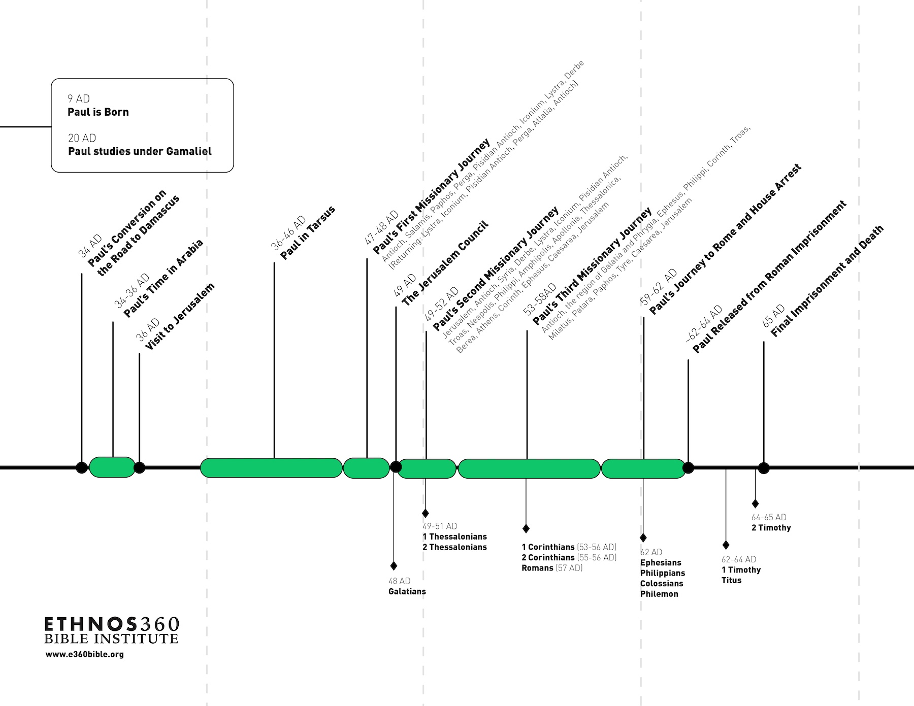
Notes:
Image source:
https://e360bible.org/blog/timeline-of-pauls-life-and-missionary-journeys/

Slide 6
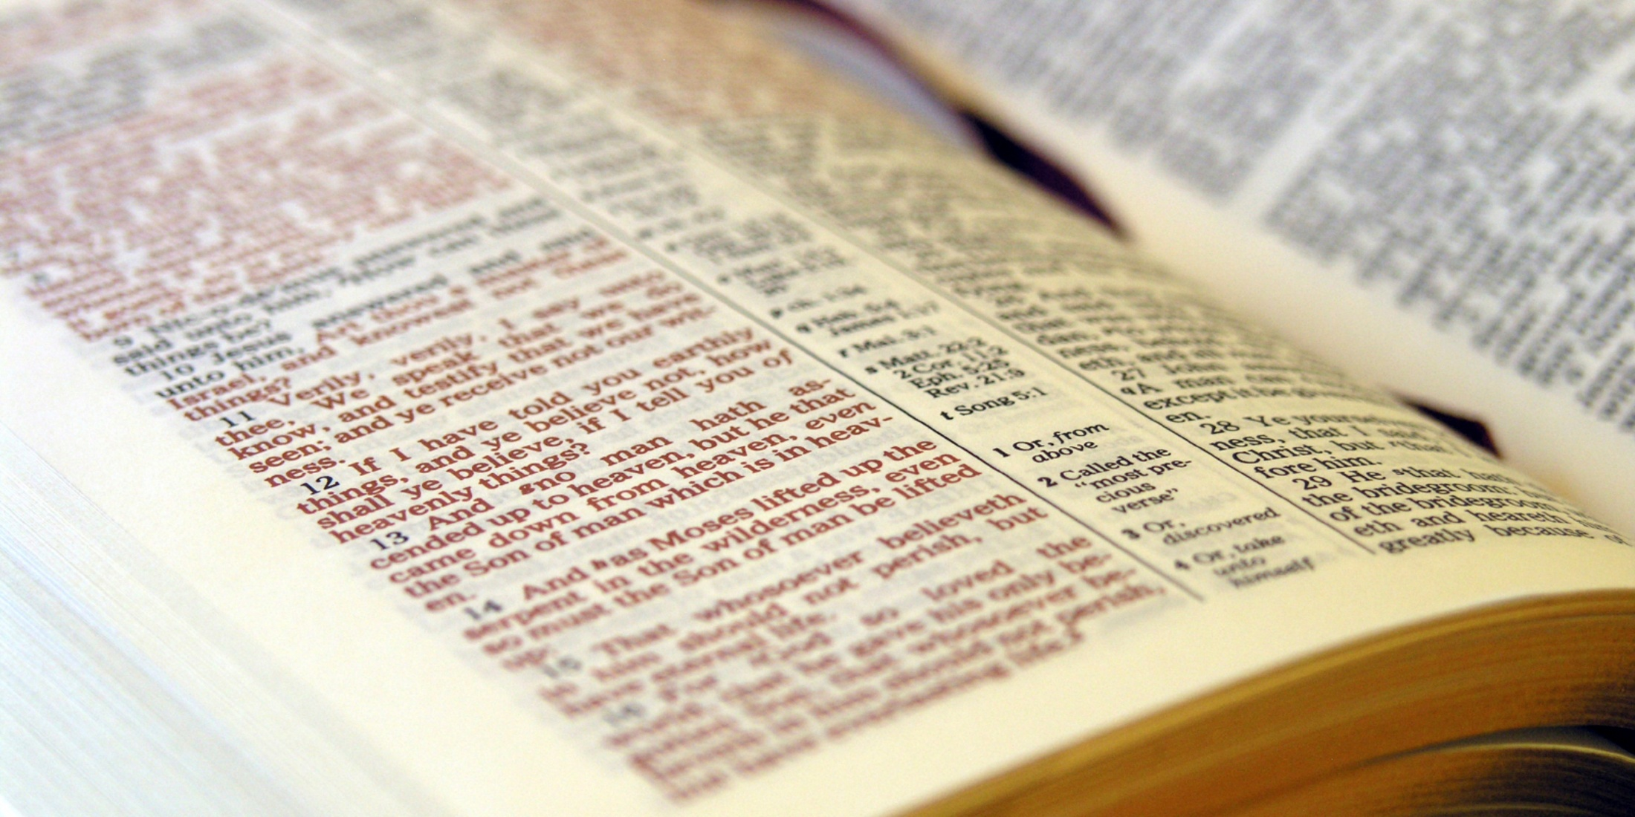
Let’s interview Saint Paul!
Notes:
Image source:
https://www.pinecove.com/blog/the-bible-tells-me-so/

Slide 7
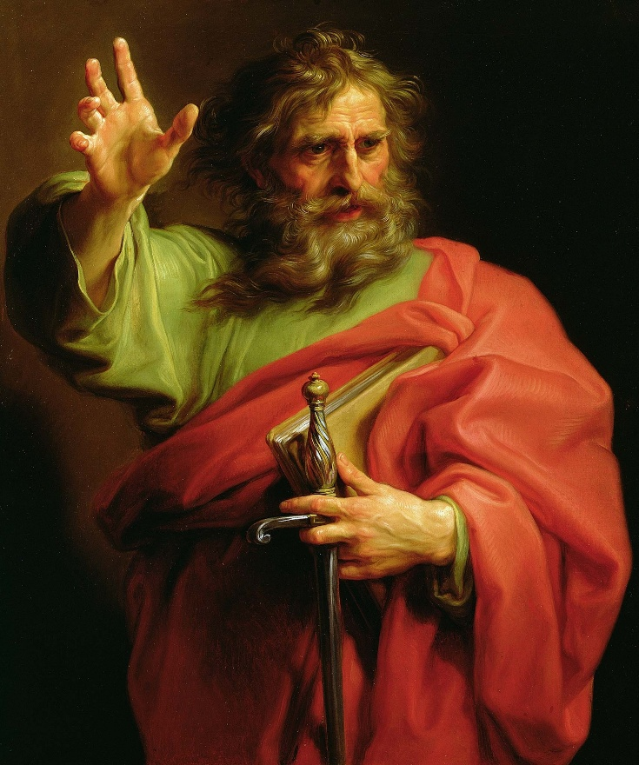
Please tell us a little about yourself and how your life started …
My story is an unusual one.
I was brought up in a strict Jewish household.
My family was wealthy; my dad was able to buy his way to get us Roman citizenship.
We weren’t living in Jerusalem; we lived in a prosperous city called Tarsus.
We were businessmen, and had a tent-making business.
Notes:
Image source:
https://www.nationalgeographic.com/history/history-magazine/article/early-christianity-paul-apostle-bible

Slide 8
Did you live a holy life and know the Scripture?
From a young age, I loved to read, and memorized much scripture.
My dad encouraged me to read and study most of the Torah, the Law of Moses.
I practically memorized the Book of Deuteronomy.
I memorized most of the Psalms of David.
We would regularly travel to Jerusalem to Feast with the Jews.
News started to spread while I was a youth about Jesus of Nazareth.
I would see the Pharisees (by the way, my dad wanted me to become a Pharisee like him) … I would see them get very upset and hear them saying that Jesus is against Moses.
Now I am a huge fan of Moses!
Anyone who dares say anything against Moses, I’d rip him apart!
So I started hating Jesus, simply because they’d convinced me that this Jesus is against Moses.
And that he’s here to destroy the principles that we’d received from our fathers.
By the way, I was quite strict by nature, an extremist.
I was eventually promoted to the rank of Pharisee; I was thrilled to receive this title!
Because, amongst my friends, I was always number one …
The one who memorized the most; the most strict; the most responsible; nobody could find a fault against me. I would NEVER break the Sabbath, or take too many steps on the Sabbath.
Everyone admired me, and I was happy that way, that I was number one!

Slide 9
Did you receive a religious education?
You may have heard of Gamaliel, a famous religious teacher.
My dad spent much to have me sent to study under him, to learn at the feet of Gamaliel, learning the fundamentals from the most important Rabbi at the time.
I was very attached to Gamaliel.
One time, Gamaliel winked at me, and said, “looks like you will become Gamaliel 2.0!”
This comment touched me, and I set my sight, my dream, to become the Gamaliel of the future.
I wanted to be like him … he was committed, bright, beloved by everyone, well versed, and at the same time very persuasive.
But he wasn’t like the rest of the Pharisees who were very severe extremists. He was committed but not always to the letter of the law. He began to instill in me a little bit of flexibility.
But, of course, when it came to Jesus of Nazareth, no flexibility … I hated this name.

Slide 10
Did you also study Greek?
During that time, my dad sent me to study in Athens.
I studied the Greek language, culture, philosophy …
I studied there, but always considered those people to be heathen infidels!
In fact, I would feel “unclean” there, as I was living amongst unclean defiled people.
So, I learned from them, but didn’t like them.
I hated them, and couldn’t wait to return to live among my people.
Every time I returned to Jerusalem, I would go through the rite of purification, so that I could enter the temple once more, because I had lived among the Gentiles.
I couldn’t wait to finish my education, and came home.
When I’d come back home, everyone would rave about how well-versed I’d become in Greek.
I could speak Greek better than the Jews. But in any case, I didn’t like speaking Greek, and preferred Aramaic because I am Jewish, a Hebrew, of the tribe of Benjamin, a Pharisee, the son of a Pharisee.

Slide 11
Did you hear more about Jesus of Nazareth?
I heard, as everyone did, that we were finally rid of Jesus, he was crucified; and I thanked God!
Then news started spreading that he was risen from the dead … of course, his followers were claiming this, but they had probably stolen his body.
The Jewish leaders then put a bounty on the followers of Jesus, to arrest them.
I came forward to the Jewish elders (and they knew me quite well) and told them to leave it to me to capture these slippery fish.
At that time, something happened that I’ll never forget …

Slide 12
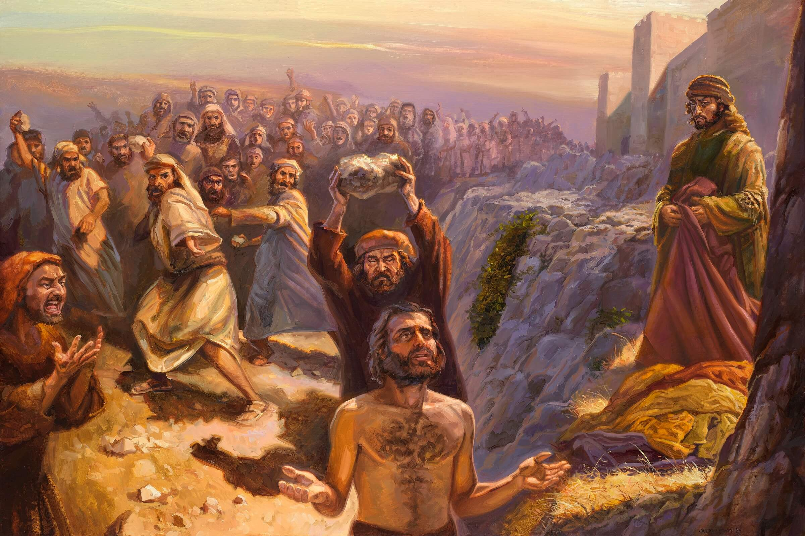
“Lord, do not charge them with this sin.”
Notes:
Image source:
https://www.gospelimages.com/paintings/138/the-stoning-of-stephen?

Slide 13
What’s that, do you want to share with us?
There was someone named Stephen that I knew from long ago …
Stephen was a fellow disciple of mine under Gamaliel for a period of time.
I remember he had a special personality: full of kindness, politeness, and simplicity.
Stephen had a unique personality.
But then I learned that he was a follower of Jesus of Nazareth!
I couldn’t believe my ears, that this brilliant Jewish man would do such a thing.
I attended the council where they judged him, and honestly, he said some very rude things!
He told the Jewish council members that they were uncircumcised of ears and heart!
He said that, throughout history, they have resisted the Holy Spirit!
And, just like you murdered the prophets, you murdered the Christ.

Slide 14
How did you feel when you heard all that?
Of course, I wanted to destroy Stephen!
Because he dared to call their Jesus as the Christ! What does Jesus have to do with Christ?
I was extremely upset at him … anyways, they did what was needed.
They dragged him out, and stoned him.
I was watching all this, and it seems they found it tough for me to throw the stones … I don’t know why I didn’t join in, though for sure I was happy to see him die.
The men would take their clothes off at my feet, because I was agreeing to his death.
They’d look to me for my consent, and I would encourage them to throw stones.
It was a strange scene. Stephen was severely wounded, bleeding everywhere.
But I heard say that he saw heaven open.
There were those around me who commented about how bright his face appeared.
What nonsense! I shouted at them, brightness, what brightness? He’s a blasphemer, he’s evil.
And the last thing he said was, “do not count this sin against them.”
I was furious, saying to him, “you are the sinner, idiot!”
Yet I was still amazed, how one, in their dying moments, be asking God for mercy for his killers?
We don’t have such a law in our Torah. It was very strange.
And he was accepting to die such a horrific death.
Of course, nobody could’ve saved him from our hands.

Slide 15
What happened after that?
I was given official commendation letters from the Jews to seek and capture followers of Jesus.
I found out that many of them were running away. Everyone was scared after we killed Stephen.
People were scattering, travelling to many other nations.
Some went on the difficult journey, far away to Damascus.
I decided that I would go catch them, imprison them …
Some may die, so be it; others might smarten up, deny Jesus, and return to Judaism.
By the way, I was accompanied by temple guards, and had official letters of commendation.
I was given this great responsibility to lead. I was still in my twenties, and proud of myself.
To be nominated for this task, having the trust of the high priest.
I was glad to do this and wasn’t seeking any glory …
I simply hated anyone who opposed Moses.
This Jesus is against Moses, so we have to be rid of him, and of his children and followers.

Slide 16
Did something happen on the way to Damascus?
Suddenly, on our way, I saw a bright flash of light like lightning; and I fell off my horse.
I heard a voice saying to me, “Saul, Saul, why are you persecuting me?” Stop kicking!
I understood from his words that I was wounding, hurting myself, resisting God’s voice.
Those with me were hearing me talking to someone, …
But I was seeing something that they didn’t see.
I was seeing the light, and seeing the One speaking with me.

Slide 17
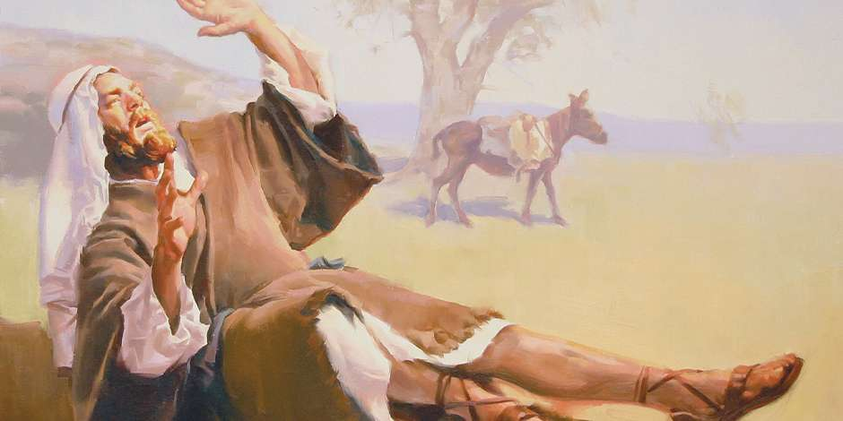
“Saul, Saul, why are you persecuting me?”
Notes:
Image source:
https://www.ldsdaily.com/personal-lds-blog/3-powerful-lessons-from-the-road-to-damascus/

Slide 18
Wow, so what did you do?
I asked Him, “Who are you?”
He replied, “I am Jesus,” the Jesus that you hate, “the one that you are persecuting.”
Enough already, “it is difficult for you to kick against the goads!”
I know that when the light appears, and there’s such an amazing, glorious vision, …
This is like what happened with Moses!
Also with Isaac, Jacob, and Abraham, and Solomon.
I was terrified, shocked. I was expecting to fall dead.
As Jews, we believe that if one were to see the glorious light of God, they would surely die.
But I didn’t die!
And I felt a huge weight of guilt that I can’t describe.
This Jesus turned out to be Yahweh!
Because he says, “I am He, Jesus” or “I AM Yahweh who is Jesus.”
So I had been wrong all along!
I discovered that I had it all wrong. And that all that the Jews had told me was wrong.
And that Jesus is truly God! And that Stephen was right.
And that I’m finished!
All this ran through my mind in mere minutes, while I’m terrified to death.
Because I felt that I should surely die.

Slide 19
Wow!
I asked Him, “Lord, what do you want me to do?”
I was expecting Him to tell me to return and tell the Jews that you saw Me.
But He told me to enter Damascus, continue your journey as you were.
There, I will tell you what comes next.
So I got up, and was shocked to learn that I’d lost my sight.
The light was gone, and the scene disappeared.
They lifted me up from the ground, and I was blind.
They led me by the hand, while I was in shock, shaken, shaking.
I entered Damascus …
Of course, everything changed …
We’re not going to capture Christians any more!
I was in dire straits. I stayed at a friend’s place.
And because I had seen the Lord (because all my life as a religious Jew, I wished to see the Lord as Moses did; I wish to go through what Isaac did; I wish that, like the verse that says that “the Lord appeared to Abraham,” that He would appear to me; Solomon saw Him two times, and I wish to see Him one time) …
So, even though I was terrified by what happened, yet because I saw Him, I was overjoyed.
But, being extremely embarrassed and feeling guilty for my past, I was unable to eat or drink.

Slide 20
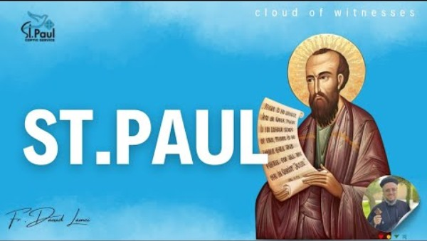
There’s a lot more to this story!
Interview with Saint Paul by Father Dawoud Lamei [AR]
youtube.com/watch?v=FUfjNlEaeA0

Slide 21
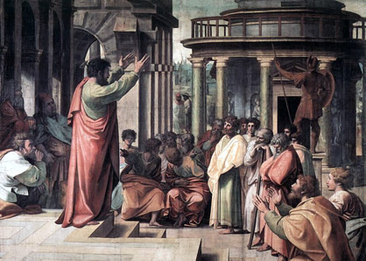
Romans 1:7
“To all who are in Rome, beloved of God, called to be saints:
Grace to you and peace from God our Father and the Lord Jesus Christ.”
Notes:
Image source:
https://biblicaltourguide.com/storyofpaulandthecla.html

Slide 22
The Church of Rome
Visitors from Rome were visiting Jerusalem at Pentecost (Act 2); some were baptized, and later returned to Rome.
Also, following Saint Stephen’s martyrdom, some Christians fled to Rome and preached the Gospel there.
Paul’s letter to the Romans was written before he visited Rome, though he personally knew many Roman Christians.
There Roman Church had a mixed population, and was at risk of being split between those of Jewish & Gentile origin.
Some Christians with Jewish background were preaching that the Jewish Law & Circumcision must be kept; Paul wanted to correct this wrong teaching.
Paul explains how both Jews & Gentiles are justified by faith and are united in Christ.
Despite the tension in Rome, Paul speaks highly of the Roman Church, saying that their faith was “proclaimed throughout the world” (Romans 1:8)

Slide 23
Key Themes in the Book of Romans
Explains why & how the Gospel of Christ is God’s power to save those who believe.
God’s Righteousness
Justification by Faith
All have sinned (both Jews & Gentiles)
All need grace
Life in the Spirit
God's Faithfulness
Unity of the Church
“… the gospel of Christ, for it is the power of God to salvation for everyone who believes”
Romans 1:16
Notes:
Image source:
https://ca.pinterest.com/pin/2744449760350028/

Slide 24
Saint Paul’s Epistle to the Romans
Chapters 1-3 Righteousness Needed God’s Righteousness, All have Sinned, All need of Salvation
Chapters 4-8 Righteousness Provided Justification by Faith, A New Life in Christ
Chapters 9-11 Righteousness Vindicated God’s Promise to Israel. God’s Mercy to All
Chapters 12-16 Righteousness Practiced The Church United in Love and Service

Slide 25
Romans 1:7
To all who are in Rome, beloved of God, called to be saints:
Grace to you and peace from God our Father and the Lord Jesus Christ.
Romans 1:8
First, I thank my God through Jesus Christ for you all, that your faith is spoken of throughout the whole world.
Romans 1:16-17
For I am not ashamed of the gospel of Christ, for it is the power of God to salvation for everyone who believes, for the Jew first and also for the Greek. For in it the righteousness of God is revealed from faith to faith; as it is written, “The just shall live by faith.”
Romans 1:28-32
And even as they did not like to retain God in their knowledge, God gave them over to a debased mind, to do those things which are not fitting; being
filled with all unrighteousness, sexual immorality, wickedness, covetousness, maliciousness;
full of envy, murder, strife, deceit, evil-mindedness; they are whisperers, backbiters, haters of God, violent, proud, boasters, inventors of evil things, disobedient to parents, undiscerning, untrustworthy, unloving, unforgiving, unmerciful;
who, knowing the righteous judgment of God, that those who practice such things are deserving of death, not only do the same but also approve of those who practice them.
Romans 6:23
For the wages of sin is death, but the gift of God is eternal life in Christ Jesus our Lord.
Romans 8:1
There is therefore now no condemnation to those who are in Christ Jesus, who do not walk according to the flesh, but according to the Spirit.
Romans 8:28
And we know that all things work together for good to those who love God, to those who are the called according to His purpose.
Romans 8:35,38-39
Who shall separate us from the love of Christ? Shall tribulation, or distress, or persecution, or famine, or nakedness, or peril, or sword? …
For I am persuaded that neither death nor life, nor angels nor principalities nor powers, nor things present nor things to come, nor height nor depth, nor any other created thing, shall be able to separate us from the love of God which is in Christ Jesus our Lord.
Romans 9:20
But indeed, O man, who are you to reply against God? Will the thing formed say to him who formed it, “Why have you made me like this?”
Romans 11:33-36
Oh, the depth of the riches both of the wisdom and knowledge of God! How unsearchable are His judgments and His ways past finding out!
“For who has known the mind of the Lord?
Or who has become His counselor?”
“Or who has first given to Him
And it shall be repaid to him?”
For of Him and through Him and to Him are all things, to whom be glory forever. Amen.
Romans 12:9
Let love be without hypocrisy. Abhor what is evil. Cling to what is good.
Romans 12:21
Do not be overcome by evil, but overcome evil with good.
Romans 15:5-6
Now may the God of patience and comfort grant you to be like-minded toward one another, according to Christ Jesus, that you may with one mind and one mouth glorify the God and Father of our Lord Jesus Christ.
Romans 15:13
Now may the God of hope fill you with all joy and peace in believing, that you may abound in hope by the power of the Holy Spirit.
Romans 15:33
Now the God of peace be with you all. Amen.
Romans 16:5
Likewise greet the church that is in their house. …
Romans 16:16
Greet one another with a holy kiss. The churches of Christ greet you.
Romans 16:20
And the God of peace will crush Satan under your feet shortly.
The grace of our Lord Jesus Christ be with you. Amen.
Romans 16:24
The grace of our Lord Jesus Christ be with you all. Amen.

Slide 26
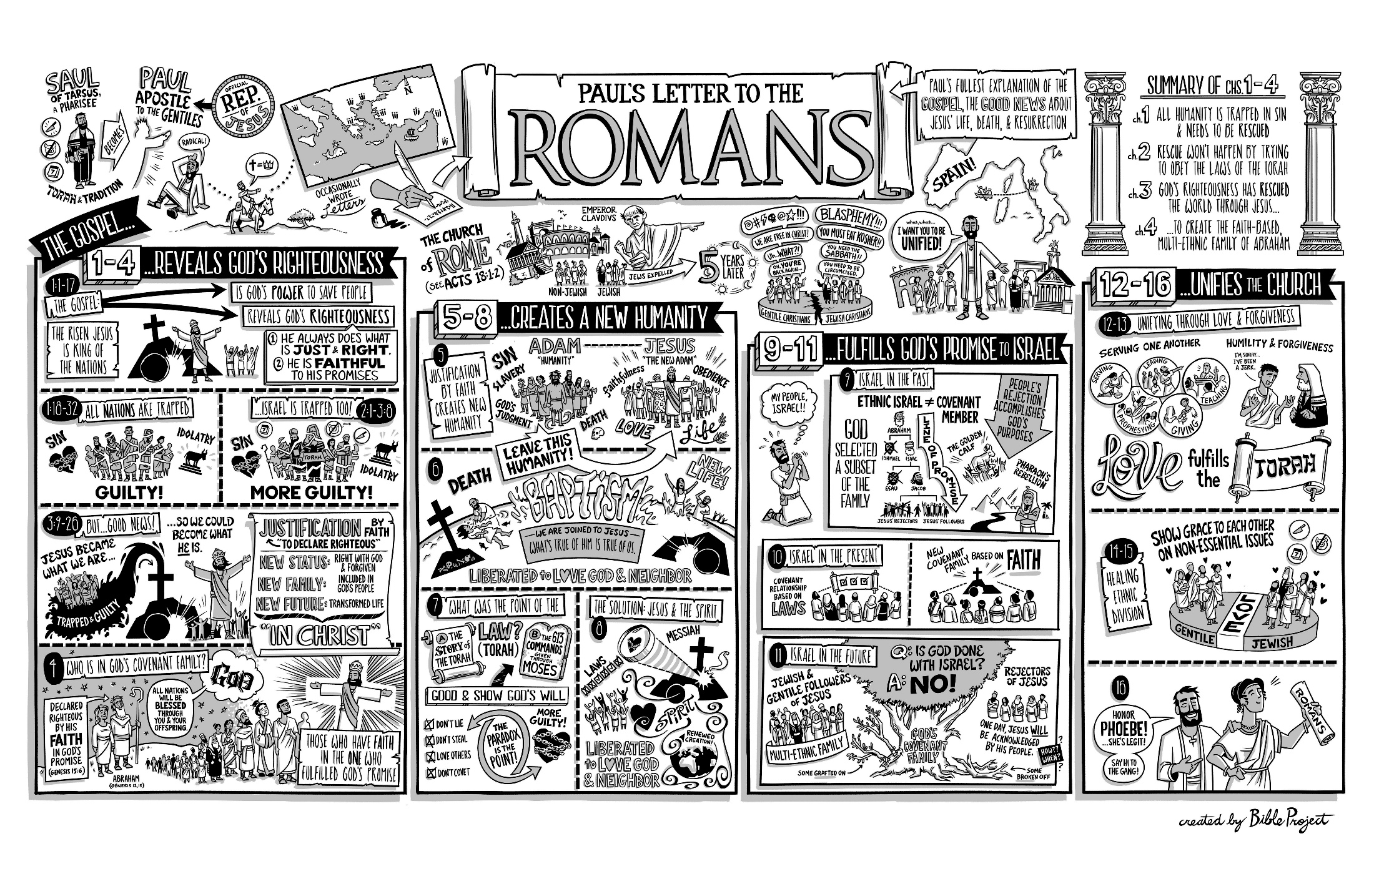
bibleproject.com/videos/romans1-4 [8 mins]
bibleproject.com/videos/romans5-16 [9 mins]
Notes:
Image source:
https://bibleproject.com/downloads/

Slide 27
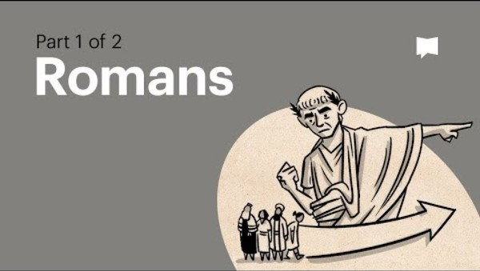
youtube.com/watch?v=ej_6dVdJSIU

Slide 28
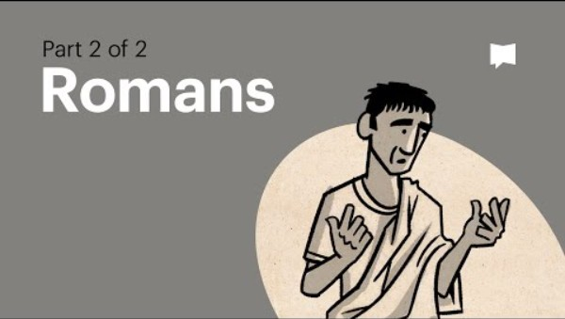
youtube.com/watch?v=0SVTl4Xa5fY

Slide 29
Interview with Saint Paul …. Adapted and Translated from sermon by Father Daoud Lamei ….
Please tell us a little about yourself, how your life started …
My story is an unusual one.
I was brought up in a strict Jewish household.
My family was wealthy; and my dad was able to buy his way to get us Roman citizenship.
We weren’t living in Jerusalem, but lived in a prosperous city called Tarsus.
We were businessmen, and had a tent-making business.
Did you live a holy life and know the Scripture?
From a young age, I loved to read, and memorized much scripture.
My dad encouraged me to read and study most of the Torah, the Law of Moses.
I practically memorized the Book of Deuteronomy.
I memorized most of the Psalms of David.
We would regularly travel to Jerusalem to Feast with the Jews.
News started to spread while I was a youth about Jesus of Nazareth.
I would see the Pharisees (by the way, my dad wanted me to become a Pharisee like him) … I would see them get very upset and hear them saying that Jesus is against Moses.
Now I am a huge fan of Moses!
Anyone who dares say anything against Moses, I’d rip him apart!
So I started hating Jesus, simply because they’d convinced me that this Jesus is against Moses.
And that he’s here to destroy the principles that we’d received from our fathers.
By the way, I was quite strict by nature, an extremist.
I was eventually promoted to the rank of Pharisee, I was thrilled to receive this title!
Because, amongst my friends, I was always number one …
The one who memorized the most; the most to be strict; the most responsible; nobody could find a fault against me. I would NEVER break the Sabbath, or take too many steps on the Sabbath.
Everyone admired me, and I was happy that way, that I was number one!
Did you receive a religious education?
You may have heard of Gamaliel, a famous religious teacher.
My dad spent much to have me sent to study under him, to learn at the feet of Gamaliel, learning the fundamentals from the most important Rabbi at the time.
I was very attached to Gamaliel.
One time, Gamaliel winked at me, and said, “looks like you will become Gamaliel 2.0!”
This comment touched me, and I set my sight, my dream, to become the Gamaliel of the future.
I wanted to be like him … he was committed, bright, beloved by everyone, well versed, and at the same time very persuasive.
But he wasn’t like the rest of the Pharisees who were very severe extremists. He was committed but not always to the letter of the law. He began to instill in me a little bit of flexibility.
But, of course, when it came to Jesus of Nazareth, no flexibility … I hated this name.
Did you also study Greek?
During that time, my dad sent me to study in Athens.
I studied the Greek language, culture, philosophy …
I studied there, but always considered those people to be heathen infidels!
In fact, I would feel “unclean” there, as I was living amongst unclean defiled people.
So, I learned from them, but didn’t like them.
I hated them, and couldn’t wait to return to live among my people.
Every time I returned to Jerusalem, I would go through the rite of purification, so that I could enter the temple once more, because I had lived among the Gentiles.
I couldn’t wait to finish my education, and came home.
When I’d come back home, everyone would rave about how well-versed I’d become in Greek.
I could speak Greek better than the Jews. But in any case, I didn’t like speaking Greek, and preferred Aramaic because I am Jewish, a Hebrew, of the tribe of Benjamin, a Pharisee, the son of a Pharisee.
Did you hear more about Jesus of Nazareth?
I heard, as everyone did, that we were finally rid of Jesus, he was crucified; and I thanked God!
Then news started spreading that he was risen from the dead … of course, his followers were claiming this, but they had probably stolen his body.
The Jewish leaders then put a bounty on the followers of Jesus, to arrest them.
I came forward to the Jewish elders (and they knew me quite well) and told them to leave it to me to capture these slippery fish.
At that time, something happened that I’ll never forget.
What’s that, do you want to share with us?
There was someone named Stephen that I knew from long ago …
Stephen was a fellow disciple of mine under Gamaliel for a period of time.
I remember he had a special personality: full of kindness, politeness, and simplicity.
Stephen had a unique personality.
But then I learned that he was a follower of Jesus of Nazareth!
I couldn’t believe my ears, that this brilliant Jewish man would do such a thing.
I attended the council where they judged him, and honestly, he said some very rude things!
He told the Jewish council members that they were uncircumcised of ears and heart!
He said that, throughout history, they have resisted the Holy Spirit!
And just like you murdered the prophets, you murdered the Christ.

Slide 30
How did you feel when you heard all that?
Of course, I wanted to destroy Stephen! Because he dared to call their Jesus as the Christ!
What does Jesus have to do with Christ?
I was extremely upset at him … anyways, they did what was needed.
They dragged him out, and stoned him.
I was watching all this, and it seems they found it tough for me to throw the stones … I don’t know why I didn’t join in, though for sure I was happy to see him die.
The men would take their clothes off at my feet, because I was agreeing to his death.
They’d look to me for my consent, and I would encourage them to throw stones.
It was a strange scene. Stephen was severely wounded, bleeding everywhere.
But I heard say that he saw heaven open.
There were those around me who commented about how bright his face appeared.
What nonsense! I shouted at them, brightness, what brightness? He’s a blasphemer, he’s evil.
And the last thing he said was, “do not count this sin against them.”
I was furious, saying to him, “you are the sinner, idiot!”
Yet I was still amazed, how one, in their dying moments, be asking God for mercy for his killers?
We don’t have such a law in our Torah. It was very strange.
And he was accepting to die such a horrific death.
Of course, nobody could’ve saved him from our hands.
What happened after that?
I was given official commendation letters from the Jews to seek and capture followers of Jesus.
I found out that many of them were running away. Everyone was scared after we killed Stephen.
People were scattering, travelling to many other nations.
Some went on the difficult journey, far away to Damascus.
I decided that I would go catch them, imprison them …
Some may die, so be it; others might smarten up, deny Jesus, and return to Judaism.
By the way, I was accompanied by temple guards, and had official letters of commendation.
I was given this great responsibility to lead. I was still in my twenties, and proud of myself.
To be nominated for this task, having the trust of the high priest.
I was glad to do this and wasn’t seeking any glory …
I simply hated anyone who opposed Moses.
This Jesus is against Moses, so we have to be rid of him, and of his children and followers.
Did something happen on the way to Damascus?
Suddenly, on our way, I saw a bright flash of light like lightning; and I fell off my horse.
I heard a voice saying to me, “Saul, Saul, why are you persecuting me?” Stop kicking!
I understood from his words that I was wounding, hurting myself, resisting God’s voice.
Those with me were hearing me talking to someone, …
But I was seeing something that they didn’t see.
I was seeing the light, and seeing the One speaking with me.
Wow, so what did you do?
I asked Him, “Who are you?”
He replied, “I am Jesus,” the Jesus that you hate, “the one that you are persecuting.”
Enough already, “it is difficult for you to kick against the goads!”
I know that when the light appears, and there’s such an amazing, glorious vision, …
This is like what happened with Moses!
Also with Isaac, Jacob, and Abraham, and Solomon.
I was terrified, shocked.
I was expecting to fall dead.
As Jews, we believe that if one were to see the glorious light of God, they would surely die.
But I didn’t die!
And I felt a huge weight of guilt that I can’t describe.
This Jesus turned out to be Yahweh!
Because he says, “I am He, Jesus” or “I AM Yahweh who is Jesus.”
So I had been wrong all along!
I discovered that I had it all wrong.
And that all that the Jews had told me was wrong.
And that Jesus is truly God!
And that Stephen was right.
And that I’m finished!
All this ran through my mind in mere minutes, while I’m terrified to death.
Because I felt that I should surely die.
I asked Him, “Lord, what do you want me to do?”
I was expecting Him to tell me to return and tell the Jews that you saw Me.
But He told me to enter Damascus, continue your journey as you were.
There, I will tell you what comes next.
So I got up, and was shocked to learn that I’d lost my sight.
The light was gone, and the scene disappeared.
They lifted me up from the ground, and I was blind.
They led me by the hand, while I was in shock, shaken, shaking.
I entered Damascus …
Of course everything changed … we’re not going to capture Christians any more!
I was in dire straits.
I stayed at a friend’s place.
And because I had seen the Lord (because all my life as a religious Jew, I wished to see the Lord as Moses did; I wish to go through what Isaac did; I wish that, like the verse that says that “the Lord appeared to Abraham,” that He would appear to me; Solomon saw Him two times, and I wish to see Him one time) …
So, even though I was terrified by what happened, yet because I saw Him, I was overjoyed.
But, being extremely embarrassed and feeling guilty for my past, I was unable to eat or drink.
How long were you in that condition?
I spent three days like that, practically just reciting Psalms the entire time,
mostly “have mercy on me, forgive me, I have sinned … I am an idiot, I messed everything up”
Those three days, I don’t know if I was crying or not.
Everything in me had dried up, I didn’t drink any water.
I didn’t know night from day.
What had happened to me, that vision, took me out of this world.
They’d bring me food or drink, but I didn’t pay any attention, didn’t see anyone.
They said he’s probably had a brain tumor; others said it appears he’s about to die.

Slide 31
Did anyone visit you?
After three days, I heard a knock on the door, and a voice I didn’t recognize.
A man approached me and said, “Brother Saul, I am Ananias”
I knew that name! I had this name at the top of the list of those I was to capture!
He was a Christians leader in Damascus, of the so-called followers of the Way.
I heard that he was one of the 70 that were chosen by Jesus … he was at the top of my list!
He said, “I am Ananias,” yet I could not see him.
And he said to me that the Lord Jesus had sent him to open my eyes.
And that he would teach me about the Lord.
And he told me, “Jesus, the righteous Lord has chosen you to be a light to the world.”
I couldn’t believe my ears!
I knelt down, feeling that I am in front of a man of God, yet I still didn’t see him.
He asked me if I believed that Jesus is God, and I said “a million percent, yes!”
He asked, “Do you want to follow Him?”
I said that I would love to!
If He would accept me, if I am yet to live, I would live for Him.
He brought water, and baptized me.
As I was being baptized, scales fell from my eyes, and I saw Ananis.
We became life-long friends.
That was the first time for me to see one of those who were close to Jesus, who lived with Him, and had enjoyed His company.
He shared with me amazing stories about Jesus, His sermons, His miracles … I spent a number of days in his house, and wouldn’t want to waste time sleeping so I can learn all I could about the Lord Jesus.
What happened next?
I entered the Synagogue with Ananias, and he’d introduced me as Saul.
He said, this Saul is the man who was coming to arrest us and kill us …
Jesus appeared to him on the road, spoke with him, and he has become one of us.
Believe me, some people were shocked, left and ran off terrified.
Because my reputation preceded me … all knew that I was a savage brute, merciless.
They all suspected that I was trying to trick them and slay them all.
And this wasn’t so much a Synagogue of the Jews …
It was the group that had become Christian having Jewish roots.
What about the actual Jews in Damascus?
As soon as the Jews in Damascus heard about this unthinkable thing that I had done, that I had become a follower of the Way, they judged that I was unfit to live.
Ananias advised me to leave.
And the Jews were in a position of power, and shut the gates of the city so I can’t flee.
Now the beloved brethren, the disciples of Ananias, told me that we have a possible solution.
But they told me that I’d have to let go of myself …
What are you planning to do?
In the middle of the night, they wanted to climb the city walls, put me in a basket, and let me down in the basket; people would be waiting to receive me, and I’d run away to escape.
I asked Ananias what to do … I could easily be killed.
I mean, I didn’t mind dying, as I had caused many to die.
But he reassured me that Christ had a mission for me to fulfill, I would not die now.
They carried me in the basket, took me to a high place in the middle of the night …
They lowered me with a rope, while I was reciting Psalms the whole time.
I was expecting if anyone saw us, we would all be done for.
And I escaped with the beloved brethren outside the city.
Then we traveled to Jerusalem.
I wanted to go back and tell those in the Temple that they were all wrong!
The Jesus that you killed has risen, and He is the Messiah, the Christ, He is the Lord our God.
What happened in Jerusalem?
I met with the Apostles (not all of them, but those who were there … many of them had gone preaching to other lands after what happened to Stephen).
To my surprise, they didn’t want me to stay in Jerusalem.
They said that I was a danger to the church.
If they want to kill anyone, you would be at the top of the list, because you embarrassed them.
You are causing shame to all the Jews by what you did.
And I heard that the Pharisees had learned about the deed that I did,
And some had taken an oath to kill me.
They advised me to quickly leave Jerusalem.
So, did you leave Jerusalem?
I tried to explain that I’m willing to speak out, to declare how sure I am, to share what I saw.
But the Apostles said that it wouldn’t work, that the Jews wouldn’t give be given a chance and that I should escape Jerusalem.
They told me that I have a mission, as Ananias was told by the Lord.
You have a mission, don’t risk your mission.
So I left Jerusalem but I wasn’t content, because I was hoping to speak out. I am not a coward.
I was willing to stand and declare everywhere that Jesus is the Christ, and that I saw Him.
And that I am sure. And that, although I was a strict Jew, yet know I declare that Christ is Risen!
But, I didn’t get a chance to do all that, and was a bit upset.
Anyways, it was God’s plan.
What did you do next?
After all that, I spent some time in the Arabian desert.
Because I was finding all the doors closed in my face.
Damascus isn’t open to receive me; nor Jerusalem; nor any of Judea …
Even the Apostles feared having me at their side.
Because I was a suspicious figure.
I spent a period of time praying, and I saw Jesus a second time!
He told me not to fear, that I still had a mission to fulfill.
But I didn’t know where to go, so I returned to Tarsus.
What happened in Tarsus?
Well, in Tarsus, my family thought I’d lost my mind.
Because the transformation I’d gone through was huge.
I no longer cared about money, nor about Greek knowledge …
Nor did I even care about being a Pharisee anymore (that had previously been my lifelong dream; and it had cost my family an arm and a leg for me to earn that title of Pharisee).
So my family was naturally furious! They thought that Christians had messed up my brain.
Nobody would listen to me. So in Tarsus, I was stalled. All I could do was pray.
Because many years had passed, from Damascus to Judea, to the desert, to Tarsus, then what!
I can’t stay like this, I want to speak out, I need to declare what I saw.
I spent time re-reading Old Testament scripture with a new understanding, with new eyes.
Every chapter that I had studied, I discovered that I hadn’t understood it at all!
From Genesis chapter 1, to the end of the Prophets, …
They all speak of Christ in a very clear, straightforward way, but I hadn’t seen before.
The more I read, and searched, and studied, …
The more I would wonder how there is a veil blinding the Jews from understanding.
How could we not see that this is all pointing to Christ Himself.
One day, as I was praying fervently, saying to the Lord that I’m frustrated, that I want to witness to You. I’m indebted to You. I tortured Your children. Are You rejecting me? I need a purpose.

Slide 32
Did God answer your prayer?
I was praying, an honourable man showed up named Barnabas, slightly older than myself.
They said that he came from far away to see me, travelling from Antioch to see me.
He introduced himself as Barnabas, a friend of Ananias, one of the Seventy.
He said that he wanted me to go and serve with him.
I’d been waiting for years to hear such a call for service!
I warned him that unfortunately, wherever I go, the doors of service would close …
Damascus, Jerusalem, Judea, even here in Tarsus. I seem to be the problem.
He insisted that he wants me to serve with him, and encouraged me, saying …
“I heard about you, and your eyes have seen Christ, and I have faith in you. Come along with me, and I will show you how we’ll serve.”
I was honestly overjoyed!
I got very attached to Barnabas. He was a loving father.
As we travelled together, he would tell me more and more about Christ, His words, His miracles, His sweetness, His meekness.
And I was a bit of a rough and tough Jew, so Barnabas started filing me down.
He’d tell me, “no, we don’t say those things … we don’t talk that way … we don’t cut people off … let the elders speak.”
Because I was a bit of a thorny Pharisee. Barnabas lovingly rebuked me.
I was always looking at him in amazement, because he was truly meek and humble.
Where did you go with Barnabas?
Barnabas brought me to Antioch.
And I found amazing Christian characters, who had been preaching of Christ for years.
One of them named Manaen was brought up in Herod’s palace … amazing personalities who had accepted the faith, and had left Judea to preach abroad, even in Antioch.
I was so amazed to be in this environment.
We would preach Christ, bring verses of the Psalms, Isaiah, and Exodus, and all that was said about Christ. I finally was able to speak, and let out all that was bottled up.
When we’d meet, they’d say a few words, and I would say ten times …
They couldn’t keep me quiet.
What was amazing, is that they all in great humility, encouraged me to keep talking.
They are all my seniors, but would leave me to preach and teach.
I spent a year working with Barnabas, and roughly half of Antioch became Christian.
I would preach, and they would baptize.
Then a day came, when they said we would fast and pray, to seek out God’s will.
I was surprised that the elders, after we had all fasted and prayed, they said …
Barnabas and Saul (or they also preferred calling me Paul), would travel to Asia Minor.
I’d never been to Asia, had only been to Greece.
So for me, I was being sent to preach, on a mission.
Ok. So long as Barnabas is with me, he’s my elder.
What happened next?
They laid their hands on me, and I received the grace of Priesthood.
They considered me a Bishop like them. I couldn’t believe it! You are entrusting me?
I am the one who tortured Christians long ago. I had killed many. I had troubled the Church.
Are you this kind and loving? They insisted on laying hands on me, knowing that I will baptize.
I was overjoyed to receive this grace. Barnabas and I started travelling all around.
We went to Asia Minor, and we had Mark with us. Barnabas loved Mark as a son.
But I have to say, even though Saint Mark is one of the Seventy, I wasn’t too hot for him.
I mean Ananias is an elder; Barnabas is an elder; but Mark is a few years younger than me.
And I’d heard he’d fled naked when the soldiers came for Christ the night before the Cross.
So, I didn’t think too highly of him.
Also, it seemed like he wasn’t doing much … like carrying our luggage but not saying much.
We don’t need a butler, wasn’t sure what he was doing here.
Anyways, after the first stop, Mark left.
And I thought, good riddance, he’s not the hard-working type.
Barnabas wasn’t happy …
Seem Mark was his nephew (his sister’s son), and Barnabas was training him.
But I was happy, because things were getting serious, and above Mark’s ability to cope.
We continued in Asia Minor, and the Lord would work miracles through us.
And things were progressing … and a pattern emerging.
We would work miracles, and preach, and converts would follow us, then we’d be beaten.
The same happened in every city.
We got such a whipping on our first missionary trip …
Honestly, I’d receive a beating more than the rest.
Perhaps they didn’t want to hit Barnabas as much because of his old age.
But I get a big beating, perhaps also because I was preaching more.
I was speaking so much that in one city they called me Hermes, the messenger god.
And they stoned me. As I was being stoned, I was telling myself that it was fitting, finally I can correct the error of my past, because of the guilt of the stoning of Stephen.
Wow, that is tough!
It was very tough, I was expecting to die.
And I was praying to the Lord, please Lord, I want to see you again, like Stephen saw you.
Suddenly I blacked out, and died. Or perhaps I didn’t die. I don’t know if I died or not!
They threw me out of the city, and the beloved brethren came and found me revived.
At that time, I saw! I saw Christ in His glory.
But I didn’t know whether I was in the body, or out of the body … I do not know.
I saw heaven, its beauty, saw the place where Stephen was, and wished to die and be there.
I had a desire to be there, but I was surprised to wake up. Life after death, I don’t know.
Maybe I died, or maybe not.
Either way I woke up, of course wounded all over. They bandaged me bit by bit.
Now Barnabas was very brave.
He said that we should go back to the city to check up on the believers.
I looked at him … what are you saying?
You want us to go back to the place they stoned me! You’re kidding me! It’s been barely a week.
Anyways, we went back. And I could barely speak, and they all were looking at me …
Aren’t you the one that died a week ago?
So I said, “Look, we must through many tribulations enter the kingdom of God.”
They all looked at me with pity, but I think they were touched by what I’d said.
I explained that someone like me cannot enter heaven that easily …
This is just a start of what I must go through. I expect much more to come.
Because I did much harm to Christians in my past.
We saw wonders in Asia Minor, one place after the other …
One city would kick us out, we’d go to the next one …
As if the Lord was telling us, "enough for this city,” and we go to another one.
We’d preach a bit, get beaten up a bit, perform some miracles, and so on.
One door would close, and another would open. It was God’s plan for us to preach all over.
Always preaching, performing miracles, and getting beaten up.
We then decided to go back to Antioch and declare what had happened.
It had been two and half or maybe three years that had passed.
We returned to Antioch and they weren’t open to hear anything. There was a big problem.
Christians had come from Jerusalem saying, how can you accept people who were not Jews to become Christian. They were claiming that this is contrary to the teaching of the Apostles.
It is forbidden. They first need to be circumcised. They need to all first enter through Judaism.
Barnabas and I couldn’t believe our ears.
We had been preaching throughout Asia Minor and baptized many who were not Jewish.
So all these claims would have messed up all the progress made.
And we were hoping our brethren in Antioch would speak up.
Yet they kept quiet as they were told that the Apostles had said that there must be circumcision.

Slide 33
And, did you keep quiet?
I couldn’t keep quiet. I said that there is no need for circumcision.
I myself was circumcised, have no problem with that.
But it’s too much to ask of the Gentiles to become Jews first and be circumcised.
Christ chose many to be His.
Imagine, he even chose to accept me, who is worse than the Gentiles.
I tortured Christians, yet he chose me; would he not accept the Gentiles?
They found me insisting on debating this issue, so they suggested I go meet the Apostles.
Out of his great love, Barnabas said that he’d come with me.
So, you went to Jerusalem?
Barnabas and I went to Jerusalem, praying the whole way there.
Lord, these doors that opened to accept the faith, please do not shut it down. We saw the repentance of the Gentile nations. We saw the world transformed.
When a synagogue would close, we’d preach in the streets, they’d follow us to hear the gospel.
Anyways, we reached Jerusalem, and they welcomed us.
Of course, Barnabas is one of the beloved ones.
The Apostles held a big council the next day, and asked us to declare all that had happened.
We started to tell everything, and you know that I don’t keep quiet.
I told them about the miracles, the sermons, baptisms, and also about the beatings we received.
Some were listening, elated, and very happy; others were listening and frowning.
Every time I mention baptisms, I’d find some frowning.
It turns out that this topic of circumcision was causing a big crisis for them.
Thank God for our elder, Saint Peter saved the day.
He stood in the midst of them, and told them not to blame Paul.
Peter said that he had baptized a Gentile before anyone else.
And God chose me to go to Cornelius, and don’t forget what happened.
And the Apostles, you were supportive at the time. What’s the problem now?
God declared that he is the God of all nations. And Abraham is the father of many nations.
And Christ didn’t just die for the Jews. And Isaiah declares that He is light for the whole world.
All kept quiet after Peter’s speech.
James then arose, being the elder Bishop of Jerusalem, and said … now you’ve heard Paul speak, and Peter confirms that this is the will of God. And the Old Testament testifies the same.
I think that we should not put a burden on those of the Gentiles that are converting.
Since they accepted Christ, there’s no need for circumcision.
If circumcision, we’d also have the Sabbath, and the sacrifices, washings, obligations, …
And even we ourselves, being Jews, can’t even ourselves keep all these.
Don’t put too heavy a burden on the Gentiles. They need only to stop heathen practices, believe, repent, and get baptised.
James asked them, “Do you agree?”
So, did the Apostles agree?
All the Apostles agreed! They put down a decree. And I was overjoyed!
I was also surprised to find that all the Apostles were loving towards me, despite my dark past.
In my past, I would’ve harmed many of their loved ones; yet they were very loving towards me.
I couldn’t believe that I was sitting among those who had lived with Christ for three years.
And they were now the leaders of the Church.
So Barnabas and I took their written decree, this statement, and Silas came with us.
We were overjoyed, and proudly returned to Antioch as victors!
We were saying, see, the Apostles agreed with us, and the rumours before were wrong.
And on the way back, I was telling Barnabas that I wanted to go back and visit Asia Minor, to check up on those we saw two years back and had baptized, lest they had wandered from the faith and gone back to heathen worship.
Barnabas thought it was a good idea, let’s go.
But he wanted to bring Mark along. “What Mark,” I thought!
Oh, I think I heard about this contention over Mark, tell us more.
It seemed I was a bit high on myself, having just convinced the Apostles, I was a bit puffed up.
I was thinking, if God is working with us, don’t slow us down by bringing Mark.
I insisted that Mark would be a burden; Barnabas insisted that Mark would be useful.
I reminded him Mark had messed up twice: once he left Christ, once he left us the last journey.
Yet he insisted on bringing Mark.
But as you know, I love Barnabas, and didn’t want to upset him.
I like Silas. So, I proposed that Barnabas takes Mark, and I take Silas.
And that way, we can divide the work in half, divide and conquer so to speak.
You and Mark start with Cyprus; and Silas and I can continue directly to Asia Minor.
That way, we’ll save time. We’ll still get to visit all, but split up the work. Barnabas agreed.
I didn’t realize at the time that this was God’s divine plan.
Barnabas took Mark and went to Cyprus.
And I was following the news, and found out that Mark, after a year, went to preach in Egypt!
I’d be scared to go to Egypt. I don’t know how Mark was brave enough to go to Egypt.
And he went all alone; Barnabas didn’t go with him to Egypt. Egypt is tougher than Greece.
I was surprised to learn that Mark, who I’d thought was weak, went to preach in Egypt.
And what happened with you and Silas?
Silas and I went to Asia Minor, thinking that we’d visit the different cities.
Not a single city of the ones we were planning to visit worked out. It was very frustrating.
My conscience started bothering me. It seems I’ve messed up, and I was feeling guilt.
Maybe I upset Barnabas? Maybe Mark was good after all, and I’d wrongly accused him?
Maybe I was high on myself?
The Spirit was forbidding us, not allowing us to preach, doors were closing, nothing working.
So I knelt down and wept. I worshiped saying, “If I have upset you by my stupidity, please straighten me out, but please tell me what’s going on. Maybe I was impulsive? Talk to me! Please don’t reject me!”
As I was praying fervently, I fell asleep and saw a vision. I saw a Greek man, a Macedonian, not from Asia Minor, saying to me in the vision, “Pass over and come to us.”
I opened my eyes, greatly comforted.
And I told Silas that it hasn’t been closed up because the Lord is upset.
It has been closed up because we are needed elsewhere, let’s go!
Go where? To Greece.
But, Silas was worried that we hadn’t agreed with Barnabas for us to do this.
Barnabas thinks we are going to minister in Asia Minor.
I told him not to worry about Barnabas, I’m tight with Barnabas, all is good.
And God is telling us to go to Greece, and I can’t say no.
So, you sailed to Greece?
We sailed, crossed the Black Sea, entered Greece, and reached Philippi.
We entered Philippi, and I have to tell you that I’m terrified of Greece.
Since my Greek education, I see them as highly educated, and I’m lacking in comparison.
Although I was clever, Greek-educated, a philosopher, yet I felt they were all superior to me.
So, I wasn’t comfortable as we entered Greece.
Asia Minor was easier, being multicultural, but this seemed tough.
But the Lord comforted us through a devout Jewish woman named Lydia who hosted us.
We preached to her Jesus as the Messiah, and her heart opened right away to accept the faith.
And she rejoiced, and we baptized her.
It looks like Philippi isn’t that bad after all.

Slide 34
Wait, wasn’t there a commotion that happened at Philippi?
There was a servant girl who started following us, and made a spectacle.
We had been preaching quietly, not wanting to make a fuss, knowing that the Greeks can be dangerous, merciless, highly educated and tough to reason with.
This servant girl kept crying out after us: “These men are the servants of the Most High God, who proclaim to us the way of salvation.”
The crowd beat us up, and I thought maybe I’ll die in Greece instead of Asia Minor. But I didn’t die. Poor Silas was beaten up with me. But this time, after the beating, we were imprisoned.
What happened in prison?
We had no one to save us.
I wasn’t even given a chance to tell them that I am a Roman citizen.
They were too busy beating us up, and didn’t give us a chance to speak.
In prison, Silas was asking what next? I said, we can’t do anything.
But the Apostles had told us, when they were imprisoned, they’d pray.
I’d heard that the Apostles were often put in prison, and every time, they’d pray.
Let us pray! Let us praise.
We were chanting Psalms in the traditional Hebrew custom, but adding always,
“O Jesus Christ our God.”
And I guess we were getting passionate and louder.
And the prisoners were listening in amazement, wondering who these new prisoners are, who were severely beaten, yet they continue singing, it’s not logical.
Suddenly, in the middle of the night, there was a great earthquake.
And we thought, we survived the beating but maybe we’ll die of the earthquake, it’s all good.
But this was an interesting earthquake … the prison doors opened, but nothing crushed us.
All the prison doors opened! We could barely move our feet, being held in the stocks.
We were waiting for the stocks to be loosed by the earthquake.
But before that could happen, we found the prisoners coming towards us.
Silas was telling them that the exit was the other way!
They said they didn’t want to leave! They wanted to come see us.
They were asked what we’d done to open the prison doors!
They thought that we had caused the earthquake.
They thought that the singing of ours had caused the earthquake.
They were convinced of this, and they all sat at our feet, asking us to teach them.
Guys, listen, this is your one chance to escape, the prison gates are open.
I was trying to reason with them, asking them to escape for now, we can meet up later, it seemed they were falsely accused like us … whoever wants to go, run!
But they insisted on staying, saying they didn’t want to lose this opportunity to be with us.
Wow, where was the jailer all this time?
The jailer at that instant was just coming back from an errand.
He was shocked to find all the prison doors open. For sure he’d be done for!
So he drew his sword to commit suicide as was the Roman custom.
I saw him and cried out from afar, “Do yourself no harm, for we are all here!”
Not a single prisoner had fled. They were all here, actually, they all stayed of their own accord.
The man couldn’t believe himself. All these could’ve fled, and not a single one did.
He asked who I was, how could this be?
And he loosened our stocks. And he began to care for our wounds.
And he began to listen to us, as did the prisoners.
He was deeply impacted, and brought us to his house.
I told him this would be a fatal move for him; he said he would’ve been a dead man anyways.
So, you went to his home?
He brought Silas and I to his home, and fed us.
And at dawn he said that he wanted to be Christian.
He was worried if something were to happen to us, he’d lose his chance to be Christian.
Silas said, why don’t we baptize him?
So, we baptized him and his whole household.
In the morning, he came joyfully to tell us that we were released from prison.
It sounds like they were tired of you and wanted you sent away.
But I was stubborn, and wasn’t going to go that easily. I’m not leaving!
Silas was surprised, why not leave? There are other places to go, much to do beyond Philippi.
But I insisted that they should know that what they did was wrong.
The jailer was looking at me, all perplexed.
Then I said that I am a Roman citizen, and the man fell off his chair, and exclaimed,
“Are you really a Roman?” and I replied “yes”
He said, “Oh my, they’d sack the governor over something like this”
So I told him to go and tell the governor!
He went to the governor, and the governor came running.
Again he asked if I was Roman, and how I became Roman … I was born a Roman.
The governor himself said that he’d paid an arm and a leg to become Roman.
I told him that I’m ahead of him; my dad had paid to become Roman, and I was born Roman.
The man was all flustered, and kept apologizing a million times
for us being beaten and imprisoned.
And we spent a few days doing whatever we wanted there.
And we went back and visited Lydia.
And nobody could touch us there.
Where did you go next?
It seemed that the Lord wanted us to go to Thessalonica.
So we went to Thessalonica, and on to Corinth, and spent a year and half there.
I was fed up with Corinth from the first month there.
I wanted to leave, seeing Corinthians as evil, …
But the Lord appeared to me at night, and commanded me to stay put.
Of course I obeyed. Christ Himself comes to tell me to stay, so I stayed a year and a half.
Corinth turned to the better, and was filled with good people.
Then we went to Athens, and I met the philosophers, the giants, that I’d heard of in the past.
They looked at me with disgust, saying “what’s this babbler talking about!?”
Who is this Jew trying to philosophize with us?
But some of their great ones accepted the faith and followed me.
Then I returned back to Antioch, informed the Apostles, and met up with Barnabas.
And I was reassured about the state of Saint Mark.
Then I went on another journey through Asia Minor.
Did you journey to Ephesus?
I went to Ephesus during very difficult times.
They were beasts in Ephesus, ready to tear me apart.
I was sick every day there. But there were also miracles every day.
Then I became homesick, as I hadn’t seen the Apostles in Jerusalem for years.
Everyone tried to stop me from going saying that would be crazy …
If you go to Jerusalem after what they’ve heard about you, for sure you’ll be slaughtered.
I said that it doesn’t matter, and that the Holy Spirit is telling me to go.

Slide 35

So, you went to Jerusalem then?
I greeted the elders, preached to them, bid them farewell, and sailed on the sea, then onto dry land because the Jews were seeking to destroy me on the sea.
I reached Jerusalem.
They advised me to show that I was following the law of Moses, to calm things down …
You are a man coming from the Gentile nations, go through the rite of purification, maybe it’ll calm things down when they realize that you still love Moses and respect the Law.
I told them I would do whatever they say.
Barely did I take a vow and begin the rite of purification, …
The Jewish mob attacked me, claiming I’d brought a Gentile person with me into the temple.
I was accused, and beaten up as usual. I lost count of how many times I was beaten.
But the Lord saved me, and I began to preach to them, and told them the story from the start.
I am Jewish like you, and a strict Pharisee.
I get why you’re upset, because I used to think like you …
Who is this Jesus to make himself the Messiah?
But hear me out … I saw Him! He appeared to me, and proved that He is the Lord.
I couldn’t believe it at first, but I searched the OT Scripture and found it pointing to Him!
I barely mentioned that I want the whole world to know Him, when they lost it!
They cannot bear to hear about the Gentile and the nations, and they started throwing stones.
And the guards grabbed me. Then I declared my Roman citizenship and they backed off.
And they started dealing with me in a civilized fashion. Things kept escalating.
I was taken from Jerusalem to Caesarea, from Caesarea by sea to Rome.
What happened in Rome?
I was waiting and waiting to be judged, but no judgement …
They kept me there in prison, so I started working.
In the Roman prison, they gave me an opportunity to come and go meet visitors.
So I would go out and preach, serving for two years from within the Roman prison.
That was on top of the two years spent in Caesarea before.
And everyone thought I was done for, after all I had preached all around.
It was a miracle, when I finally stood before Caesar to be judged, …
He did not find anything worthy of death, and declared me innocent.
But the Lord had told me this, and I had reassured the Philippians, and also Philemon, and told them that I would visit them, to see them face to face and reassure them.
I went on a journey, then Christ told me …
Did you want to come to heaven?I said, yes, for a long time now!
He told me, ok, that is enough for now.
As I was returning to Rome, they captured me.
I was imprisoned, and I knew that that was it this time.
I wrote to Timothy urging him to come to me quickly.
I wanted to greet him, instruct him and bid him farewell before I depart …
“Be diligent to come to me quickly”
How would you summarize your life?
My entire life is like a canvas the Lord was painting.
I didn’t really choose the strokes, but followed His will.
Well the first part was a bit messy, because of my stubbornness and pride.
But the second part of my life, I was obedient to the Lord’s will.
And as much as I suffered much, yet I also had much grace, blessing, visions and great joy.
Any parting words?
I now tell you, as servants, that the most precious thing you must do, is first save people!
It would be a shame for those around you to perish out of ignorance, not knowing Christ.
What you received freely, deliver that to others, don’t just pocket it. Don’t waste time.
Preach. Labour. Travel. Go. Put all your talents and abilities at the Lord’s feet.
Love Christ, love His Cross, and have faith that He works with the ministry.
Trust that He works miracles and wonders with you.
And believe that the whole world needs to know the Lord.
Glory be to our God forever, Amen.
Notes:
Image source:
https://www.nationalgeographic.com/history/history-magazine/article/early-christianity-paul-apostle-bible

