Slide 1
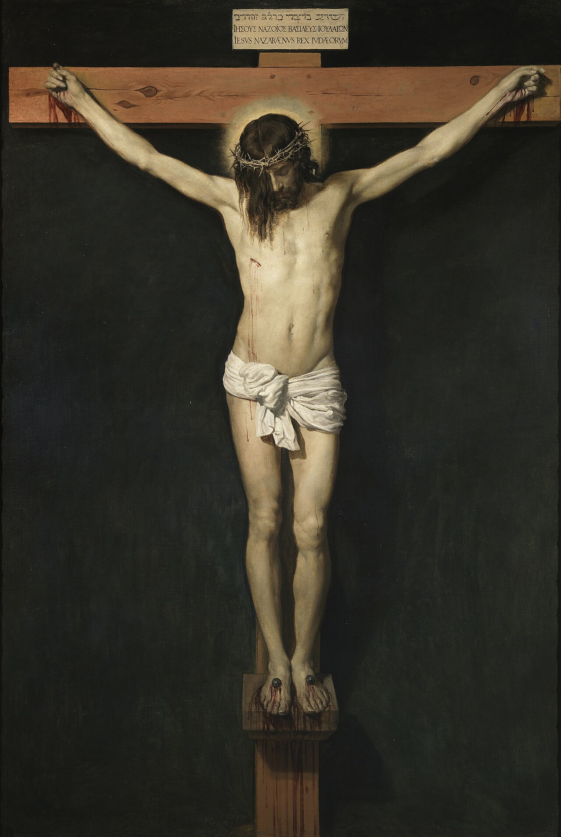

Integrity vs
Hypocrisy
2026-04-06
audio.stmary-ottawa.org/sermons/2026/SMO-2026-04-06-Integrity.pdf
Notes:
Image source:
https://en.wikipedia.org/wiki/Crucifixion_of_Jesus
https://en.wikipedia.org/wiki/Coptic_cross

Slide 2
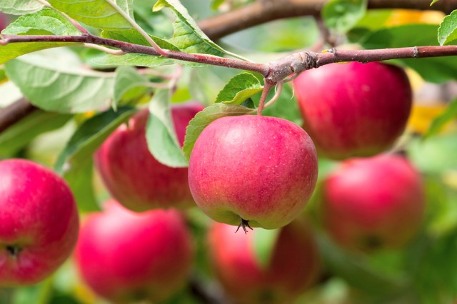
A good tree is known by its fruit
Notes:
Image source:
https://lambchow.com/2015/05/a-tree-is-know-by-its-fruit/

Slide 3
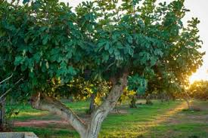
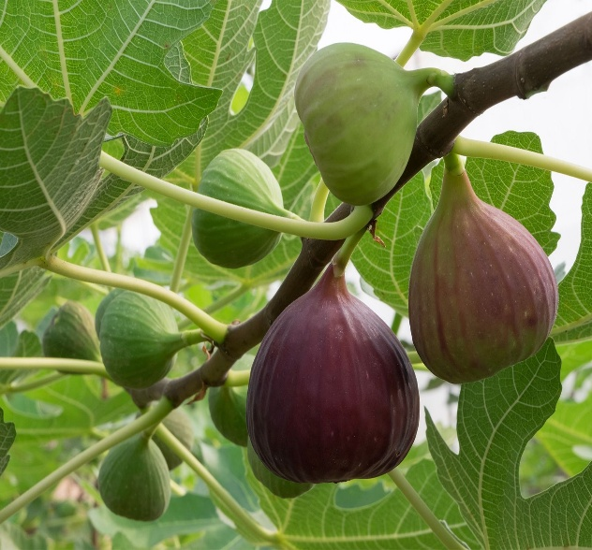
Outer Beauty but No Fruit!
Now the next day, when they had come out from Bethany, He [Jesus] was hungry. And seeing from afar a fig tree having leaves, He went to see if perhaps He would find something on it. When He came to it, He found nothing but leaves, for it was not the season for figs.
In response Jesus said to it, “Let no one eat fruit from you ever again.” And His disciples heard it.
-- Mark 11:12-14
Notes:
Image source:
https://hcog.tv/the-fruitless-fig-tree/
https://www.britannica.com/plant/fig

Slide 4
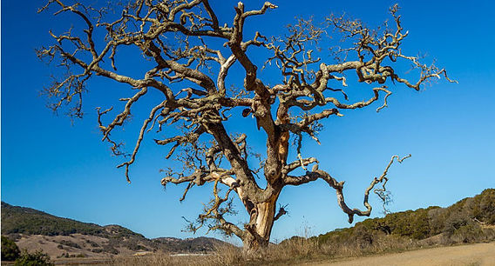
Let no one eat fruit from you ever again
“Rabbi, look! The fig tree which You cursed has withered away.”
-- Mark 11:21
Notes:
Image source:
https://www.cccc.ca/single-post/2019/01/21/grow-some-fruit-dont-wither

Slide 5
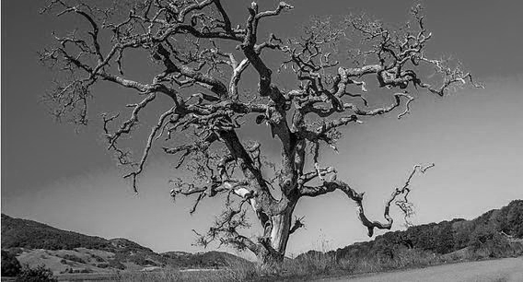
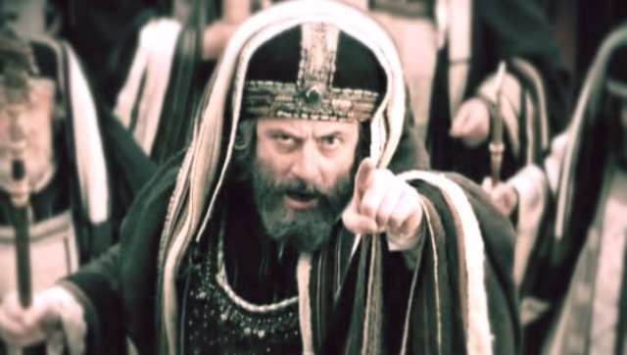
Hypocrisy
“Beware of the leaven of the Pharisees,
which is hypocrisy”
-- Luke 12:1
رياء
Notes:
Image source:
https://readingacts.com/2022/04/28/the-hypocrisy-of-the-pharisees-matthew-23/

Slide 6
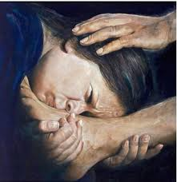
Integrity
استقامة
Notes:
Image source:
https://www.facebook.com/groups/680414867141239/posts/969927211523335/

Slide 7
Integrity
Consistently acting in accordance with your values.
Your private behavior matches your public commitments.
There is alignment between:
what you believe,
what you say,
and what you do.

Slide 8
Integrity in Christ
Consistently acting in accordance with Christian values.
Your private behavior matches your public commitments.
Alignment between:
your faith
(on the inside,
what you believe),
your words
(what you say), and
your actions
(what you do).

Slide 9
Hypocrisy
Claiming to hold values or standards
that your actions or thoughts contradict
preaching honesty while lying
condemning a bad behavior,
while you yourself privately engage in it

Slide 10
Hypocrisy
Pretending
to be good
Wanting to get the
approval of others
Living a lie …
eventually, believing the lie
Living a double-life
(good outside but not inside)

Slide 11
Dangers of Hypocrisy
Hypocrisy
hardens the heart
Hypocrisy
creeps in quietly
& settles in like a weed
A very dangerous hidden sin
Only the Lord can weed it out …
Hypocrisy prevents me from repenting!

Slide 12
Integrity vs Hypocrisy
You judge yourself
You try & work to be good
You know yourself
You seek to please God
You practice what you preach
You genuinely want to change and become better
You judge & condemn others
You pretend to be good
You fool yourself
You seek others’ praise
You preach “down to” others
You convince yourself that you are already righteous
“Those who are well have no need of a physician, but those who are sick.
I did not come to call the righteous,
but sinners, to repentance.”

Slide 13
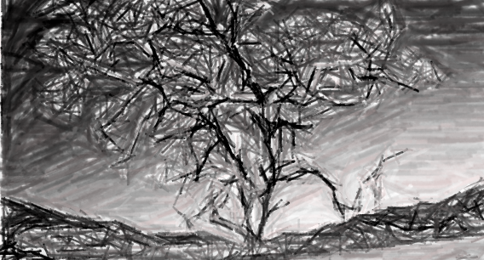
Hypocrisy has many “cousins”
The sin of Pride
Judging & Condemning
Anger, Hatred, Lacking Peace
Self-righteousness
Spiritual Blindness
Spiritual Lukewarmness
…
Hypocrisy leads to a
shallow and fruitless life!
“Let no one eat fruit from you ever again!”

Slide 14
“Because you say,
‘I am rich, have become wealthy, and have need of nothing’—and do not know that you are wretched, miserable, poor, blind, and naked”
– Revelation 3:17
to the Angel of the
Church of Laodicea

Slide 15
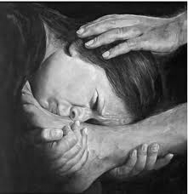
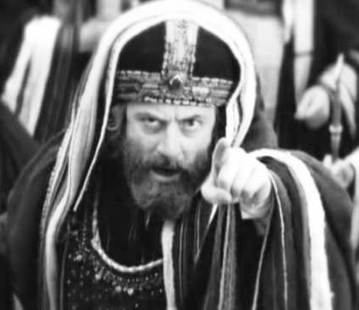


Wisely focus our effort …
on trying to become better,
not pretending to be righteous!
Repentance
Hypocrisy
“Those who are well have no need of a physician,
but those who are sick.
I did not come to call the righteous,
but sinners, to repentance.”

Slide 16
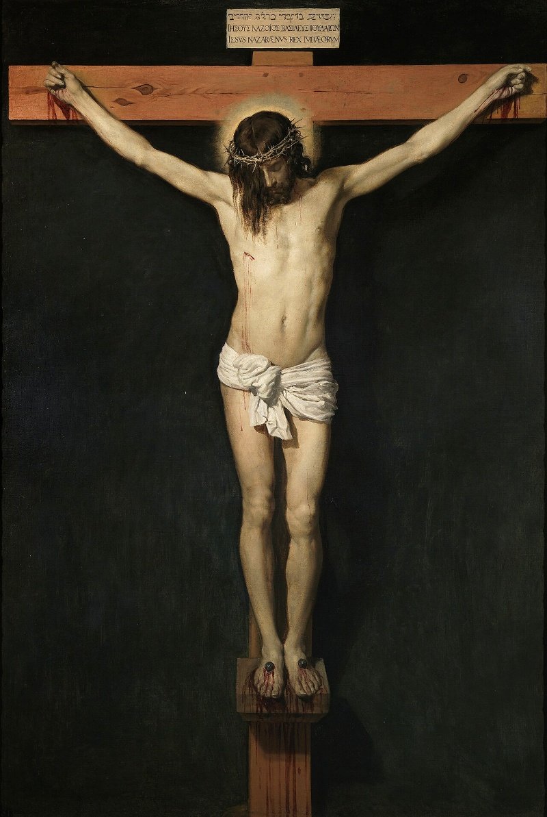
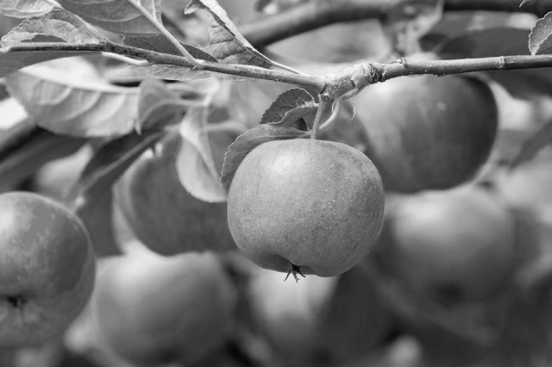
Integrity and its “cousins”
Self-examination
Humility & Honesty
Continual Repentance
Courage to do what is right
Courage to ask for God’s help
Coming Closer & Closer to the Lord
…
Integrity leads to an
authentic & fruitful life!
“A good tree is known by its fruit.”
Do I want a fruitful life in Christ?

Slide 17
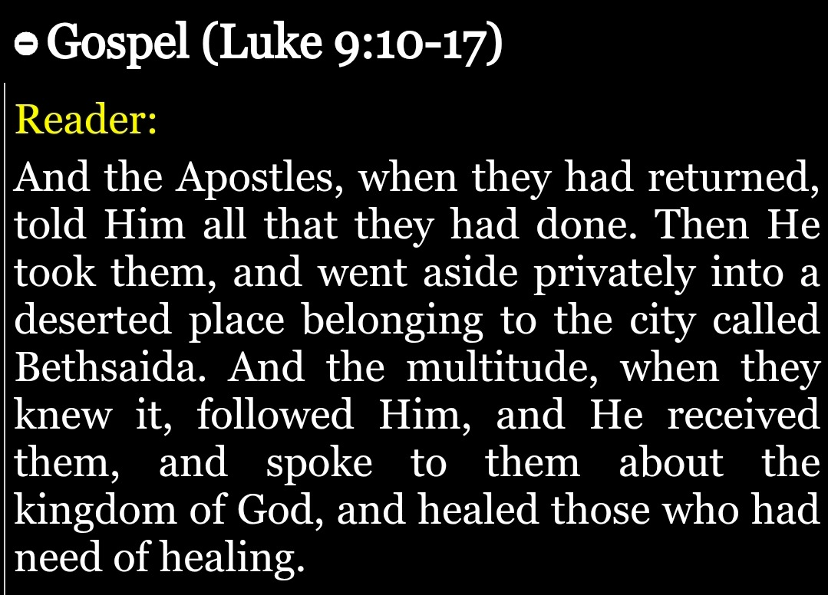
Do I want a fruitful life?
Do I realize that I need healing?

Slide 18
Do I need healing?
Seek healing from
the One true Physician
Seek to be saved by
the Only true Saviour
Seek to be forgiven by
the One who paid the price
Seek comfort at
the feet of Him who truly loves you
His arms are open for you & me!

Slide 19
A call to action!
We have a Healer,
a Helper, a Saviour.
Do not waste time and effort convincing others or yourself that it's “all good”
(AVOID HYPOCRISY)
Instead seek to have integrity and run to Him who alone IS all Good.
(INTEGRITY IN CHRIST)
Thine is the Power!

Slide 20




Choose one…
REPENTANCE
Upward spiral
leading to salvation and
eternal life.
HYPOCRISY
Downward spiral of lies
leading to condemnation.
OR
Notes:
Image source:
https://www.istockphoto.com/illustrations/upward-spiral
https://www.istockphoto.com/photos/spiral-down

Slide 21
Fight the good fight …
Do NOT waste effort
to PRETEND to be good.
Use your effort & prayers
to BECOME better.
Do not worry about looking good … but about being good.

Slide 22
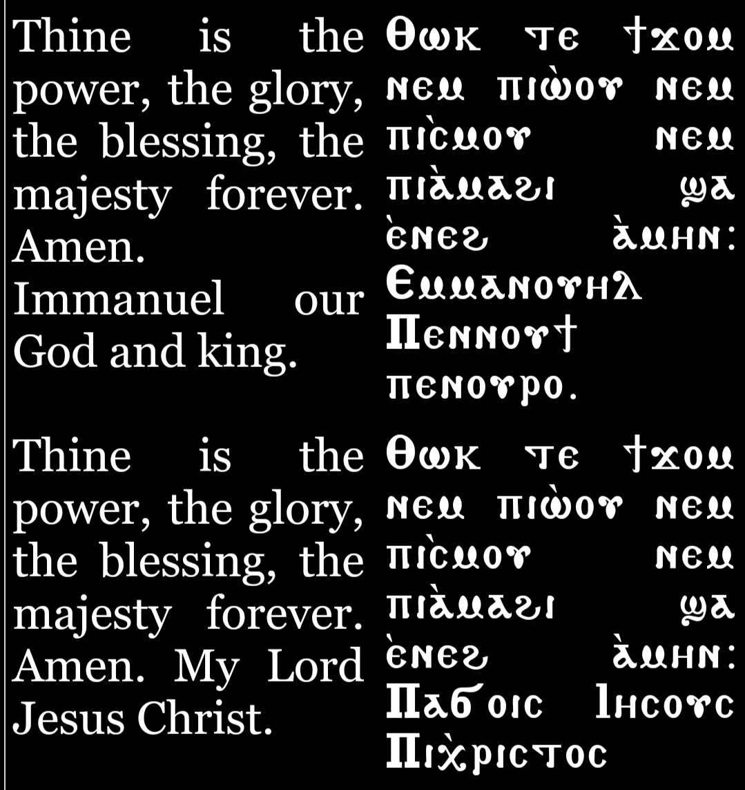
There is hope!
He has the power to cleanse.
The Lord has the power to save!
Can we really root out this dangerous sin?
“The things which are impossible
with men are possible with God.”
Do not worry about looking good … focus on being good.

Slide 23
Thine is the power!
The Lord has the power to save,
He has the power to cleanse.
But we need to repent.
The Lord asks each of us,
“Do you want to be saved?”
Do not worry about looking good … but about being good.

Slide 24
Especially during this most Holy Week …
SEEK INTEGRITY
Examine yourself
Repent & confess …
try & work to be better
Seek to please God
Practice what you preach
Genuinely make an effort to become better & better
ROOT OUT HYPOCRISY
Do not judge others
Do not condemn others
Forgive & you will be forgiven
Do not pretend to be good
Do not seek others’ praise
Do not trick yourself into thinking you are righteous
“Those who are well have no need of a physician, but those who are sick.
I did not come to call the righteous,
but sinners, to repentance.”

