Slide 1
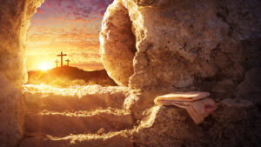
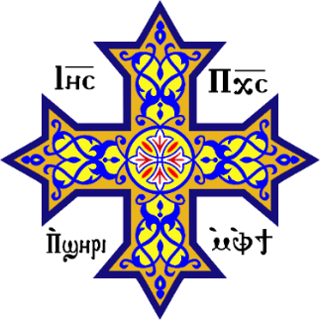
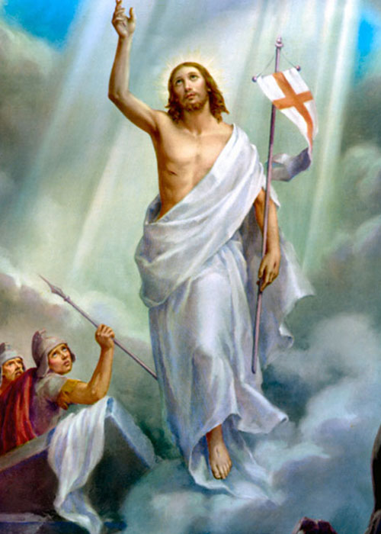

Resurrection and the Holy Sacraments
May 5, 2026
audio.stmary-ottawa.org/sermons/2026/SMO-2026-05-05-Sacraments.pdf
Notes:
Image source:
https://apologeticspress.org/reasoning-about-the-resurrection-of-christ-3689/
https://mycatholicprayers.com/prayers/prayer-to-the-risen-christ/
https://en.wikipedia.org/wiki/Coptic_cross

Slide 2
“I will give you a new heart and put a new spirit within you;
I will take the heart of stone out of your flesh and give you a heart of flesh.”
(Ezekiel 36:26)
Heart of stone → Death
New heart of flesh → Risen Alive!
How, Lord, will you do this? Through Resurrection and the Sacraments!

Slide 3
Without or With the Power of Resurrection
Hardened Heart
Lacking Meaning
Sense of Darkness
Sadness & Despair
Hopeless
Restless
Defeated
Enslaved by sin
New Heart
Full of Life
Light of Christ
Joy in the Lord
Hope
At Peace
Victorious
True Freedom

Slide 4
Power of the Resurrection
“I can do all things through Christ who strengthens me.”
(Philippians 4:13)
The risen Christ strengthens me!

Slide 5
Without Resurrection
“And if Christ is not risen, then our preaching is empty and your faith is also empty.”
(I Corinthians 15:14)
Without Resurrection, there is no Christianity!

Slide 6
“Then the disciples were glad when they saw the Lord.”
(John 20:20)
Full of joy, courage & faith in the risen Lord!
No more fear, no more doubt, no more terror.

Slide 7
Power of the Lord’s Resurrection
He rose in glory
He rose victorious
He rose with a glorified body
He did not need someone to raise Him
The Lord rose by His own Divine Power
He rose with the tomb sealed with the stone
He spent 40 days teaching His disciples things pertaining to the Kingdom of God (Acts 1:1-3)

Slide 8
His Resurrection
The Lord overcame the power of death.
The Lord defeated the devil and his evil army.
The Lord opened the gate of Paradise.
The Lord restored Adam.
“I can do all things through Christ who strengthens me.”
(Philippians 4:13)

Slide 9
Living the Resurrection
Live the Resurrection through the Holy Sacraments.
“I can do all things through Christ who strengthens me.”
(Philippians 4:13)

Slide 10
Our Church is a Sacramental Church
What is a Sacrament? Invisible Gift of God with Visible Sign
+
Visible Sign
Administered by a Priest
Seen by our Physical Eyes
Invisible Gift
Work of the Holy Spirit
Seen by the Eyes of Faith
“Outward and visible signs of an inward and spiritual grace.”
- Saint Augustine

Slide 11
7 Sacraments
ADMINISTERED ONCE
Baptism Gift of a new nature able to enter God’s Kingdom
Confirmation Gift of becoming a dwelling of God’s Holy Spirit
Confession Gift of forgiveness of sins when we faithfully repent
Communion Gift of the Lord’s risen Body and life-giving Blood, given for remission of sin, and attaining eternal life
Unction Gift of healing (“Andeel” in Arabic)
Marriage Gift of unity of Bride & Groom in Christ
Priesthood Gift of administering God’s sacraments
REPEATED OFTEN
SPECIAL CALLING

Slide 12
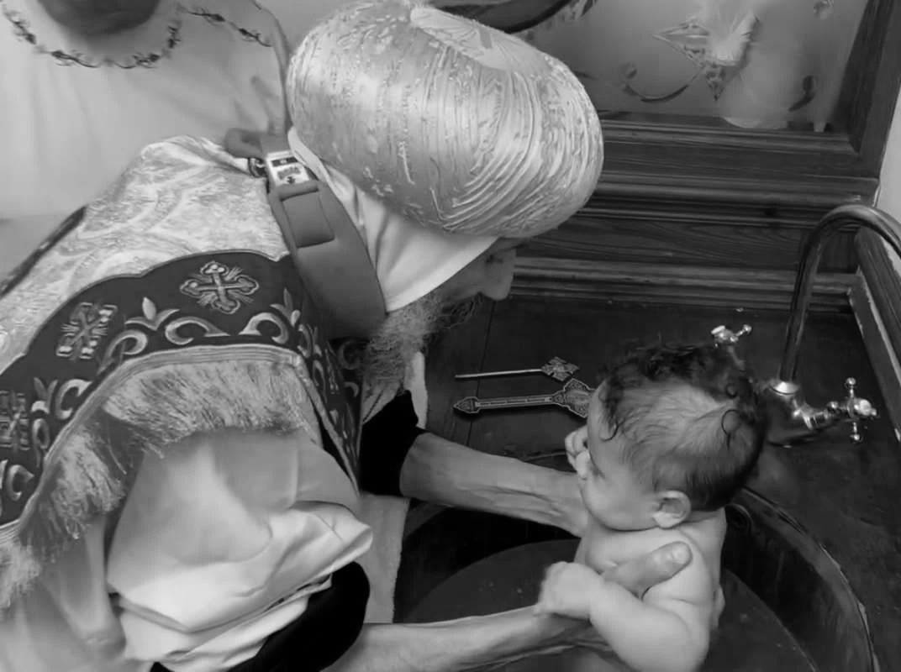
Baptism

Slide 13

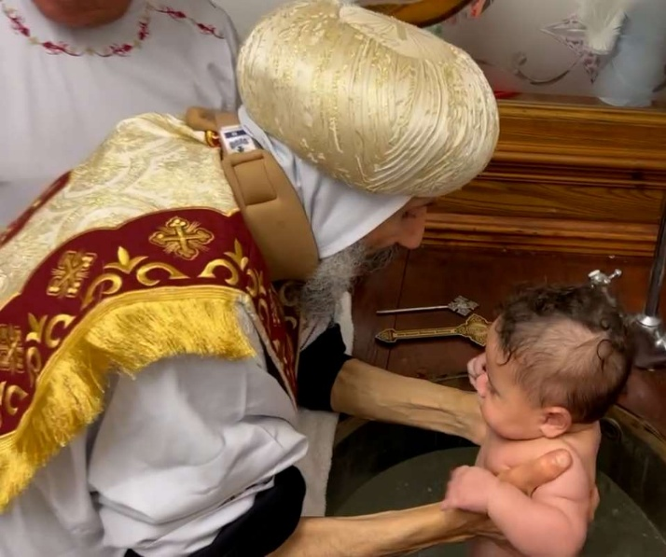
Baptism
Adopted into God’s family … Citizenship in God’s Kingdom
A New Birth, a New Nature
Die with Christ (old nature), Rise with Christ (new nature)
Visible Sign: Water
Baptism by immersion 3 times:
Buried with Christ for three days
In the Name of the Holy Trinity
“Go therefore and make disciples of all nations, baptizing them in the name of the Father and of the Son and of the Holy Spirit.”
(Matthew 28:19)
Notes:
Image source:
https://stmaryandstjohn.org/en/coptic-orthodox-faith/the-seven-sacraments

Slide 14

Baptism
Baptism is my resurrection from death to life. A new life in the risen Christ
Buried & risen!
From darkness of old nature to the light of the risen Lord

Slide 15
A new birth
“Most assuredly, I say to you, unless one is born of water and the Spirit, he cannot enter the kingdom of God.”
(John 3:5)

Slide 16
A new life
“we were buried with Him through baptism into death, that just as Christ was raised from the dead by the glory of the Father, even so we also should walk in newness of life.”
(Romans 6:4)

Slide 17
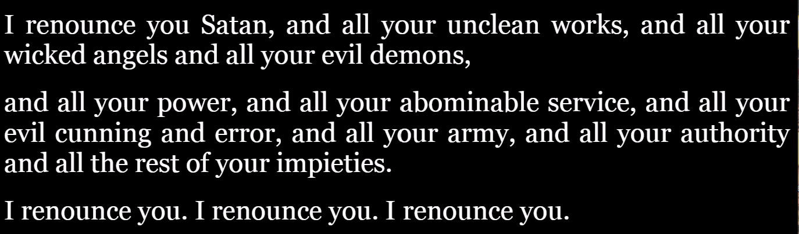
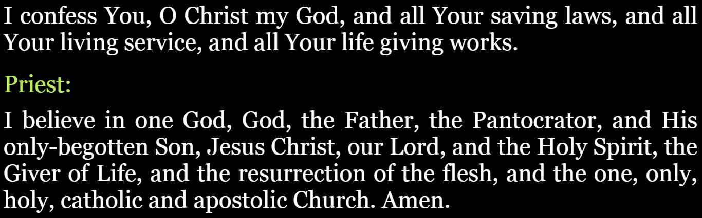
From darkness to light
Reject evil – Renounce Satan
Accept new life with God

Slide 18
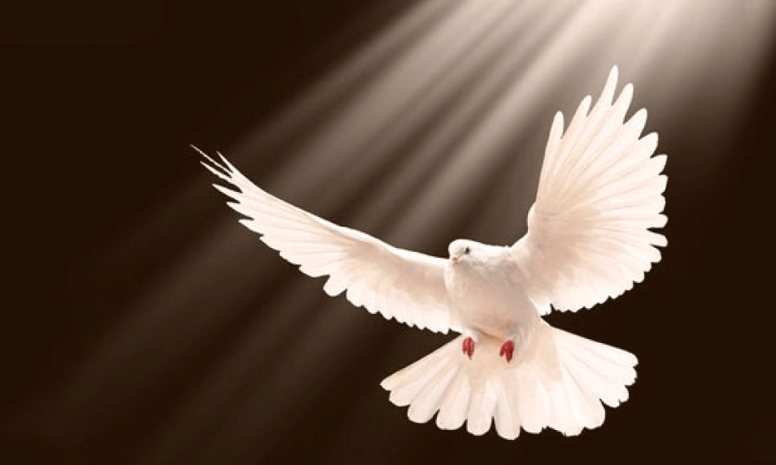
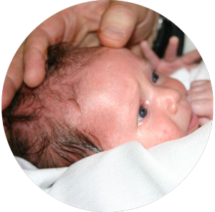
Confirmation
Notes:
Image source:
https://awf.world/theology-and-history/person-and-work-of-the-holy-spirit/
https://www.dreamstime.com/sacred-anointing-oil-bottle-christian-cross-symbol-radiance-sacred-anointing-oil-bottle-christian-cross-symbol-image414338575

Slide 19
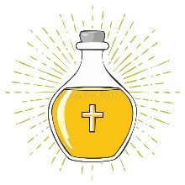
Confirmation
Dwelling of the Holy Spirit
Confirmation also called Chrismation
The body (along with spirit) dedicated to the Lord
Holy Chrismation ‘Myron’ Oil anoints 36 crosses on entire body
Coptic Church administers this immediately following Baptism
Visible Sign: Holy Chrismation Oil

Slide 20
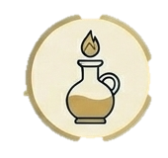
Confirmation
“But this He spoke concerning the Spirit whom those believing in Him would receive; for the Holy Spirit was not yet given, because Jesus was not yet glorified.”
(Acts 7:39)

Slide 21
The Paraclete
The Lord rose, ascended, and sent us the Paraclete.
“It is to your advantage that I go away; for if I do not go away, the Helper will not come to you; but if I depart, I will send Him to you.”
(John 16:7)

Slide 22
Confirmation
Confirmed with Holy Oil.
36 Crosses sealing the entire body.
The Cross of Christ leads to Resurrection.
There is no Resurrection without the Cross, and there is no Christian Cross without Resurrection.

Slide 23
Confirmation
“that I may know Him and the power of His resurrection, and the fellowship of His sufferings, being conformed to His death.”
(Philippians 3:10)

Slide 24
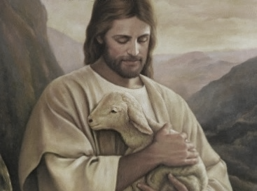
Confession
Notes:
Image source:
https://www.etsy.com/au/listing/125701961/jesus-christ-with-lamb-high-quality-hand

Slide 25
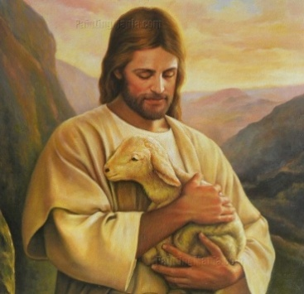
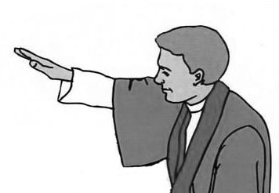
Confession
Gift of Forgiveness
Goes hand-in-hand with Repentance
Stop doing bad (harmful) things
Increase doing good (useful) things
Forgiveness through the price paid by the Lord
Practiced regularly (remember to confess every 1-2 months)
Important to receive this absolution prior to communion
A general absolution is prayed at the beginning of the Liturgy, for sins that have yet to be confessed
Visible Sign: Laying of hands of the Priest to give Absolution

Slide 26

Risen!
Repentance and Confession from death of sin to a risen life leading to eternal life
“For the wages of sin is death, but the gift of God is eternal life in Christ Jesus our Lord.”
(Romans 6:22)

Slide 27
Forgiven!
“If we say that we have no sin, we deceive ourselves, and the truth is not in us. If we confess our sins, He is faithful and just to forgive us our sins and to cleanse us from all unrighteousness.”
(I John 1:8-9)

Slide 28
New life in the Risen Christ
“I have been crucified with Christ; it is no longer I who live, but Christ lives in me; and the life which I now live in the flesh I live by faith in the Son of God, who loved me and gave Himself for me.”
(Galatians 2:20)

Slide 29
Absolution
The priest has the authority to provide absolution to those who repent & confess.
“Assuredly I say to you, whatever you bind on earth will be bound in heaven, and whatever you loose on earth will be loosed in heaven.”
(Matthew 18:18)

Slide 30
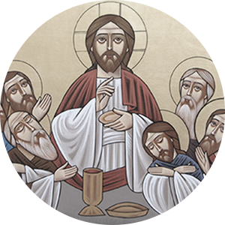
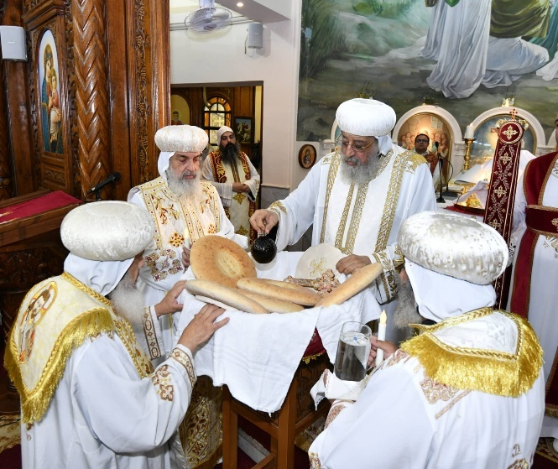
Communion
Notes:
Image source:
https://copticorthodox.church/en/2024/09/14/h-h-pope-tawadros-ii-prays-the-golden-jubilee-liturgy-at-the-church-of-st-gawargious-and-st-anthony-in-nozha/

Slide 31
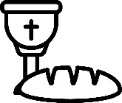
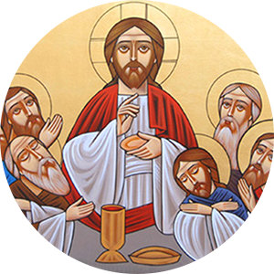
Communion
Body & Blood of Christ
Visible sign: Bread & Wine
Bread transformed to the Body
Wine transformed to the Blood
Most Holy Sacrament of Sacraments
Holy Eucharist given for:
Remission of our Sins
Obtaining Eternal Life
Notes:
Image source:
https://www.vecteezy.com/vector-art/25095452-communion-icon-in-line-art

Slide 32
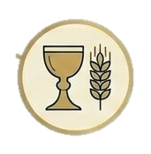
Communion
“Take eat, this is My Body.” Then He took the cup, and when He had given thanks He gave it to them, and they all drank from it and He said to them “This is My Blood of the new covenant which is shed for many” (Mark 14:22-24)

Slide 33
Communion
Communion renews the Power of Resurrection in our lives.
The Lord’s Body & Blood is given:
for the remission of sins for those who repent & regularly confess,
and for eternal life … partake of the Tree of Life!

Slide 34
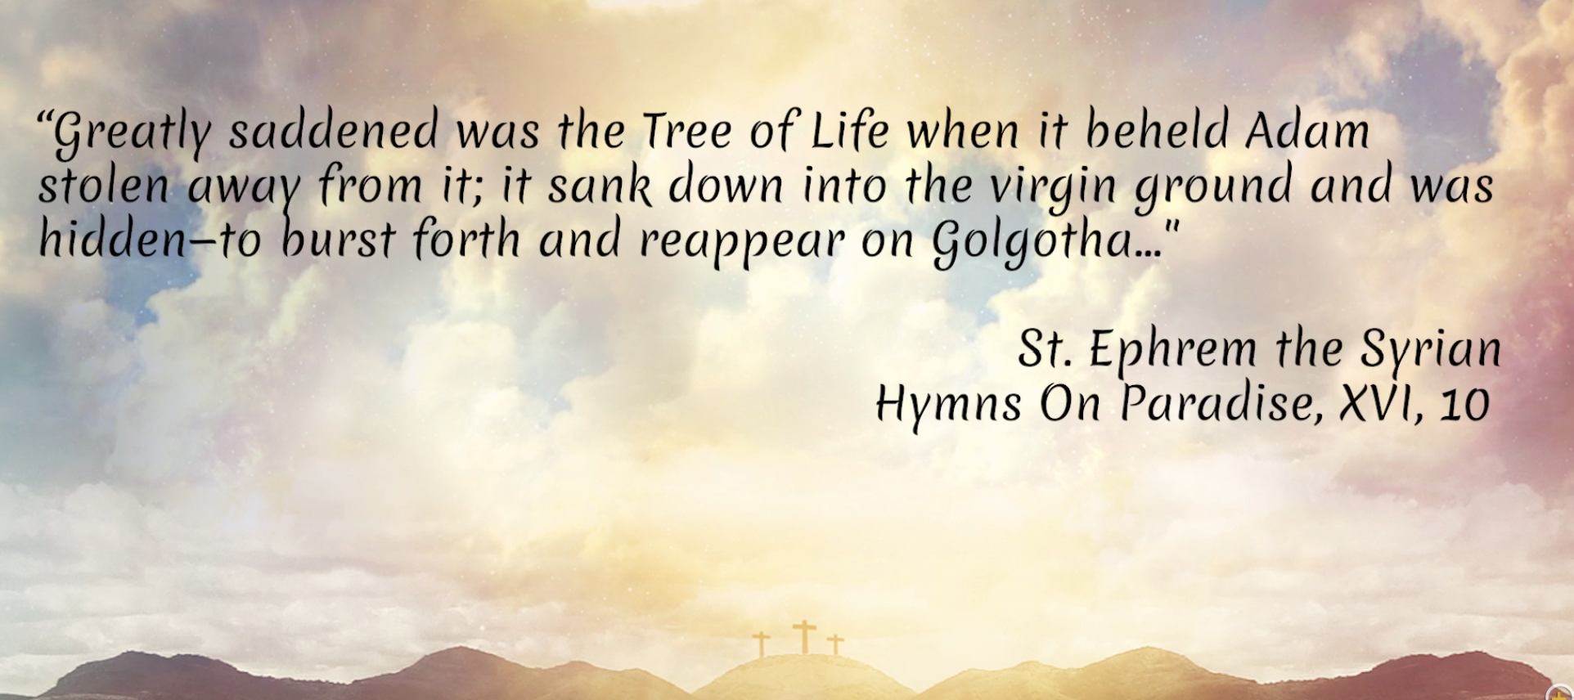
The Tree of Life
Notes:
Image source:
https://youtu.be/3szLkFEvk0E?t=48
Fr. Gabriel Wissa on What does the Tree of Life represent?

Slide 35
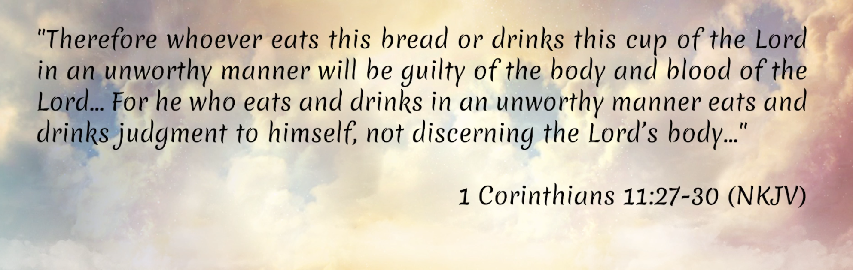
Approach in a worthy manner!
Notes:
Image source:
https://youtu.be/3szLkFEvk0E
Fr. Gabriel Wissa on What does the Tree of Life represent?

Slide 36
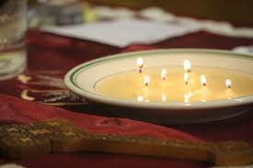
Unction
Notes:
Image source:
https://www.facebook.com/St.MosesCopticOrthodoxChurch/posts/the-sacrament-of-the-unction-of-the-sick-is-one-of-the-holy-seven-sacraments-of-/912631332506545/

Slide 37

Unction
Healing … according to God’s will
Visible sign: Holy Unction Oil
Coptic Church practices this sacrament:
For Families or Individuals (in houses of the believers)
Communally (in church, typically during Great Lent)

Slide 38

Heal the sick!
“Whatever city you enter, … And heal the sick …”
(Luke 10:8-9)
“Heal the sick, cleanse the lepers, raise the dead, cast out demons. Freely you have received, freely give.”
(Matthew 10:8)
“And they cast out many demons, and anointed with oil many who were sick, and healed them.”
(Mark 6:13)

Slide 39
Unction
Healing & Forgiveness
“Is anyone among you sick? Let him call for the elders of the church, and let them pray over him, anointing him with oil in the name of the Lord. And the prayer of faith will save the sick, and the Lord will raise him up. And if he has committed sins, he will be forgiven.”
(James 5:14-15)

Slide 40
Unction
The Lord will raise him up. And he will be forgiven.
“Confess your trespasses to one another, and pray for one another, that you may be healed.”
(James 5:16)

Slide 41
Unction
The Lord will raise him up. And he will be forgiven.
The Lord may or may not always provide physical healing.
The Lord cares more for spiritual healing & forgiveness.
“For I consider that the sufferings of this present time are not worthy to be compared with the glory which shall be revealed in us.”
(Romans 8:18)

Slide 42
Unction Prayer
The priests prays the following:
(at the end of the 1st Unction Prayer)
“O You who raised from death the widow’s son and the official’s daughter when You commanded them to rise, and raised Lazarus from Hades after he had been dead for four days by the authority of Your divinity; raise up Your servant from the death of sin; and if You command to raise him up in another time, give him support and help that he may please You while in the world and all the days of his lifetime.
And if You advocate that his soul be taken, let it be by powerful hands of angels of light to save him from the demons of darkness. Transform him to the Paradise of joy to be with all the saints …”

Slide 43
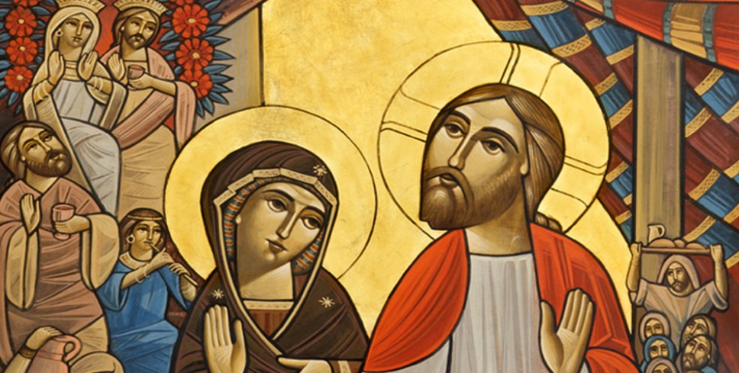
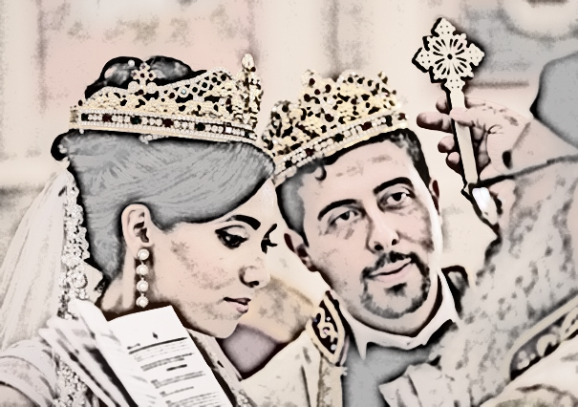
Marriage
Notes:
Image source:
http://www.stgeorgeministry.com/homily-wedding-cana/
https://scottshawphoto.com/marian-and-edys-cleveland-wedding-cleveland-wedding-photographer-scott-shaw-photo/b-st-mark-coptic-orthodox-wedding-11/

Slide 44

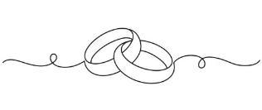
Marriage
Union of … Christ, Groom, Bride
Visible sign: wedding rings
Coptic Ceremony full of wonderful symbols with deep meanings (crowns, robes, rings)
Holy Matrimony is an unbreakable covenant (no divorce) according to the words of Christ, “what God has joined, let no man separate”

Slide 45
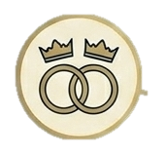
Marriage
Holy Matrimony is the height of joy.
The union of man & woman is likened to the union of Christ with the Church!
“For this reason a man shall leave his father and mother and be joined to his wife, and the two shall become one flesh. This is a great mystery, but I speak concerning Christ and the church.”
(Ephesians 5:31-32)

Slide 46
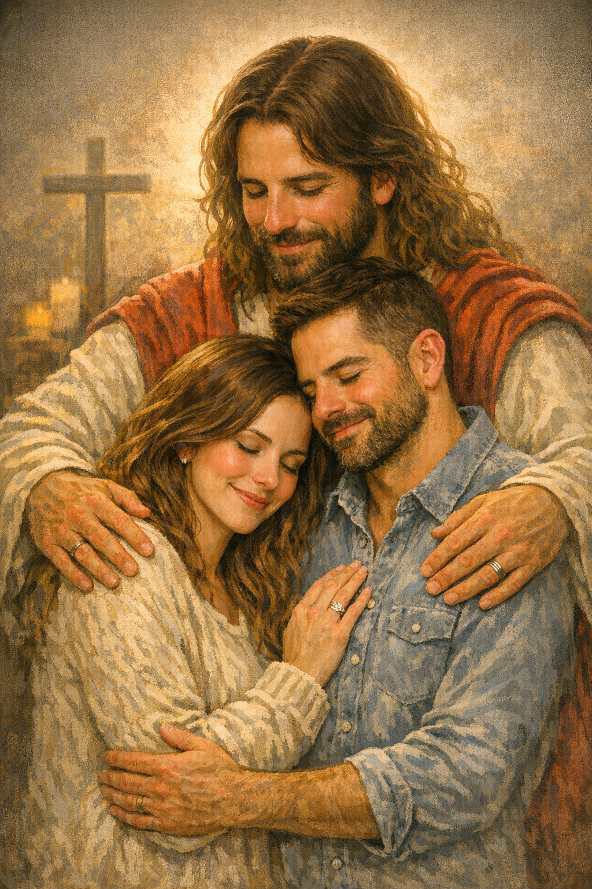
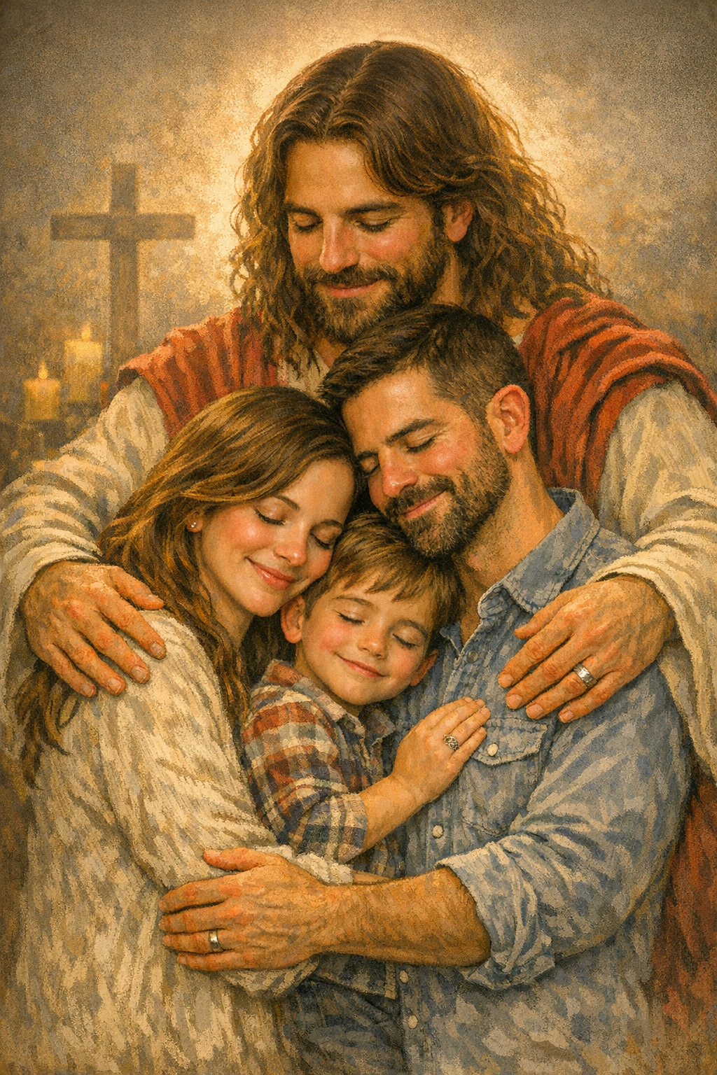
Marriage
“For where two or three are gathered together in My name, I am there in the midst of them.”
(Matthew 18:20)
Notes:
Image source:
AI Generated by Microsoft Copilot Chat on May 5th, 2026

Slide 47
Marriage
The Church as a whole is the Bride of Christ,
And the soul of every Christian is also wed to Christ!
“Therefore, just as the church is subject to Christ, so let the wives be to their own husbands in everything.
Husbands, love your wives, just as Christ also loved the church and gave Himself for her.”
(Ephesians 5:24-25)

Slide 48

Marriage
The first sacrament performed by God was the marriage of Adam & Eve!
Then the rib which the Lord God had taken from man He made into a woman, and He brought her to the man. And Adam said: “This is now bone of my bones and flesh of my flesh; She shall be called Woman, because she was taken out of Man.” Therefore a man shall leave his father and mother and be joined to his wife, and they shall become one flesh.
(Genesis 2:22-24)
The first miracle performed by the Lord was turning water into wine at the Wedding of Cana of Galilee. (John 2:1-11)
Notes:
Image source:
https://theadventum.com/blogs/the-adventum-blog/adam-and-eve

Slide 49
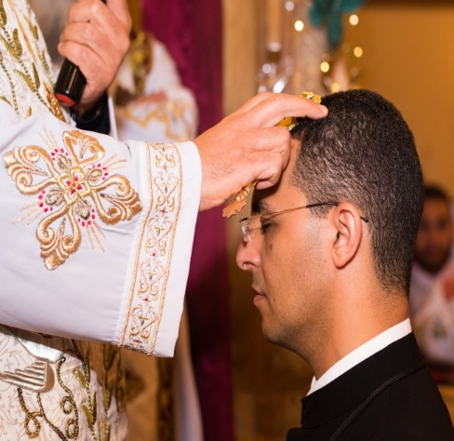
Priesthood
Notes:
Image source:
https://twitter.com/suscopts/status/785477188892123136
Fr. Joshua Gerges - Priest Ordination
Oct 9, 2016

Slide 50
Priesthood
Minister of Christ to administer the Sacraments
Unbreakable covenant
Priesthood is a calling for life
Visible sign: laying of hands
Coptic Priests can be Celibate or Married
Only a small group is granted this mystery
“No man takes this honour unto himself, but it is for those who God calls, as Aaron was”
(Hebrews 5:4)

Slide 51
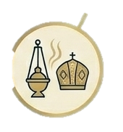
Priesthood
The Holy Spirit acts in the priest, enabling him to administer the sacraments.
He is granted to rise to a new level, a new resurrection, a new life of service.
The priest receives a new name, new attire, and even a new look suitable for this new level of service.

Slide 52
Priesthood
After the Lord’s Resurrection, He breathed on them, and said to them, “Receive the Holy Spirit. If you forgive the sins of any, they are forgiven them. If you retain the sins of any,
they are retained.”
(John 20:22-23)

Slide 53
Priesthood
Only a priest can grant absolution:
“Lord, if we have committed any sin against You knowingly or unknowingly, or through anguish of heart, whether in deed or word or from faint-heartedness, O Master who knows the weakness of men as the Good One and Lover of Mankind, O God, grant us the forgiveness of our sins, bless us, purify us, absolve us, and all Your people.”

Slide 54
Priesthood
“The harvest truly is plentiful, but the laborers are few. Therefore pray the Lord of the harvest to send out laborers into His harvest.”
(Matthew 9:37-38)

Slide 55
CHOOSE WISELY … Without or With the Holy Sacraments
Hardened Heart
Lacking Meaning
Sense of Darkness
Sadness & Despair
Hopeless
Restless
Defeated
Enslaved by sin
New Heart
Full of Life
Light of Christ
Joy in the Lord
Hope
At Peace
Victorious
True Freedom
Keep the Power of Resurrection active through the work of the Holy Spirit in the Sacraments!
Repentance & Confession and Communion are essential to our Christian life.

Slide 56




On the Sacraments
Father Shenouda talk [May 1, 2026]: youtube.com/watch?v=8PMLkYdAc6w
suscopts.org/coptic-orthodox/church/sacraments
stmaryandstjohn.org/en/coptic-orthodox-faith/the-seven-sacraments
Slide material from today’s talk [May 5, 2026]: audio.stmary-ottawa.org/sermons/2026/SMO-2026-05-05-Sacraments.pdf

Slide 57
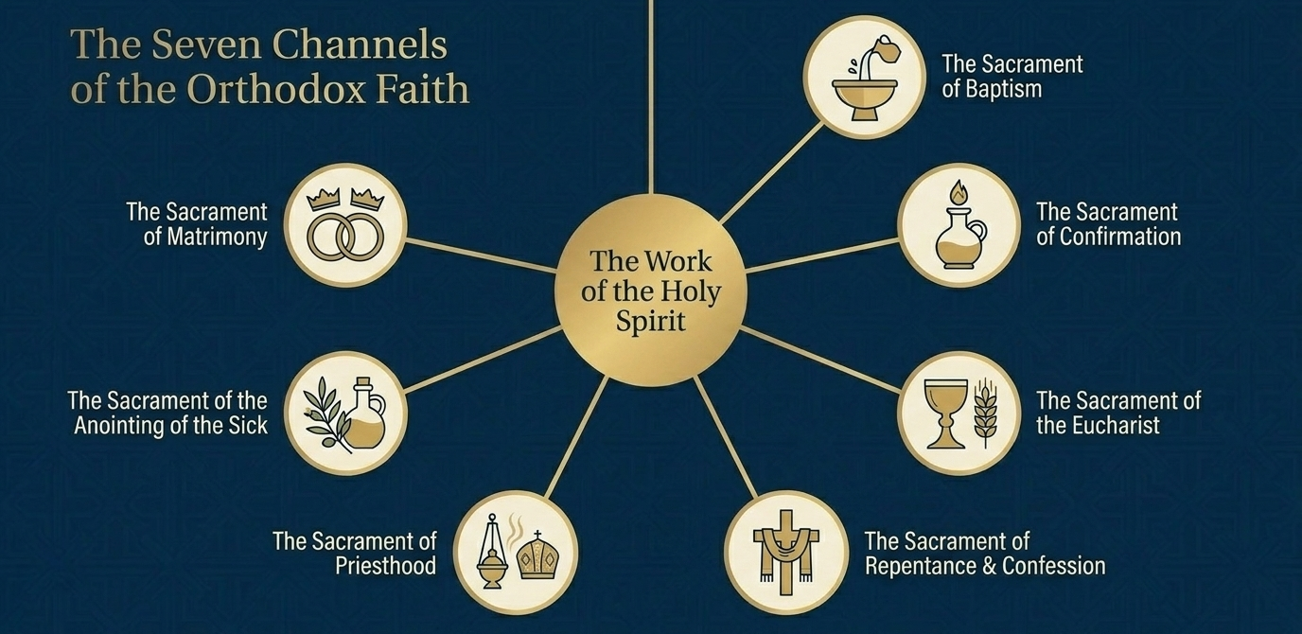
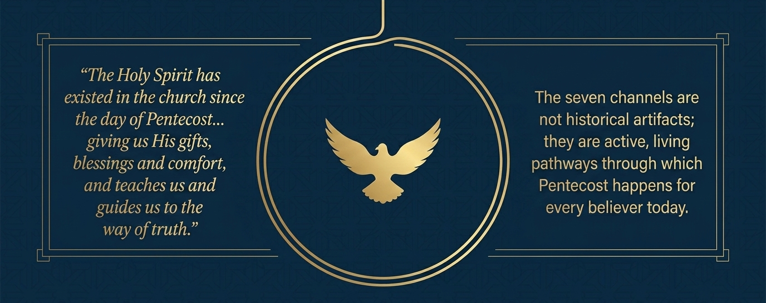

Slide 58
