Slide 1
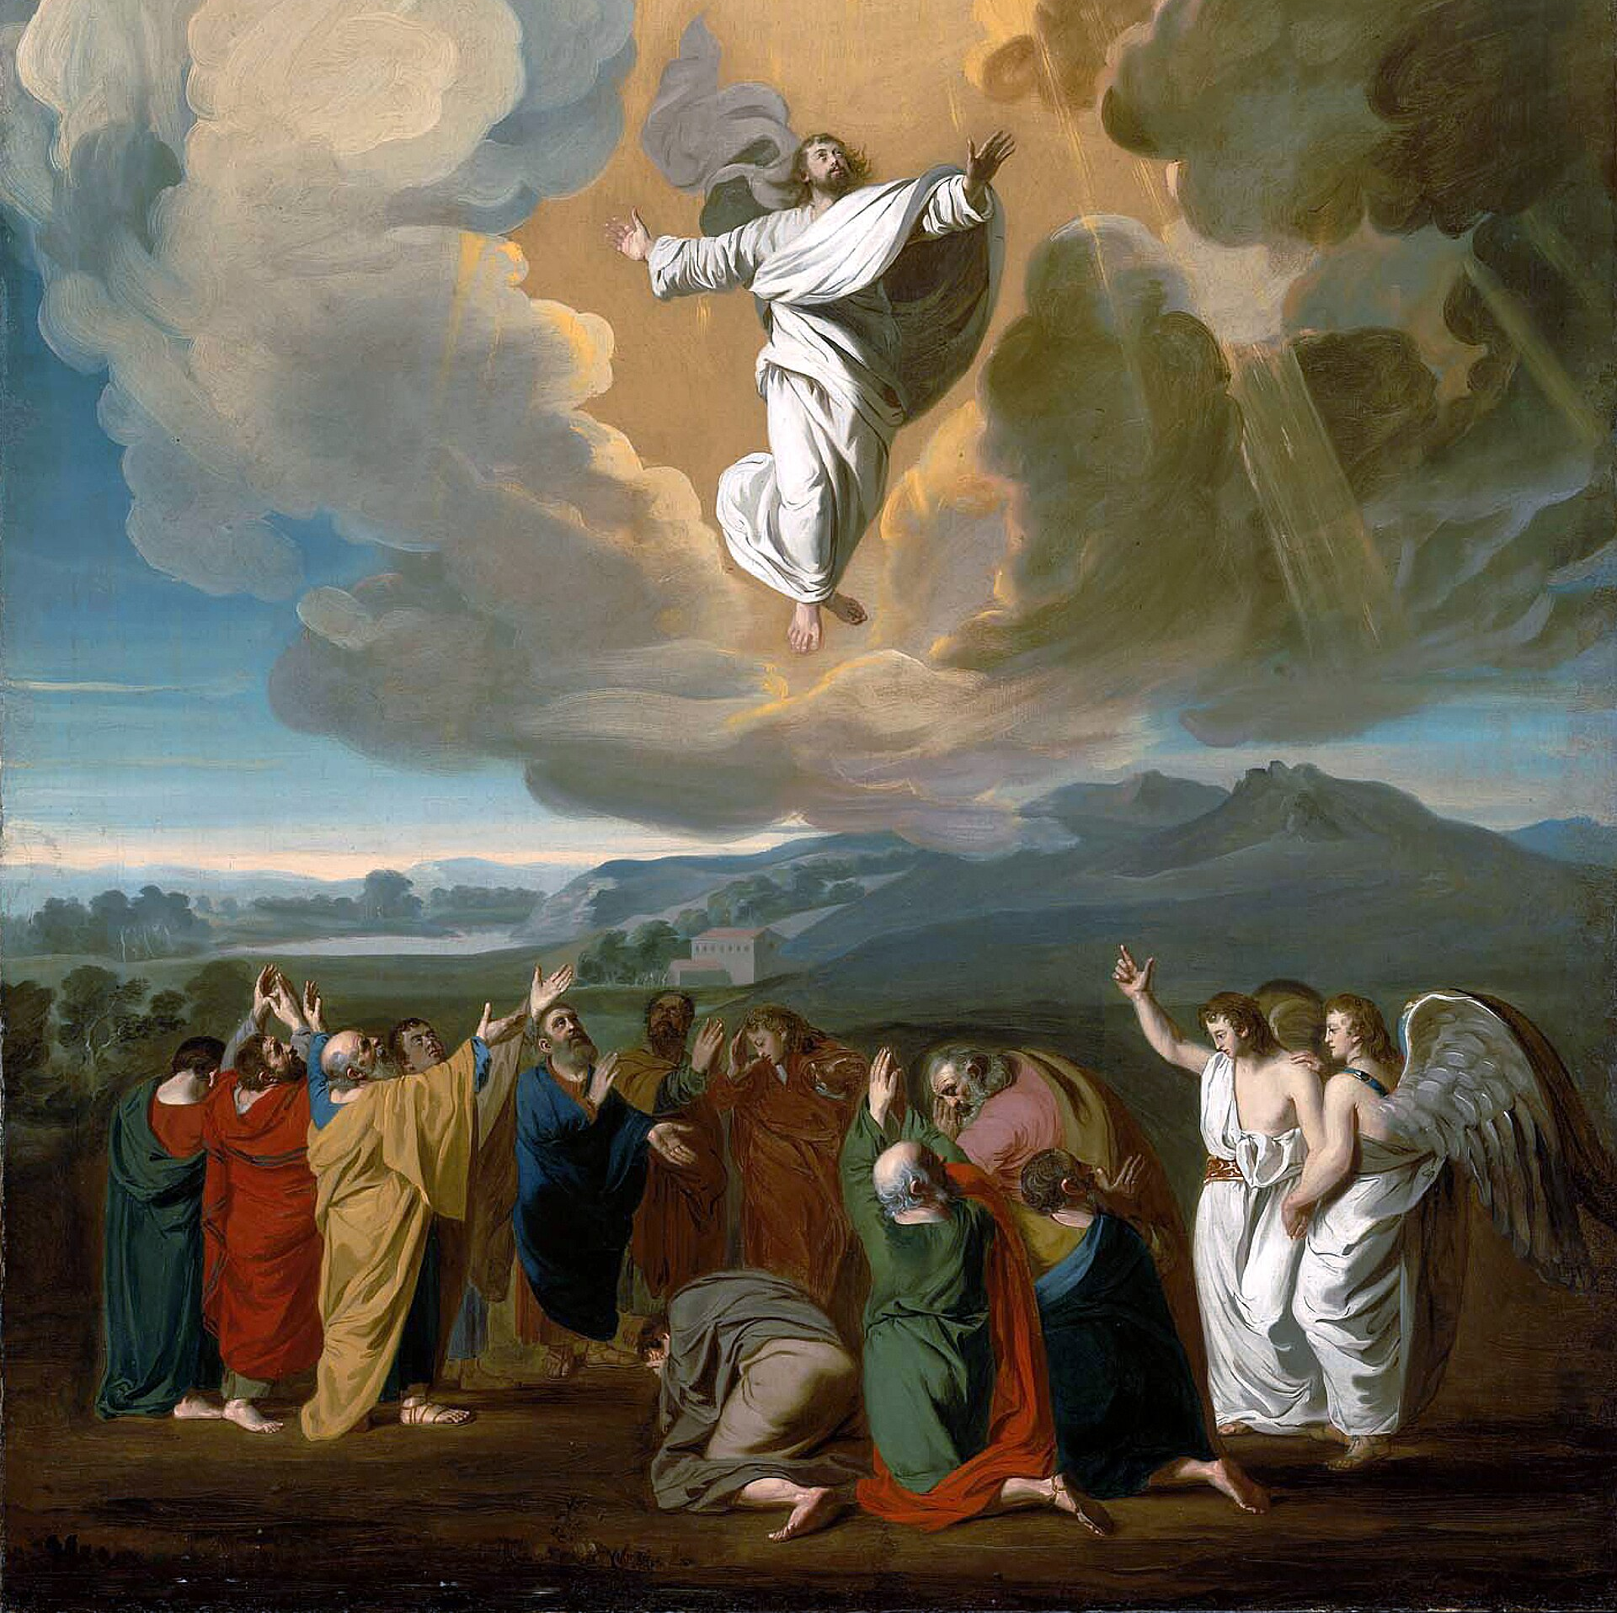
The Ascension
TLG May 19th 2026

Slide 2
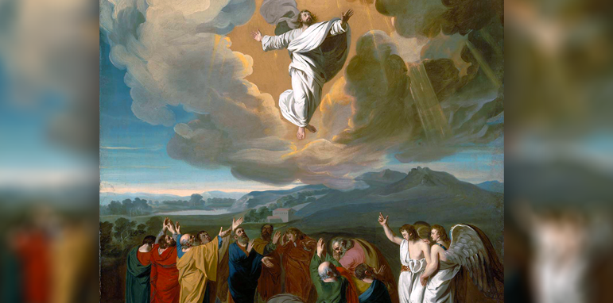
So what? What does it mean for me?

Slide 3
The Ascension Passages
Mark 16:15-20
Luke 24:50-54
Acts 1:6-11

Slide 4
Mark 16:15-20
¹⁵ And He said to them, “Go into all the world and preach the gospel to every creature. ¹⁶ He who believes and is baptized will be saved; but he who does not believe will be condemned. ¹⁷ And these signs will follow those who believe: In My name they will cast out demons; they will speak with new tongues;¹⁸ they will take up serpents; and if they drink anything deadly, it will by no means hurt them; they will lay hands on the sick, and they will recover.”
¹⁹ So then, after the Lord had spoken to them, He was received up into heaven, and sat down at the right hand of God. ²⁰ And they went out and preached everywhere, the Lord working with them and confirming the word through the accompanying signs. Amen.
Notes:
Promise of the Holy Spirit
/
Humanity back in heaven/paradise
Preach the Gospel

Slide 5
Luke 24:50-54
⁴⁴ Then He said to them, “Thus it is written, and thus it was necessary for the Christ to suffer and to rise from the dead the third day, ⁴⁷ and that repentance and remission of sins should be preached in His name to all nations, beginning at Jerusalem. ⁴⁸ And you are witnesses of these things. ⁴⁹ Behold, I send the Promise of My Father upon you; but tarry in the city of Jerusalem until you are endued with power from on high.”
⁵⁰ And He led them out as far as Bethany, and He lifted up His hands and blessed them. ⁵¹ Now it came to pass, while He blessed them, that He was parted from them and carried up into heaven. ⁵² And they worshiped Him, and returned to Jerusalem with great joy, ⁵³ and were continually in the temple praising and blessing God. Amen.

Slide 6
Acts 1:6-11
⁶ Therefore, when they had come together, they asked Him, saying, “Lord, will You at this time restore the kingdom to Israel?” ⁷ And He said to them, “It is not for you to know times or seasons which the Father has put in His own authority. ⁸ But you shall receive power when the Holy Spirit has come upon you; and you shall be witnesses to Me in Jerusalem, and in all Judea and Samaria, and to the end of the earth.”
⁹ Now when He had spoken these things, while they watched, He was taken up, and a cloud received Him out of their sight. ¹⁰ And while they looked steadfastly toward heaven as He went up, behold, two men stood by them in white apparel, ¹¹ who also said, “Men of Galilee, why do you stand gazing up into heaven? This same Jesus, who was taken up from you into heaven, will so come in like manner as you saw Him go into heaven.”

Slide 7
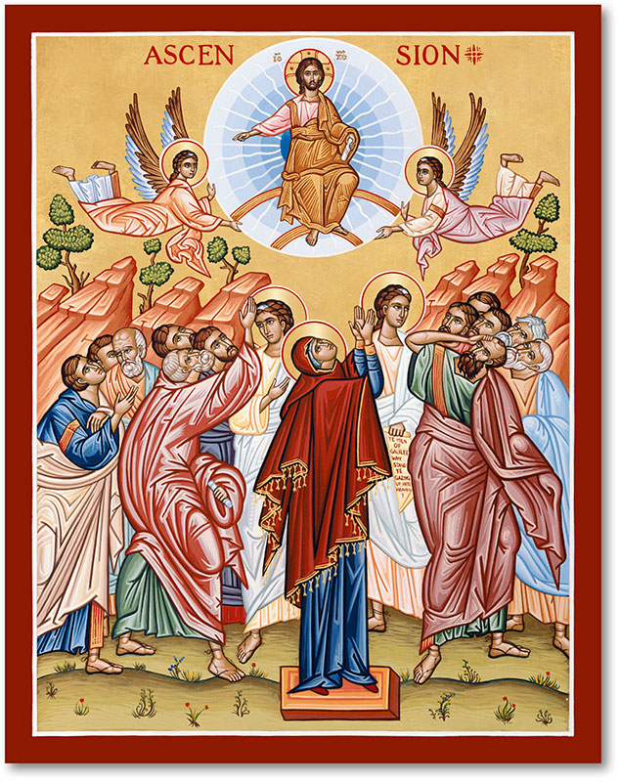
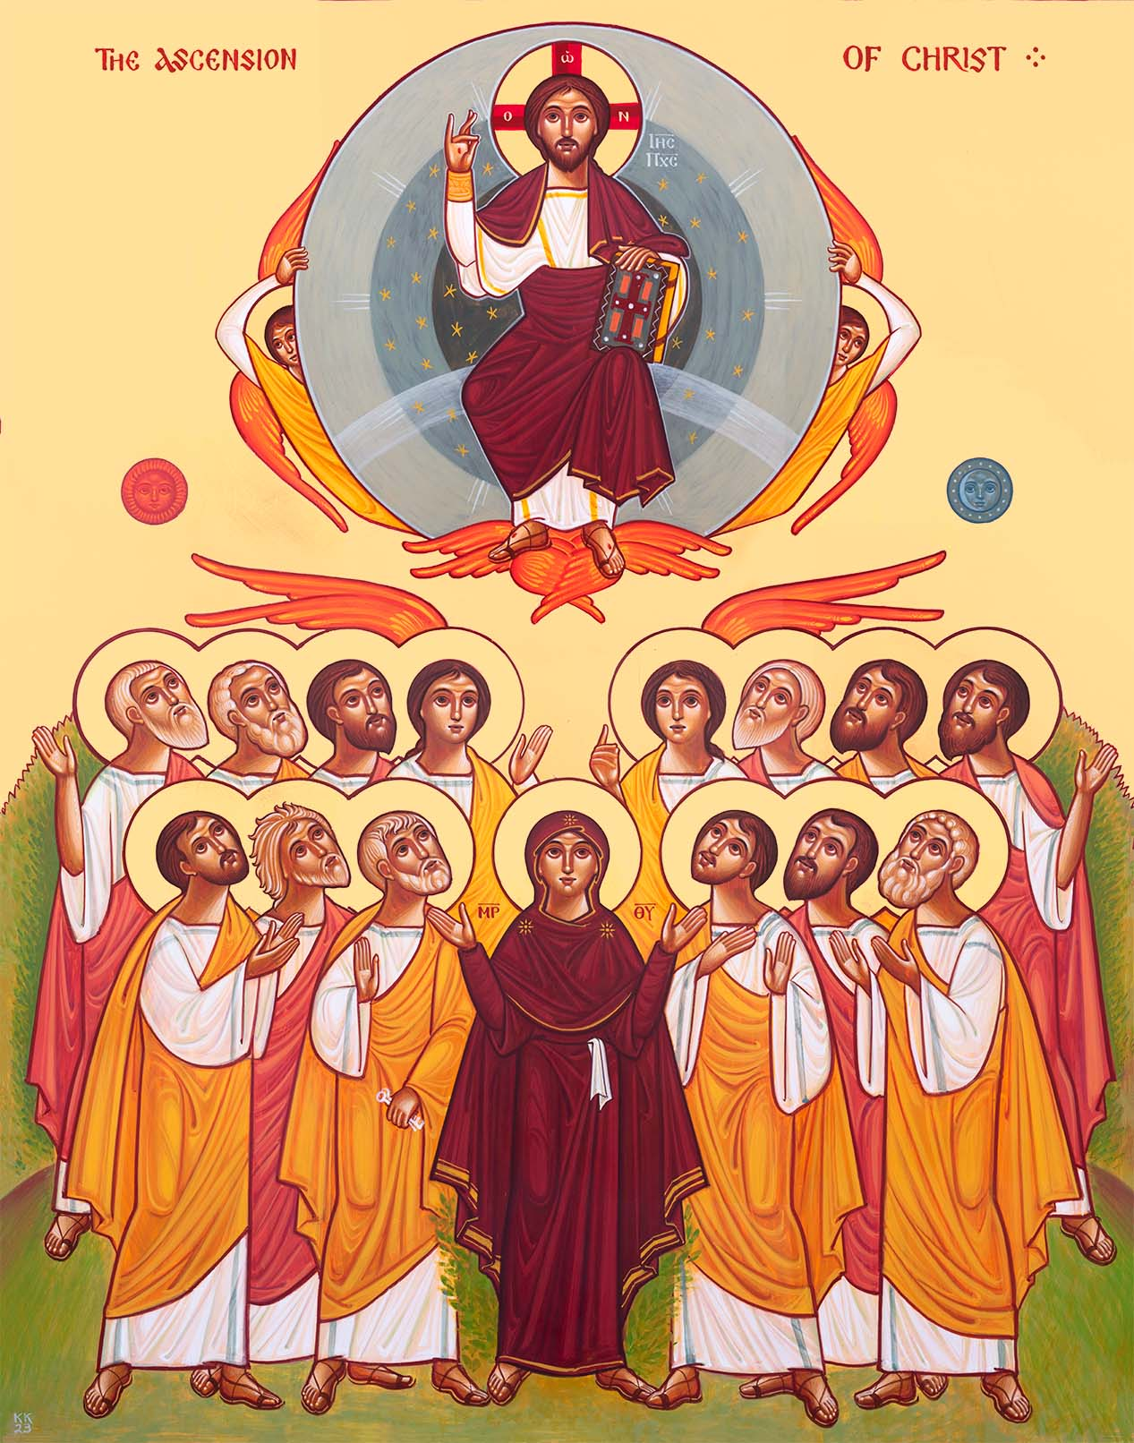
Notes:
Christ is shown inside the mandorla blessing all with his right hand and holding a scroll in his left. This is to show love and knowledge. This sphere is being carried up in glory by angels.
Even though we see Christ departing, the Orthodox Church sees the second and glorious coming in the same icon. Jesus said he would return exactly as he ascended. The icon does not show direction. His love and teachings are still with the
Church.
The focus of the lower part of the icon is the Theotokos. She represents the entire Church waiting for Jesus' return.
In the Ascension of Jesus, a mandorla is an almond-shaped aureole or glory of light that encircles Christ’s entire body. It visually separates the celestial and earthly realms, signifying that Jesus is entering the transcendent glory of God, beyond the limitations of normal human vision.

Slide 8
St. John Chrysostom on the Ascension
Today, the angels have received what they had long yearned for; today, the archangels have seen what they long desired: our nature gleaming from the royal throne, resplendent in immortal glory and beauty.
For it is this that the angels long yearned for; it is this that the archangels long desired. And even though the honor exceeded their own, they still rejoiced in our blessings. For, indeed, when we were punished, they were grieved; and even as the Cherubim were guarding Paradise they nevertheless felt sorrow. And just as a servant who has taken a fellow slave into custody watches over him due to the master’s command but is still distraught by the fact due to his compassion for his fellow slave, so likewise the Cherubim assumed the guardianship of Paradise but grieved at having to do so.

Slide 9

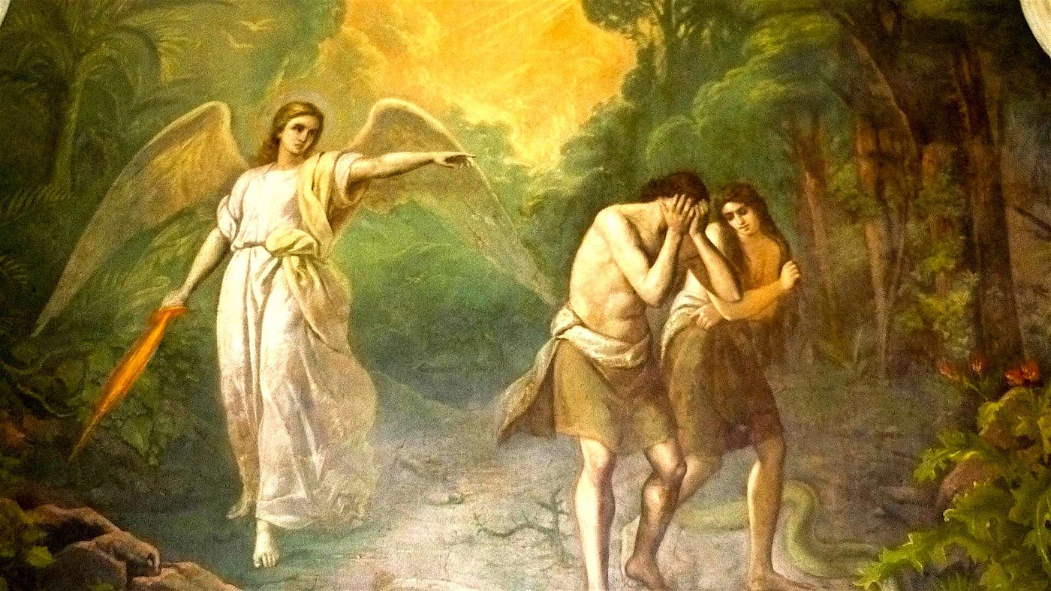
Humanity Restored

Slide 10
Psalm 24:9-10 “Lift up your heads O you gates and be lifted up you ancient doors and the king of Glory shall come in. Who is this king of Glory? The Lord of Hosts, He is the king of Glory”
1 Timothy 3:16 “He was manifested in the flesh, vindicated by the Spirit, seen by angels, proclaimed among the nations, believed on in the world, taken up in glory.”
John 14:2-3 “In My Father’s house are many mansions; if it were not so, I would have told you. I go to prepare a place for you. And if I go and prepare a place for you, I will come again and receive you to Myself; that where I am, there you may be also.”
1 Thessalonians 4:16-17 ”The Lord himself will descend from heaven at the given signal, at the voice of an archangel; and we, the living who have been left, will be seized up on clouds to meet the Lord in the air, but not all”

Slide 11
Colossians 3:1-4
“Since, then, you have been raised with Christ, set your hearts on things above, where Christ is, seated at the right hand of God. Set your minds on things above, not on earthly things. For you died, and your life is now hidden with Christ in God. When Christ, who is your life, appears, then you also will appear with him in glory.”

Slide 12
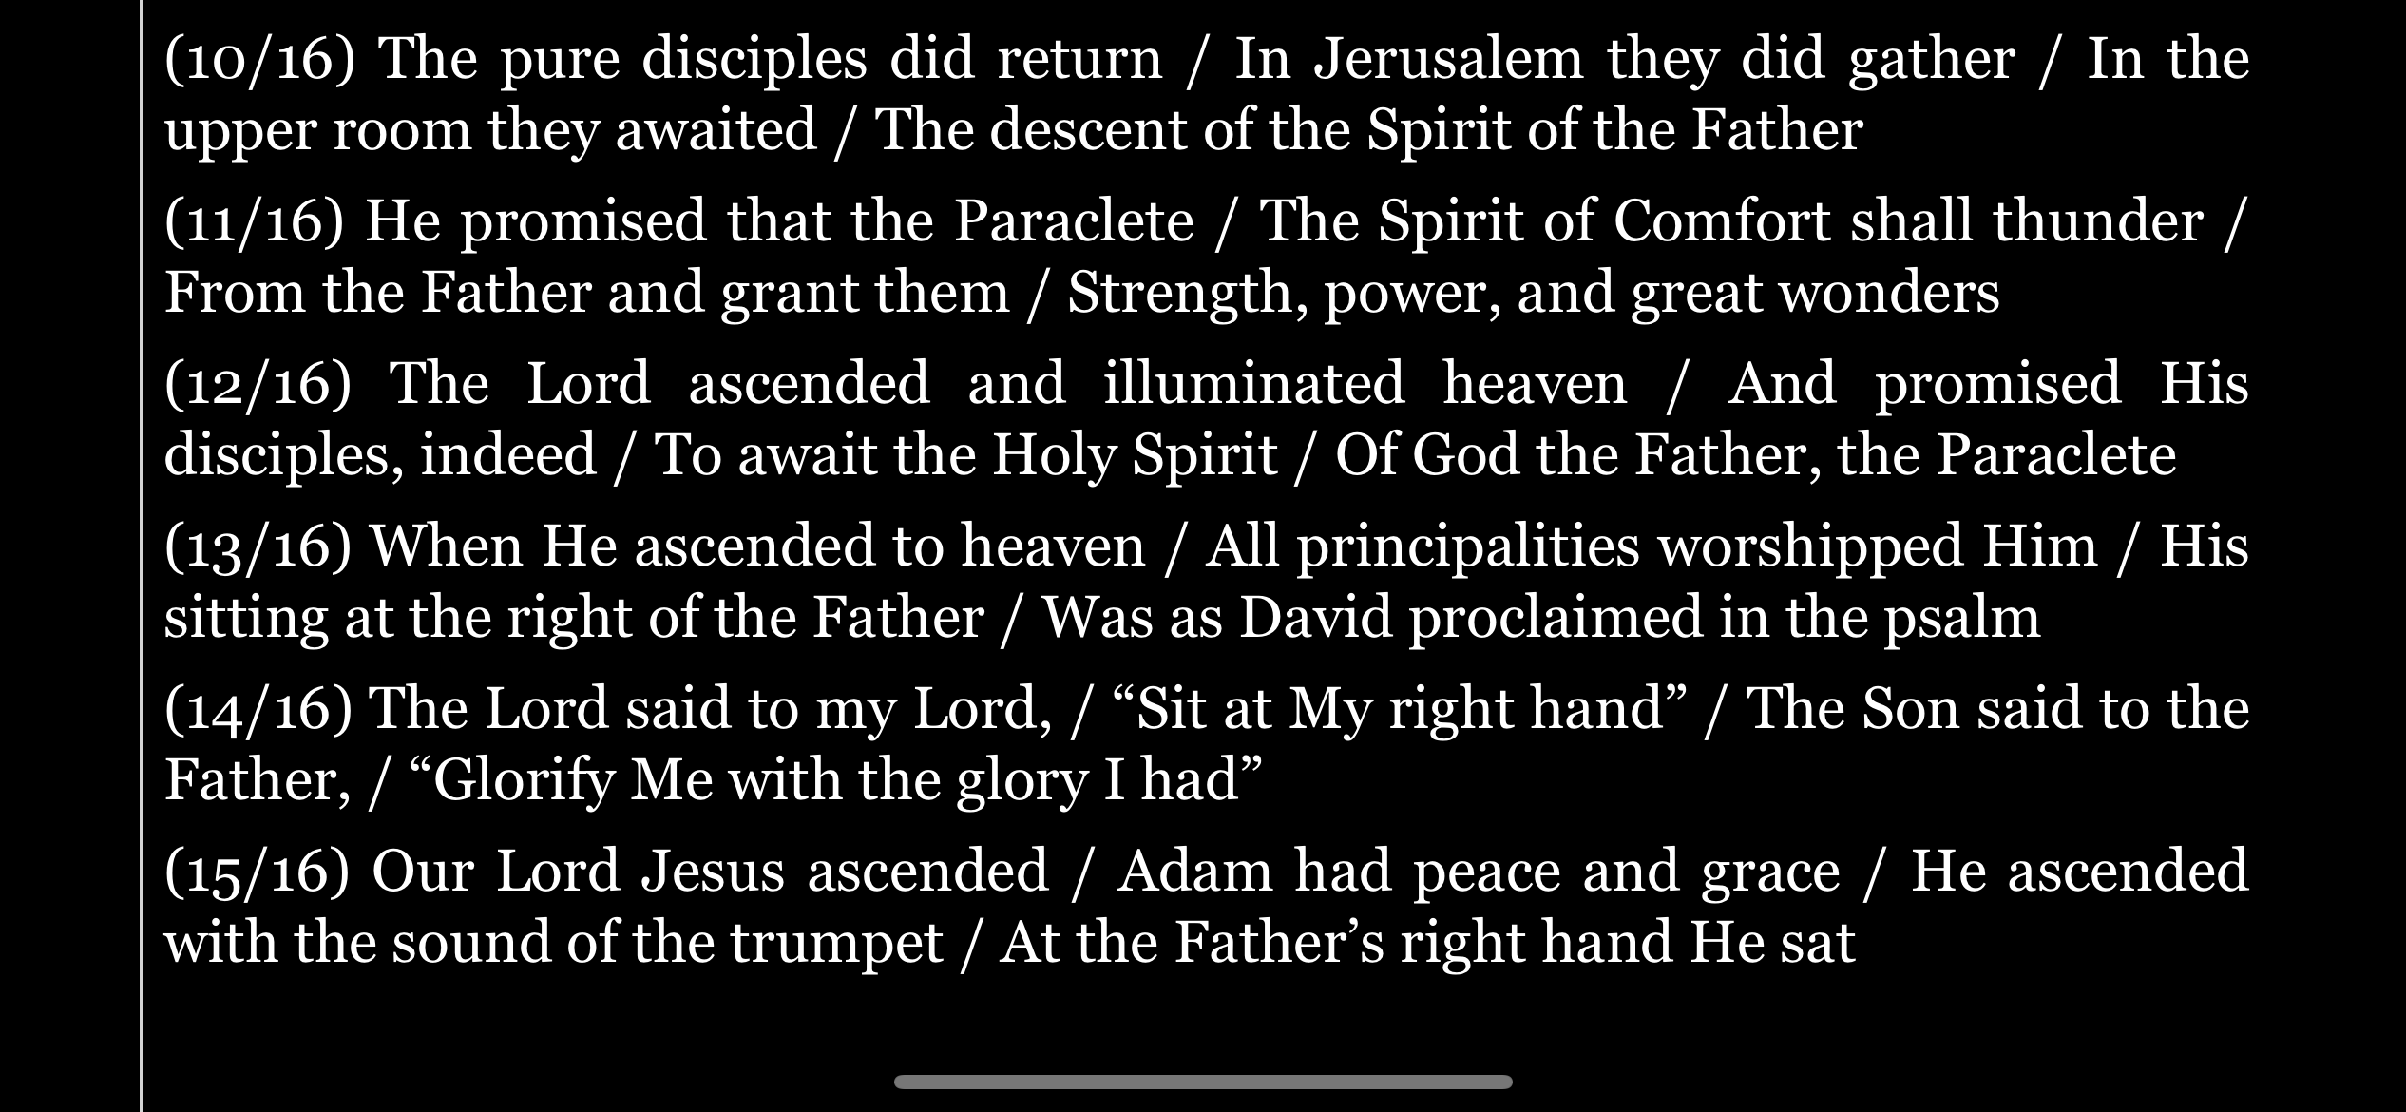
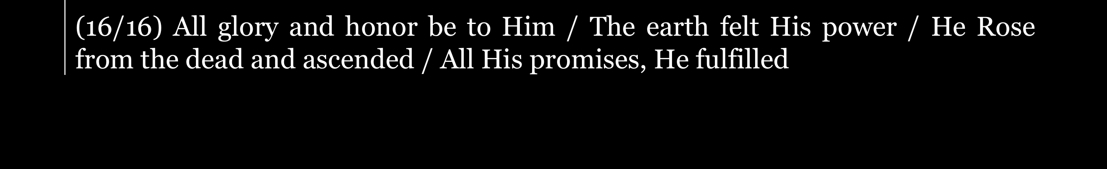
ffff

Slide 13
